Slide 1
Docking, Castrating and Disbudding

Slide 2
Docking, castrating, and disbudding are management practices routinely performed on sheep and goat farms.
Maintaining a high standard of animal welfare should
be a consideration in all decisions related to docking, castrating, and disbudding.

Slide 3
Docking lambs
The tail protects the sheep's anus, vulva, and udder from weather extremes.
Docking prevents fecal matter from accumulating on the tail and hindquarters of sheep and lambs. Research has shown that tail docking greatly reduces fly strike (wool maggots), while having no ill effect on lamb mortality or performance.

Slide 4
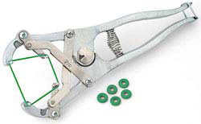
Banding tails
The simplest and most common method of tail docking is to apply a rubber ring (band) to the tail using an elastrator tool. Banding is a bloodless method of tail docking. The band cuts off the blood supply to the tail, and the tail falls off in 7 to 10 days. Some producers cut the “dead” tail off before it falls off.

Slide 5
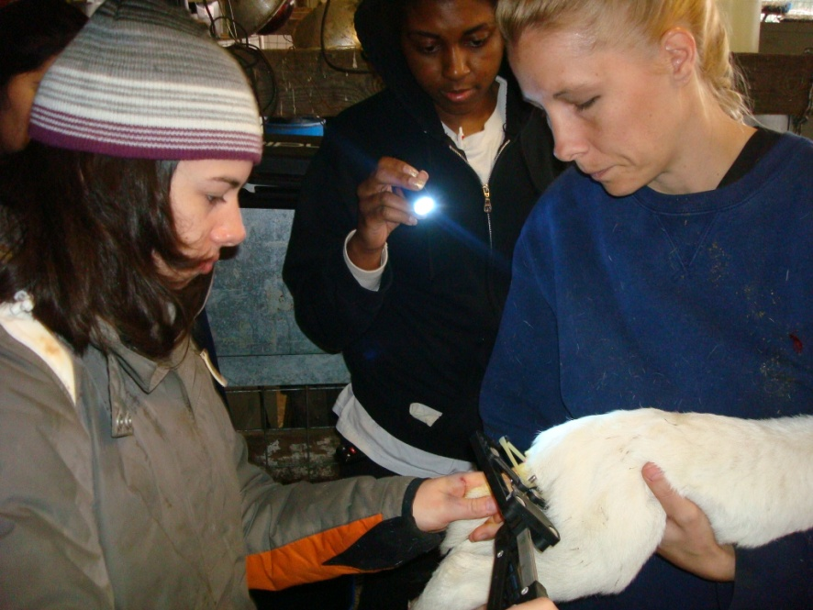
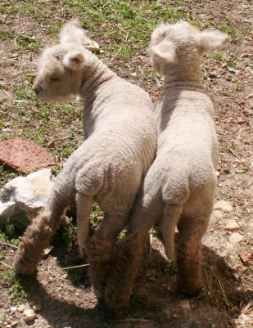
Lambs should be at least 24 hours old before bands are applied, and bands should only be applied during the lamb's first week of life.
When the elastrator technique is used, it is very important that the lamb be protected against tetanus,

Slide 6
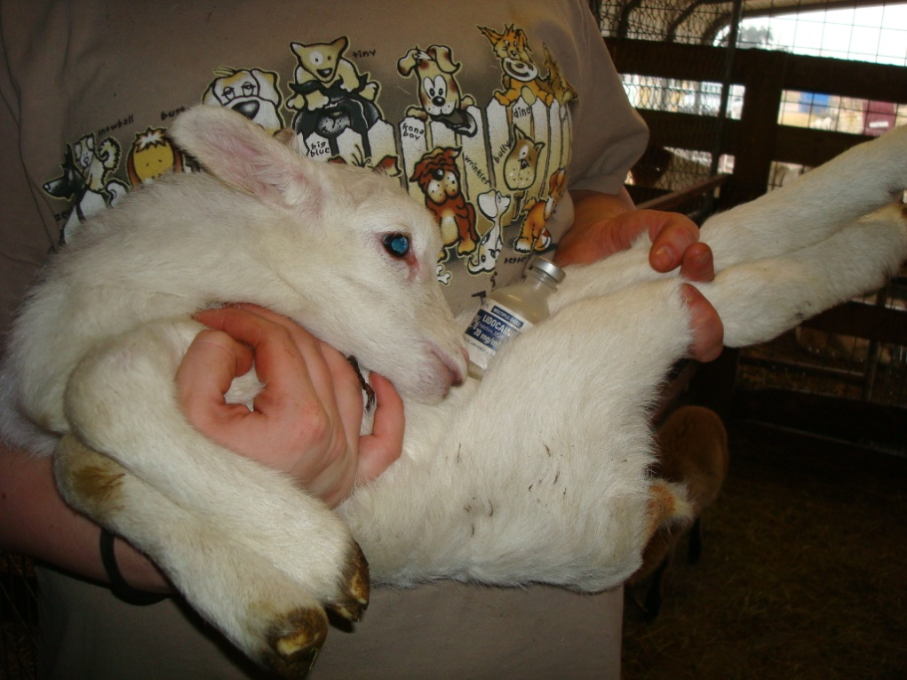
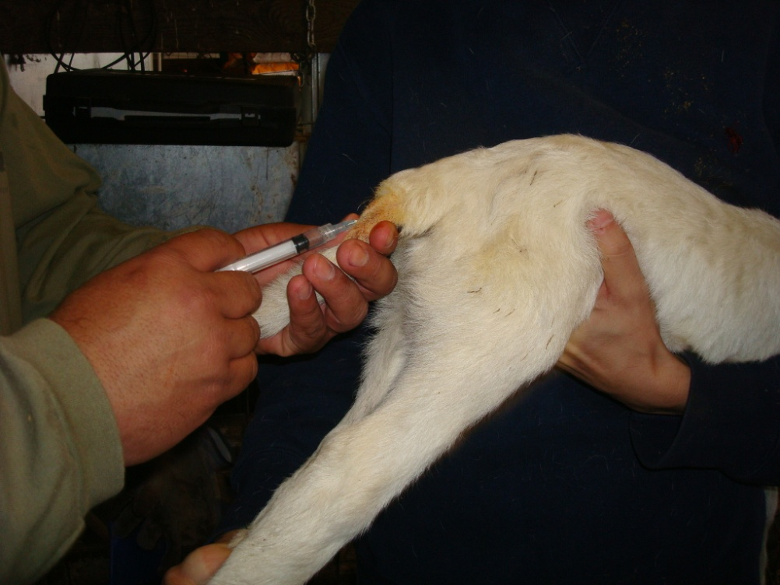
If it is practical, the use of a local anesthetic, such a lidocaine, can be used to reduce the pain felt by the lamb.

Slide 7
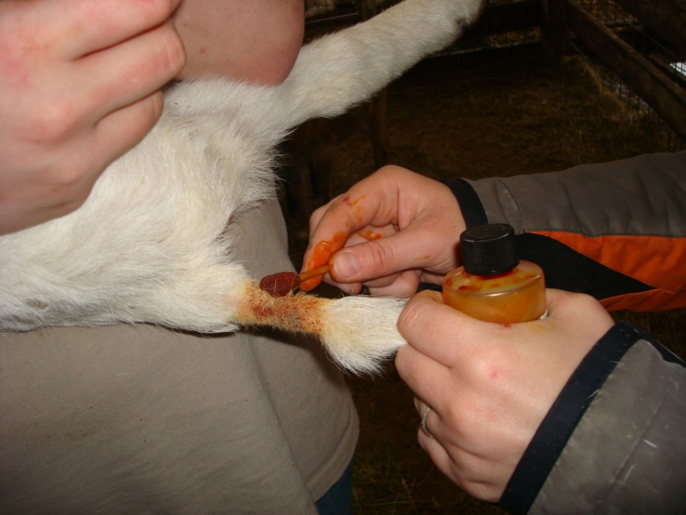
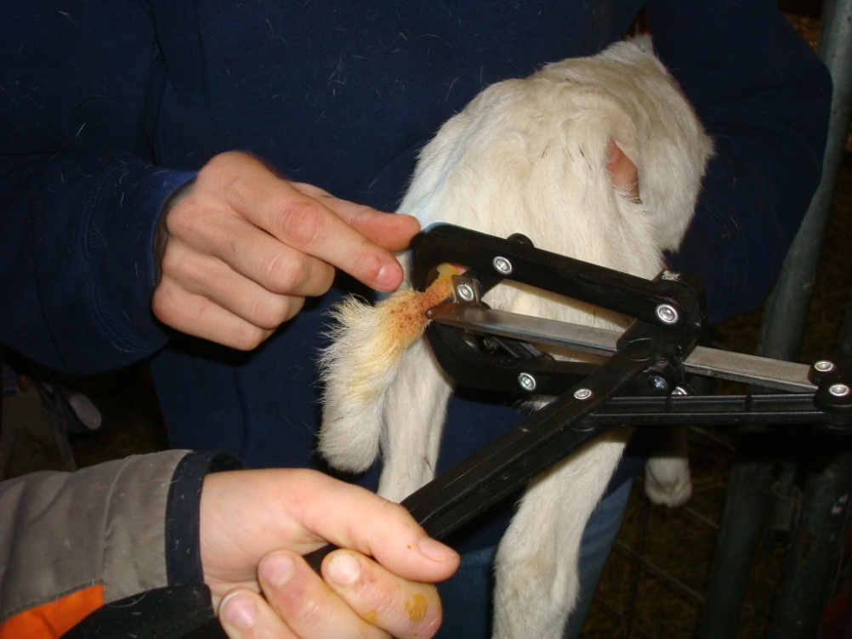
Scrub with betadine for disinfecting, also it helps for position correctly the rubber band

Slide 8
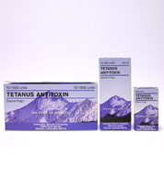
Castration
Reasons
Consumer preference: Better tasting meat
Better animal disposition
Environment: low fly season, tetanus prophylaxis: tetanus antitoxin or tetanus toxoid
Age
Best age: 1 to 4 weeks or under 3 months of age to minimize stress. < 1 month: lateral recumbency
Prepping
Restrain in a chute or head gate
Scrub scrotal area
Methods: open (incision- scrotum)vs. closed

Slide 9
Castration of rams and bucks
The decision to castrate ram lambs and buck kids should be based on the management preferences of the producer and the demands of the market place.
Ram lambs grow faster than ewe and wether lambs and when ram lambs are marketed at a young age (less than 5-6 months), the market place usually does not discriminate in price.
Buck kids grow faster than wether kids until they reach sexual maturity

Slide 10
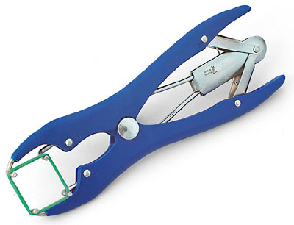
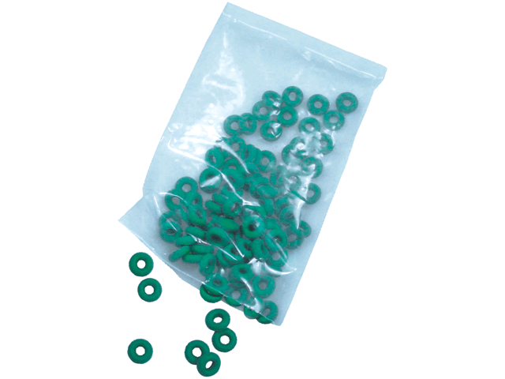
Castration by banding
An elastrator band can be placed around the neck of the scrotum, with care taken not to place the band over the rudimentary teats.
The scrotum will shrivel up and fall off in two to three weeks.
As with docking, the “dead” scrotum may be removed after a few days.
Both testicles must be below the placement of the band. If one testicle is missed

Slide 11
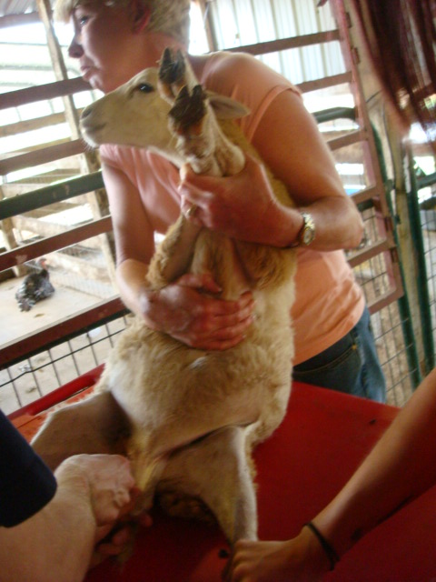
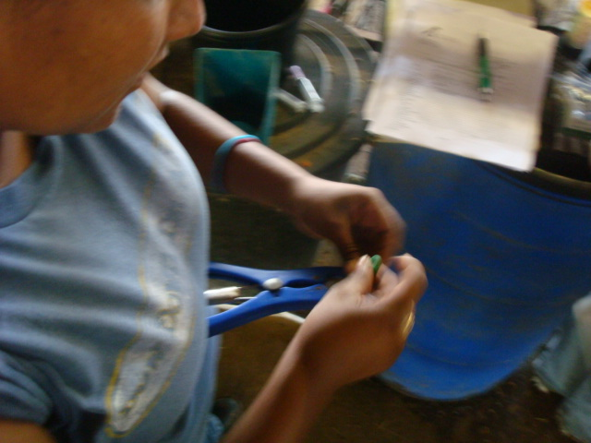
Castration
Both testicles must be below the placement of the band.
If one testicle is missed, it will be retained in the belly cavity, resulting in a "bucky" lamb or kid.
A short-scrotum is a male whose testicles are pushed above the band.

Slide 12
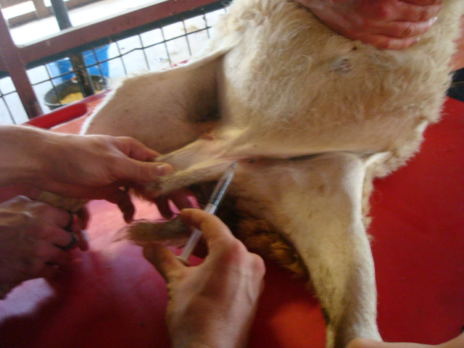
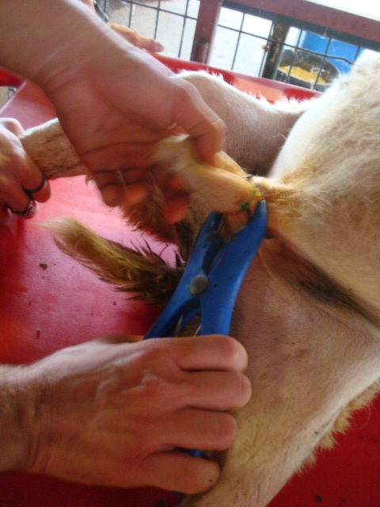
Castration by banding is painful and should be done at a young age (1 to 7 days). Some experts advocate the use of lidocaine to reduce the pain felt by the animal.
As with banding tails, lambs and kids should be protected against tetanus though either colostridial immunity or use of the tetanus anti-toxin at the time of castration.

Slide 13
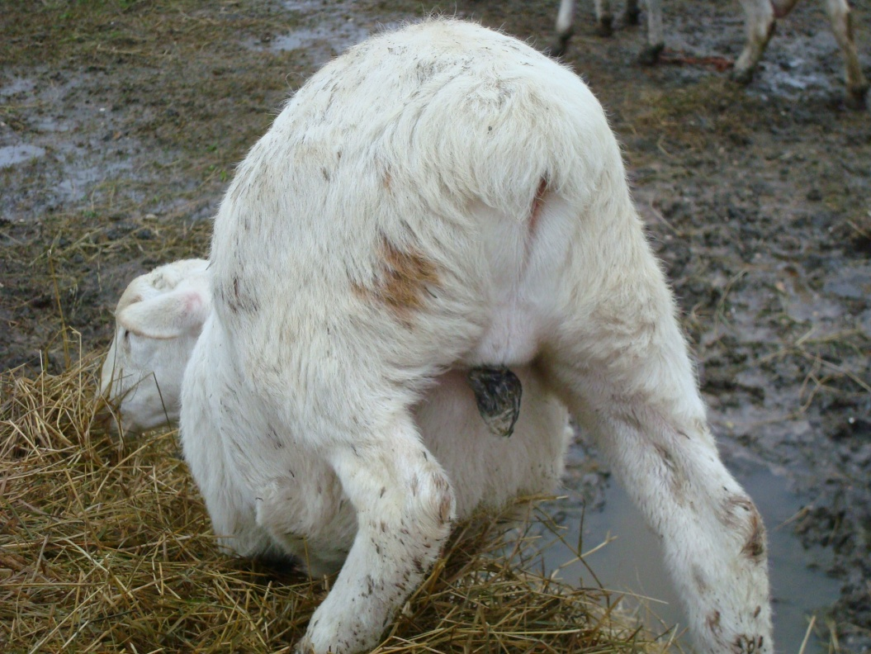
10 days later

Slide 14
Surgical castration of ram lambs and buck kids
Testicles may be surgically removed. With surgical castration, a sharp knife or preferably a scalpel is used to remove the bottom one-third of the scrotal sac.
The testicles are removed and the wound is allowed to drain and heal naturally.
It is essential that proper aseptic technique be used when the surgical method of castration is used.
http://www.esgpip.info/PDF/Technical%20bulletin%20No18.html

Slide 15
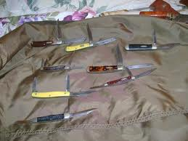
Castration (cont’d)
Different types
Jack knife or blade
Remove bottom one third of scrotum with blade
Expose testicles through opening
Cut with blade or jack knife
May apply antiseptic powder or spray
May apply a stop quick powder if bleeding in excess
May make one or two incisions
Notes:
Scalpel blade method

Slide 16
Castration (cont’d)
Elastic ring elastrators
Used for calves under 2 weeks of age
Apply a strong elastic ring around the base of the scrotum
Causes necrosis of the scrotum and the testicles
Sloughs off in 2 to 3 weeks
Problem: Tetanus, black leg, and malignant edema (clostridial diseases)

Slide 17
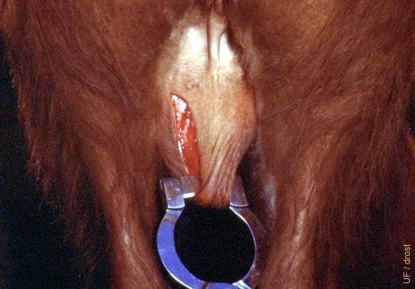
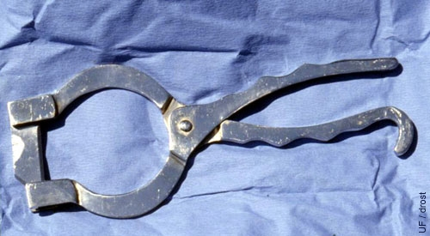
Castration (cont’d)
Newberry knife method
Common for bulls weighing over 500 lb.
Restrain bull in head gate or chute.
Have someone pull tail up and over the
back of the bull.
Scrub the scrotal area.
Grasp lower half of the scrotum, and push testicles up as far as possible.
Use Newberry knife to cut through the scrotum side to side, pulling toward you. This will leave two scrotal flaps.
Pull down the testicles in opening. Separate connective tissue, crush, and clamp the cord with hemostats.
Remove testicles with emasculator.
Crushing the cord helps prevent hemorrhaging.

Slide 18
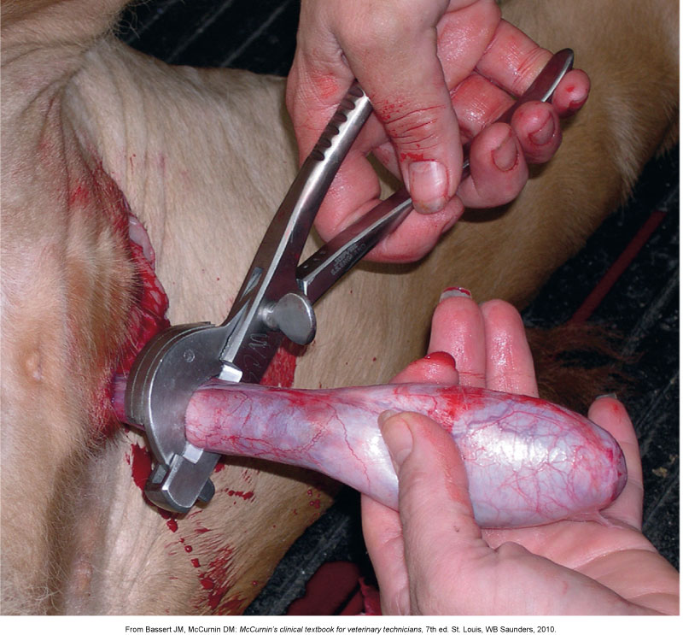
Hemostasis

Slide 19
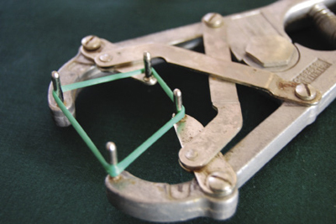
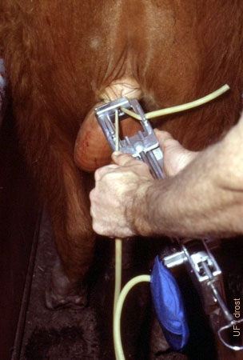
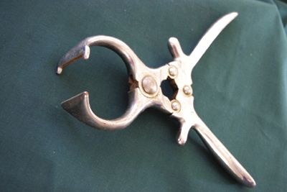
Emasculatome used to crush the spermatic cord of the testes while still inside the scrotum, may be less reliable, bloodless
Elastrator: < 2 weeks old

Slide 20
Castration on cattle
Pictures onyx
Video Henderson tool

Slide 21
Castration (cont’d)
Postoperative care
Check hemorrhage and infection.
Place animal in a clean dry area away from others if possible.
Return to mother if still nursing.
Some swelling is normal.
Notes:
Typically not going to be nursing

Slide 22
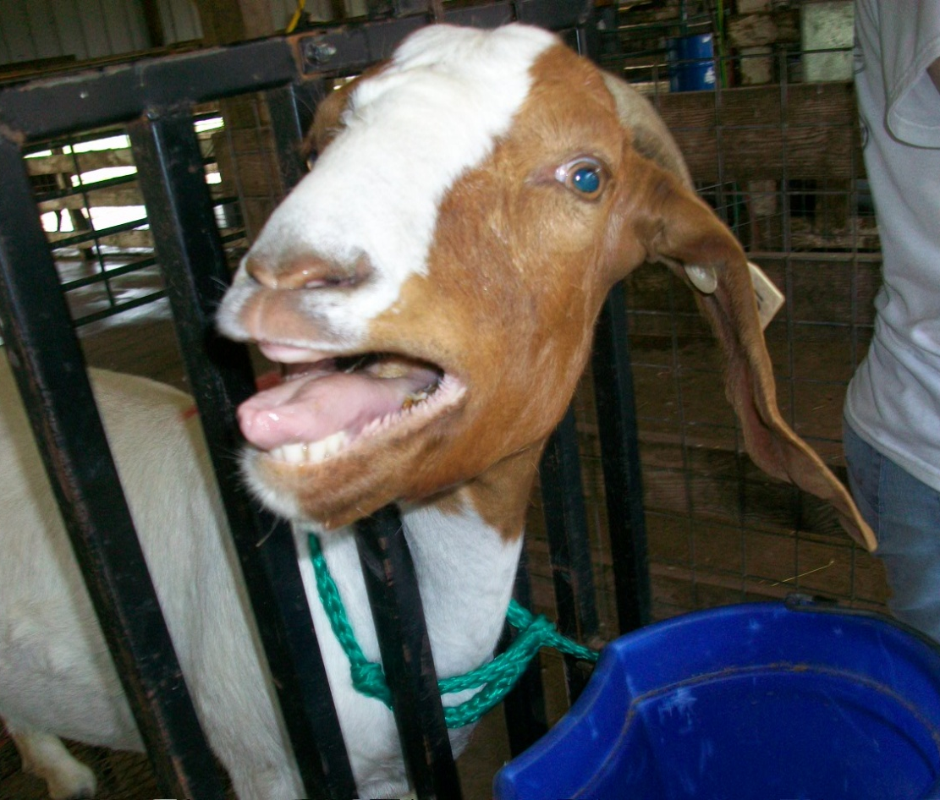
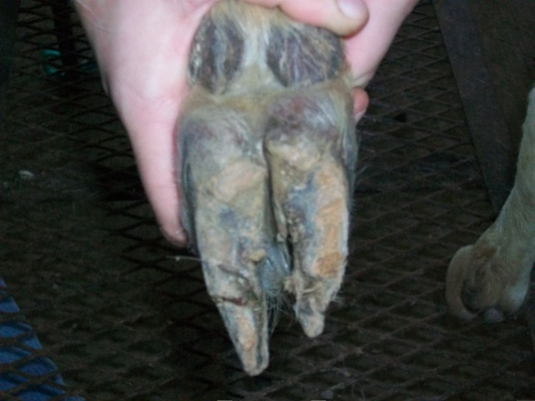
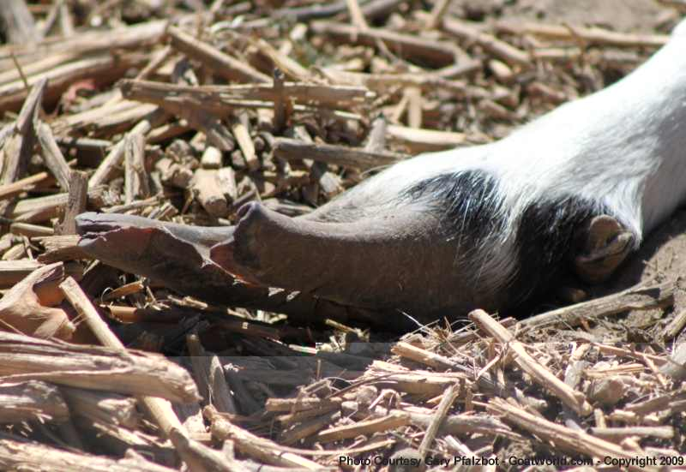
Hoof care

Slide 23
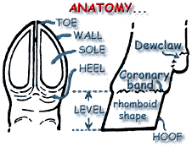

Slide 24
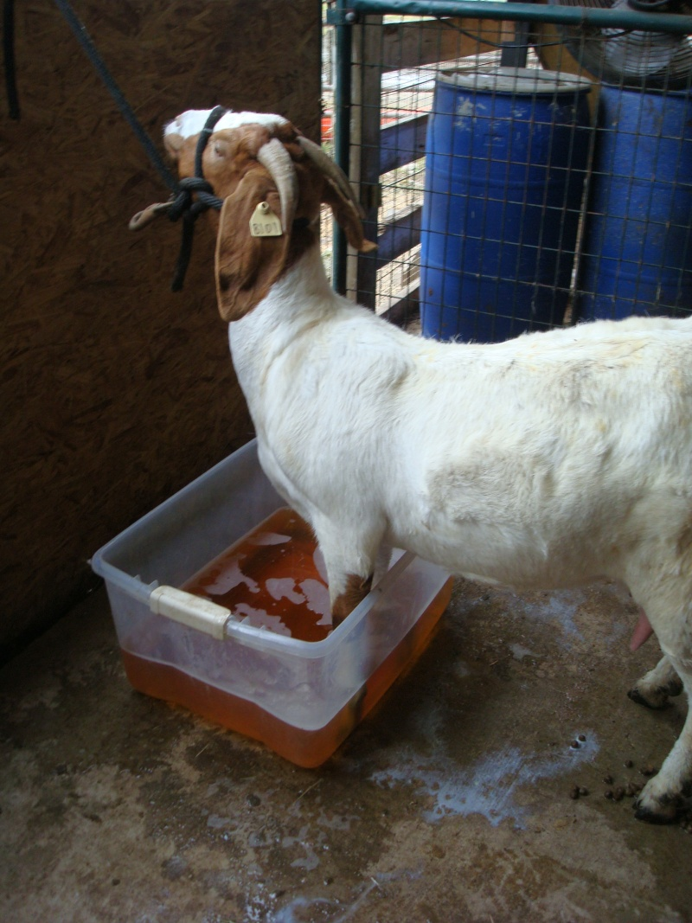
pdf

