Slide 1
Swine Parasites

Slide 2
Introduction:
Most parasitic infections of swine will be diagnosed by finding the adult or larval parasites or the lesions they produce while performing a necropsy. However, in reviewing the common spp. Of swine parasites, a characteristic egg has also been included.

Slide 3
Internal Parasites
Roundworms (Ascarid) Ascaris suum
Whipworms (Trichuroidea) Trichuris suis
Nodular worms (Nodular worm) Oesophagostomum dentatum
Stomach worms Hyostrngylus, Ascarops, Physocephalus
Lung worms (Metastrongyloidea) Metastrongylus spp.
Kidney worms Stephanurus
Threadworms (Rhabditoidea) Strongyloides ransomi

Slide 4
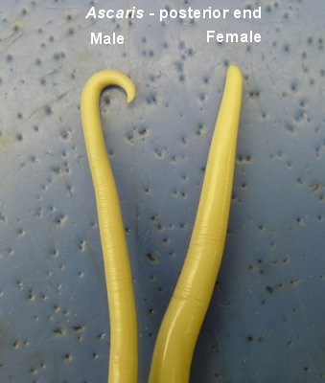
Roundworms
Most common internal parasite of swine
Large, white, round worms that are ~8” long
Compete for nutrients from the pig in the small intestine
Females lay up to 1,000,000 eggs per day
Eggs are sticky and hard to get rid of in the environment
Eggs survive in the environment for years
Potential zoonotic

Slide 5
Roundworms
Life cycle
Eggs are shed in feces (can survive for years in soil)
Eggs requires 2 weeks to become infective
Eggs ingested by pig
Eggs hatch in gut
Larvae travel through gut mucosa and blood stream to liver (liver migration leaves scarring – milk spots)
Larvae travel through bloodstream to lungs
Migrate up trachea (coughed up) and reswallowed to get back into gut
Mature to adult stage in small intestine

Slide 6
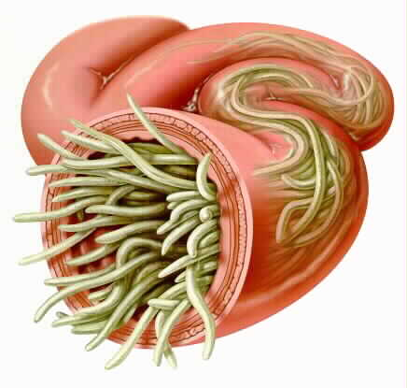
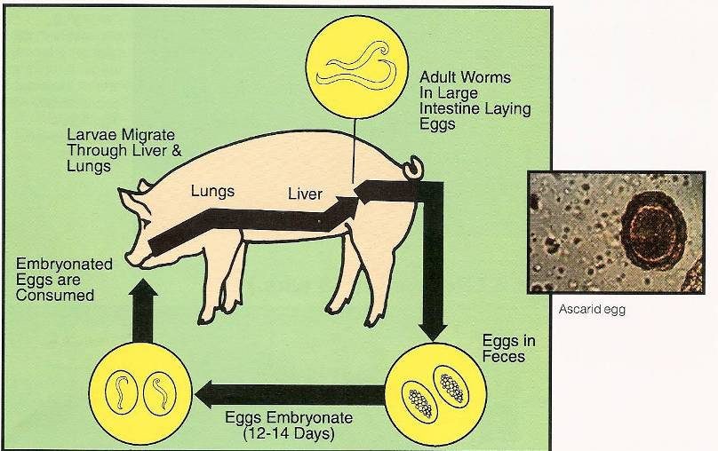
Roundworm Life Cycle

Slide 7
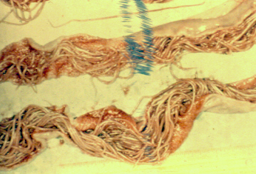
Adult Ascaris suum: heavy infection
Large numbers of adult worms adult may occlude or perforate the gut. Migration into the bile duct has been reported. This migration may occur after treatment.

Slide 8
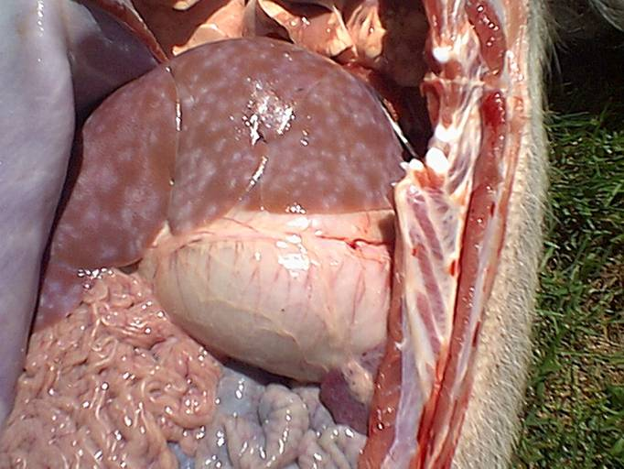
Liver Milk Spots

Slide 9
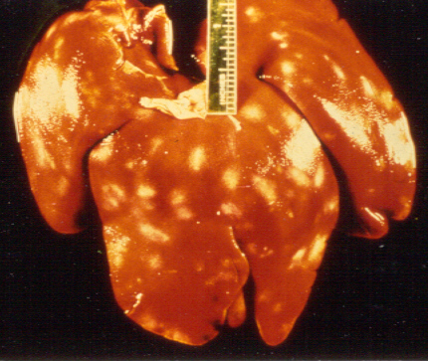
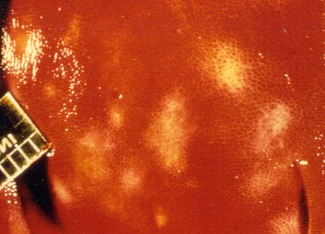
Gross liver lesions
These are produced by host response to migrating larvae and may cause considerable loss at slaughter due to condemnations. The majority of these may resolve in a period of 25- 40 days

Slide 10
Ascaris
Diagnosis
Egg in fecal flotation
Adults found on small intestine
“Milk spots” found on liver
Treatment
Febendazole 3mg/kg x 3d
Ivermectin 0.3mg/kg IM, SQ
Levamisole 5-8 mg/kg PO

Slide 11
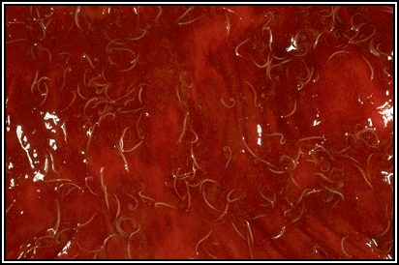
Whipworms
Another important worm
Small (~2”), whitish worms that are shaped like a whip and live in the cecum
Adults burrow into the wall of the cecum and large intestine, damaging the gut
Results in a bloody scour
Eggs survive in the environment for years
Direct life cycle

Slide 12
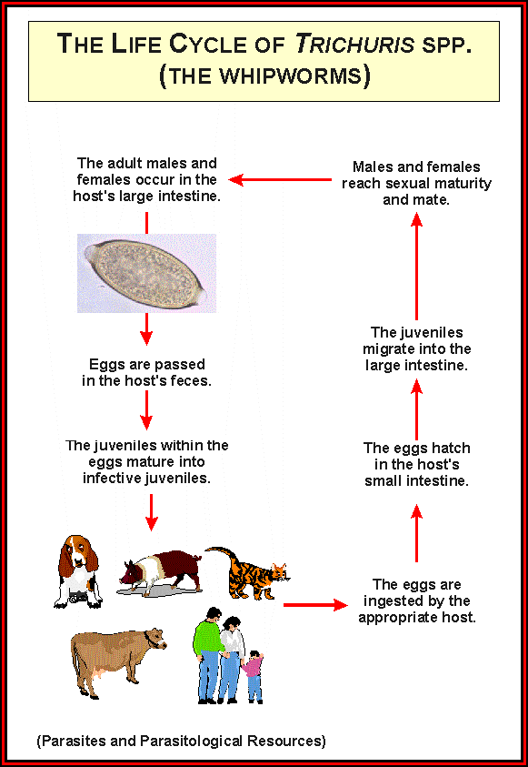
Whipworm Life Cycle

Slide 13
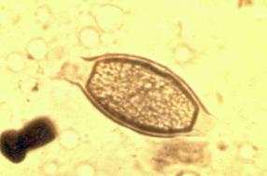
Trichuris suis egg: ( 50 – 60u x 21 – 25 u)
Trichuroid egg with mucoid plugs. These are common worms of swine

Slide 14
Trichuris
Diagnosis
Egg in fecal flotation
Adults found on cecum and colon
Treatment
Dichlorvos12-22 mg/kg PO
Febendazole 3mg/kg x 3d
Ivermectin 0.3mg/kg IM, SQ
Levamisole 5-8 mg/kg PO

Slide 15
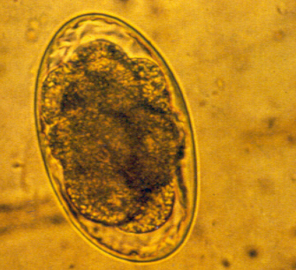
Oesophagostomum spp. Egg(73 – 89u x 34 – 45u)
These eggs are typical thin-shelled strongyle-type eggs and are similar to the eggs of the red stomach Hyostrongylus.

Slide 16
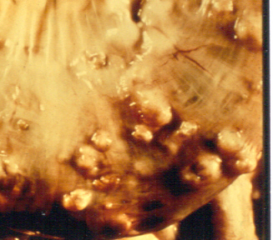
Oesophagostomum nodules in large intestine. These worms are very common in older swine, infection occurs by ingestion of third stage larvae which encyst in nodules later to emerge as L4. The prepatent period is 23 - 53 days according to species.

Slide 17
Oesophagostomum :
The nodular worm of swine are elastic considered non-pathogenic although very heavy infections may cause G.I.disturbances.
Rx:piperazine salt, TBZ. levamisole. fenbendazole, ivermectin. Dechlorvos, and pyrantel.

Slide 18
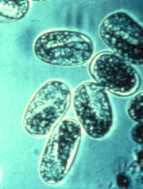
Strongyloides ransomi: eggs (45-55 u. x 26-35 um) eggs are similar to other Strongyloides sp. , thin-walled and larvated.

Slide 19
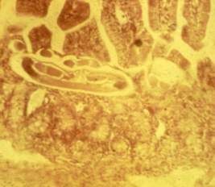
Life cycle features of Strongyloides ransomi:
Three routes of infection occur, prenatal, transcolostral and percutaneous( lung migration).
Prepatent periods are very short ( 2 – 10 days)
Adults in small intestine of young pigs
Section of pig intestine showing location and small size of adult worms.

Slide 20
Strongyloides:
The earliest parasitic infection producing signs in very young animals.
Rx – Ivermectin, levamisole.

Slide 21
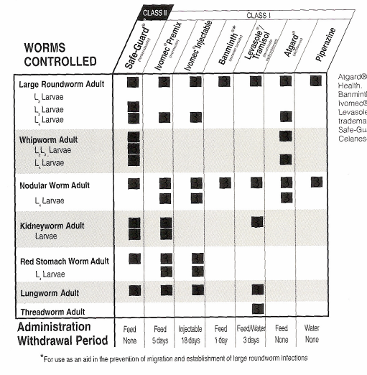
Dewormers

Slide 22
When To Deworm
When clinical signs are seen
Coughing
Weight loss
Scour
Every 6-8 week on heavily infected lots
Can monitor with fecal exams

Slide 23
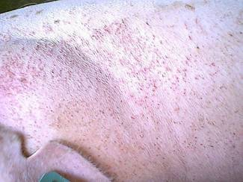
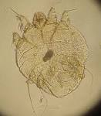
External Parasites
Mange (Sarcoptes scabiei)
Mites burrow under the skin
Causes severe skin irritation and itching
Itching results in hair loss
Small, red bumps on the skin – particularly between the legs, on the neck/jowl area and inside the ears

Slide 24
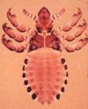
External Parasites
Lice (Haematopinus suis)
Similar clinical signs as mange
Itchy pigs
Can actually see lice on the pigs
Like mange, lice are host specific and are normally transmitted from pig to pig

Slide 25
Lice and Mange Treatment
Ivermectin is the most common treatment
Injectable or feed grade
Also effective for internal parasites
Pour-ons also available

