Slide 1
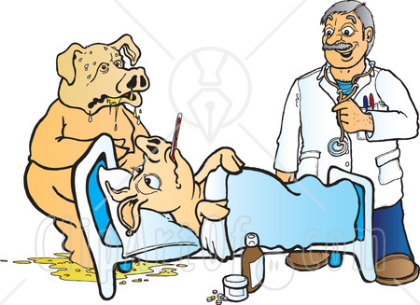
Swine diseases

Slide 2
Ages of pigs are important
Neonates 0-3 weeks
    <4 kg
Weanlings/nursery 3-10 weeks
    4-25 kg
Growers/finisher 10-26 weeks
    25-120 kg
Breeders/adults >6-8 months
    >120 kg

Slide 3
Orderly thinking...
Multisystemic Diseases
Respiratory Diseases
Gastrointestinal Diseases
Neurologic Diseases
Musculoskeletal Diseases
Reproductive Diseases
Dermatology
Miscellaneous

Slide 4
Multisystemic diseases
Erysipelas (Erysipelothrix rhusiopathiae)
Glasser’s disease (Haemophilus parasuis)
Salmonella
PRRS (arterivirus)
Pseudorabies virus (herpes virus)
Vitamin E / selenium deficiency

Slide 5
Erysipelas
Erysipelothrix rhusiopathiae
    Gram positive rod
Environmental contaminant
    most herds have carriers
Septicemia
    diamond skin, arthritis, endocarditis, necrosis

Slide 6
Signalment
Not commonly seen in new borns
  Due to maternal antibodies
  Passive immunity
Common in growing or adult swine
Seen in swine once done weaning
3 forms of occurrence
Acute skin form
  Untreated diamond shaped everywhere
Chronic arthritic form
  Produces mild to severe lameness
Endocarditic form
  Death from embolism

Slide 7
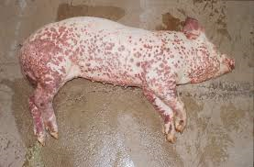
Clinical signs
Chronic
Acute
Sudden and unexpected death
High temperatures
  104-108 degrees F
Reddened or cyanotic skin
  Diamond shaped
Refusal to stand
  Painful but wont appear swollen
Enlargement of joints
Little mortality
Pregnant sows commonly abort
Low milk production
Cutaneous lesions
  May seem to be healing over time

Slide 8
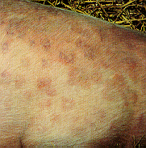
Diamond skin disease

Slide 9
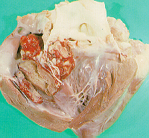
Valvular endocarditis

Slide 10
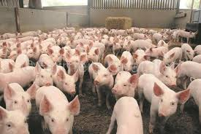
transmission
Spread by swine carriers in herd
Flies and tick – transmit from swine to swine
Ingestion of contaminated feed and water
Skin wounds – even though less common
Contaminated bedding
Contaminated feces
  Not infective after 35 days

Slide 11
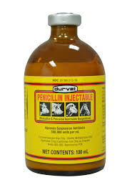
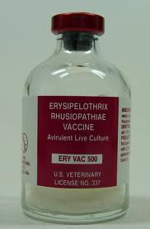
wellness
Treatment
  Penicillin 12hr intervals
  At least 3 days
Tetracyclines
  In food or water
  Administration to a large number of swine
Aspirin
  Help with fever in acute cases
Prognosis is good
  If treated as soon as clinical signs appear
  If all are checked
Prevention
  Vaccines very effective
  Susceptible pigs – prior, during, and after weaning
  Those selected breeding herd – booster 3-5 weeks later
  Breeding stock twice yearly
  Good sanitation
Treatment
Prognosis & Prevention

Slide 12
Glasser’s disease (polyserositis)
Haemophilus parasuis
    Gram negative coccobacillus
Endemic, initiated by stress
Polyserositis, septicemia (fibrinous)
    Pleuritis
    Pericarditis
    Peritonitis
    Meningitis!!!

Slide 13
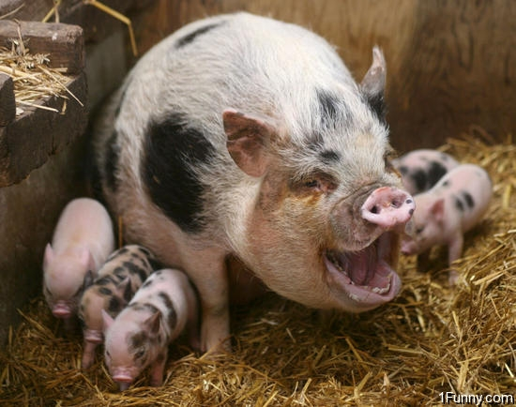
Signalment
Swine
Non gender specific
6 weeks -4 month of age

Slide 14
Transmission/incubation
Transmission is by direct contact.
There is no incubation period
Clinical signs are seen when the weanlings experiences stress such as being weaned, environmental changes or other diseases.

Slide 15
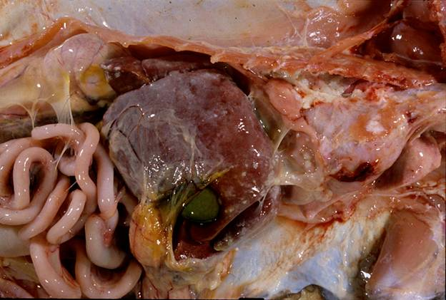
Clinical Signs
Pleurisy
Pericarditis
Peritonitis
Arthritis
Meningitis
Septicemia
Fever
Weight loss
Pale
Poor growing

Slide 16
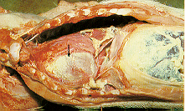
Glasser’s disease
The fibrinous exudate can be seen on the pleura, pericardium, peritoneum post mortem.

Slide 17
Glasser’s cont...
Diagnosis
    Culture is difficult (but try it)
    Go with suspicion from gross lesions
Treatment
    Penicillins
    Tetracyclins
Prevention and control
    Reduce stress
    Vaccine at weaning then again 3-4 weeks later

Slide 18
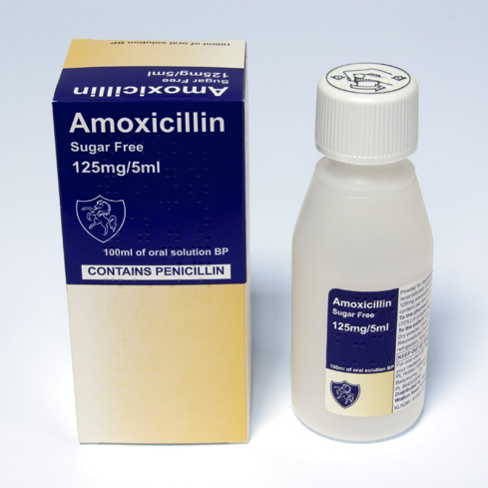
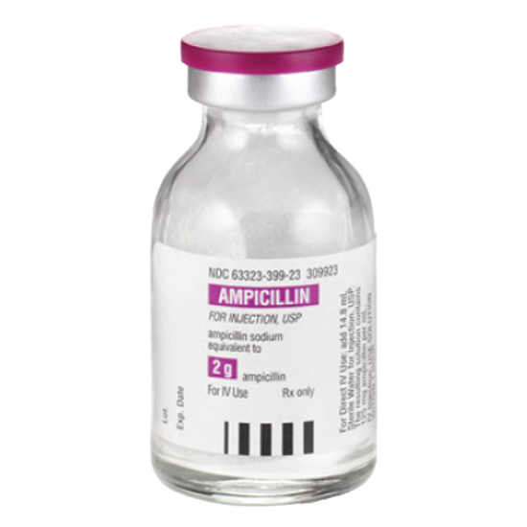
Treatment
Treatments are best, using injections of either penicillin/streptomycin, trimethoprim/sulpha, ceftiofur or synthetic penicillins
Treat for 2-3 days.
The sows can be fed 7 days before and 7 days after farrowing with phenoxymethyl penicillin (penicillin V).
The alternative way is the sows can be injected with long-acting penicillin at farrowing.

Slide 19
PRRS
Porcine reproduction and respiratory syndrome
Arterivirus
Clinical signs - neonates
    anorexia, lethargy, fever
    cyanosis of the ears, respiratory distress
    secondary bacterial pneumonia
    delayed or abnormal estrus cycle with increased numbers of stillborns/mummies

Slide 20
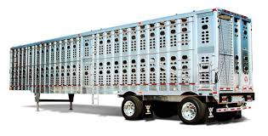
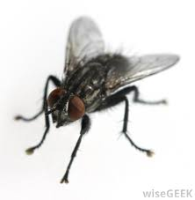
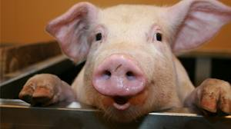
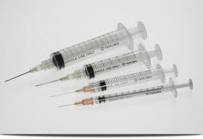
Signalment & transmission
Any pig, whether domestic or feral, can contract this virus.
Indirect routes of transmission
  Mechanical transport and transmission has been reported via contaminated needles, fomites , farm personnel, transport vehicles (contaminated trailers), and insects (houseflies and mosquitoes).
  Aerosol transmission has been confirmed as an indirect route but environmental factors, such as wind direction and velocity, significantly impact spread via this route.
Direct routes of transmission
  Direct contact
  Transmission by semen can also occur, both via natural service and artificial insemination.

Slide 21
PRRS
The incubation period is between 4 to 8 days experimentally, but can range from 3 to 37 days in natural outbreaks

Slide 22

PRRS cont...
Diagnosis
    serology, virus isolation
    IFA, IHC most common test used in the USA

Slide 23
Treatment & withdraw period
Currently, there are no effective treatment programs for acute PRRS. Attempts to reduce fever using NSAID (aspirin) or appetite stimulants (B vitamins) appear to have minimal benefit. The use of antibiotics or autogenous bacterins to reduce the effects of opportunistic bacterial pathogens has also been reported; however, results have been mixed.
Diseased pigs cannot be sent to the slaughterhouse; they must be destroyed or quarantined until the symptoms pass.

Slide 24
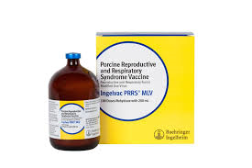
Prevention and prognosis
Prevention of infection appears to be the primary means of control.
Commercial vaccines, both modified live and killed, have been licensed and have been effective in controlling outbreaks and preventing economic losses.
In adults the prognosis is relatively good with treatment
Affected litters have a very poor prognosis
Weaned piglets also have a poor prognosis
Prognosis

Slide 25
Pseudorabies
Aujesky’s disease
Herpes virus
Dogs, cats, domestic ruminants
Not humans!

Slide 26
Signalment
Among domestic animals, swine are the only natural host of pseudorabies virus (PRV). All age groups not previously exposed or vaccinated are susceptible.
The disease was eradicated from the US commercial pig industry in 2004 but remains in some localized feral swine populations.

Slide 27
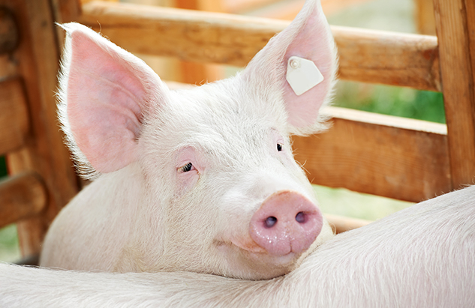
Incubation Period
Pseudorabies virus (PRV) is an alphavirus in a subfamily of Herpesviridae.
Incubation period: Typically 2-6 days and suckling pigs have shorter incubation period of 48 hours.

Slide 28
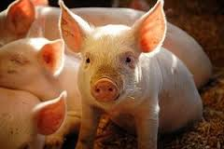
Transmission
Pseudorabies is highly contagious. In most cases, this disease is transmitted through nose-to-nose contact, which is the most common type of transmission because the virus is mostly present in nasal and oral areas. This disease can wipe out entire herds.
Other potential methods of transmission include mechanical (via fomites) and viral aerosolization
Zoonotic= NO

Slide 29
Pseudorabies cont...
Baby piglets
    up to 100% mortality
    neurologic dz, vomiting, diarrhea
    Ulcers on oral cavity and esophagus
Weanling/growers
    up to 60% mortality in weanlings, 0-15% in finishers
    pneumonia impt, neurologic dz, vomiting, extreme pyrexia
Adults - often inapparent
    can cause stillbirth/abortion

Slide 30
Pseudorabies cont...
Reportable disease!
Diagnosis
    Necropsy -
      histologic lesions in brain, ulcers in gi tract
    Serum neutralization is standard test
    ELISA can be used as a screening test
Treatment - none
Prevention
    closed herd! quarantine! restrict wildlife
    vaccination

Slide 31
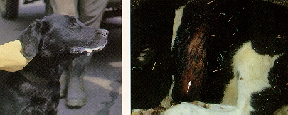
Pseudorabies

Slide 32
Pseudorabies
Regulation
  use of vaccine regulated by states
  federal regulations for monitoring
    all animals over 6mo old must be tested
    25% of herd tested q3months or...
    10% of herd tested q1month

Slide 33
White muscle disease / Mulberry heart disease
Nursery or grower pigs
Vitamin E / Selenium deficiency
    Propionic acid destroys Vit E / Sel
    Rancid fat can destroy
    Midwest U.S. is selenium deficient
Clinical signs
    acute death (mulberry heart disease)
    muscle weakness (white muscle disease)

Slide 34
Vit E / Selenium cont...
Diagnosis
    Necropsy - hydropericardium, fibrinous epicarditis, myocardial hemorrhage
    Diffise hepatic necrosis - hepatosis dietetica
    Liver selenium < 0.5 ug/g

Slide 35
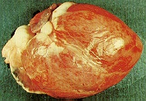
Mulberry heart disease

Slide 36
Treatment
Antioxidants must be provided. It will take time at least 2 weeks of supplemented feed to restore Vitamin E levels.
In the acute disease situation, Vitamin C can be supplemented via water for 5-7 days.
Injectable Vitamin E can be given around weaning.
Vitamin C and E can be included in creep diets but only where diets are prepared as meal or are pelleted using cold water - hot pelleting will destroy Vitamin C.

Slide 37
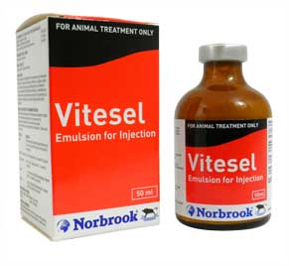
Vitesel
Vitesel Injection is indicated for the prevention and treatment of Vitamin E- Selenium deficiency syndrome in piglets, lambs and calves, including various manifestations of nutritional muscular dystrophy (White Muscle Disease). Administration of Vitesel to the pregnant ewe may assist in the prevention of the deficiency syndrome of new born lambs under similar conditions.
Administer by SQ or IM injection to lambs and by SQ injection only to ewes and by IM injection only to calves and piglets.
Alpha-Tocopheryl Acetate 68mg/ml
Selenium (as Potassium Selenate) 1.5mg/ml
Benzyl Alcohol as antimicrobial preservative 20mg/ml

Slide 38
Respiratory diseases
Atrophic rhinitis
Swine influenza
Mycoplasma pneumoniae
Actinobacillus pleuropneumoniae
Pasteurella
Verminous pneumonia

Slide 39
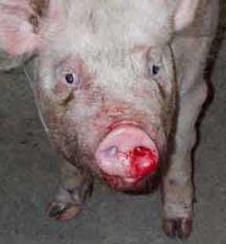
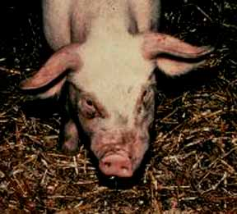
Atrophic Rhinitis
Atrophic rhinitis is an infectious disease of swine characterized by serous to mucopurulent nasal discharge, shortening or twisting of the snout, and atrophy of the turbinate (conchal) bones.

Slide 40
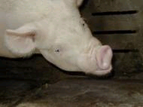
Atrophic rhinitis
Bordatella bronchiseptica
Pasteurella multocida
High ammonia

Slide 41
Atrophic Rhinitis
Signalment
Infection is usually picked up during the second half of the sucking period or after weaning and clinical disease may be evident from three weeks of age onwards.

Slide 42
Transmission
Spread of disease between herds is almost invariably by the carrier pig. Spread within herds is by droplet infection between pigs or by direct pig to pig (nose to nose) contact. It can also be spread indirectly on equipment, clothes etc

Slide 43
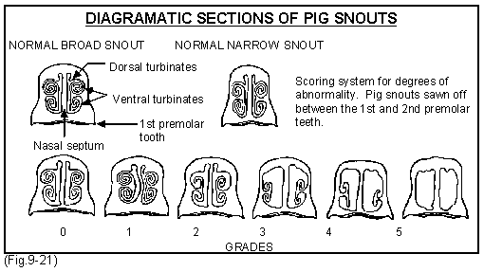
Clinical signs
    sneezing, sniffling
    twisted snouts
    excessive lacrimation
    epistaxis
Assess snout deviation at slaughter slaughter-X section snout
Culture nasal swabs
Must demonstrate P. multocida toxin to confirm (PCR)

Slide 44
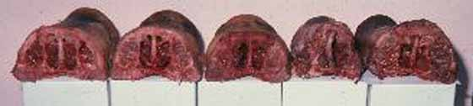
Atrophic rhinitis cont...
Diagnosis
    Necropsy - cut snout at 2nd premolar
    Nasal culture for either organism
Treatment
    tetracyclines in the feed
    LA200 to neonates
Control and prevention
    all in all out, reduce stress, clean air
    vaccinate sows

Slide 45
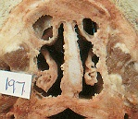
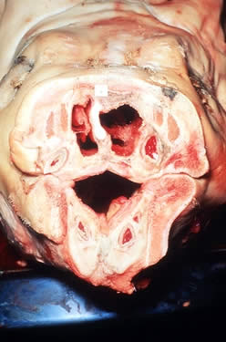
Atrophic rhinitis

Slide 46
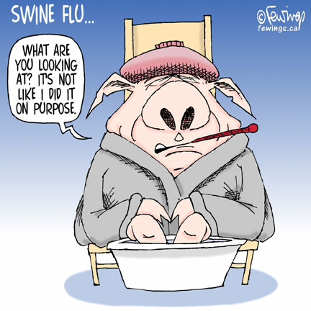
Swine influenza
Influenza virus
Zoonotic
Outbreaks associated with movement or extreme weather changes
    up to 100% morbidity
    low mortality unless secondary bacterial infection complicates things

Slide 47
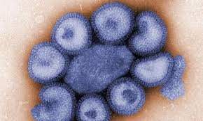
Etiology
SIV is an orthomyxovirus of the influenza A
3 influenza a subtypes that have been isolated in pigs
  H1N1, H1N2, H3N2
  Most common is H1N1

Slide 48
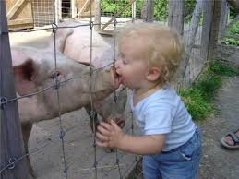
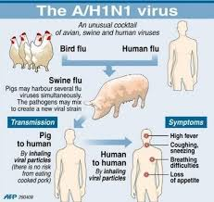
Signalment
Pigs are the principle hosts of SIV and in all ages.
Chicken, ducks, turkeys, many wild birds and people can also be prone to SIV

Slide 49
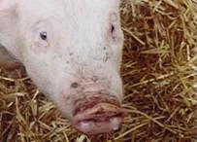
Swine influenza cont...
Diagnosis
    Necropsy - cranioventral pneumonia
    Fluorescent antibody test
Treatment - supportive
Prevention
    closed herd
    control secondary infections
    keep away from humans
    (no shows!)

Slide 50
Mycoplasma hyopneumoniae
Enzootic pneumonia
Most common cause of chronic pneumonia
Chronic, non-productive cough
Low mortality
Secondary bacterial complication

Slide 51
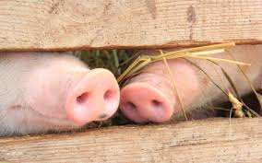
transmission.
By nose-to-nose contact and coughing. Can also be transmitted by aerosol; evidence suggests that aerosol spread can occur over several miles. A mycoplasma-free status of a herd can be difficult to maintain.
It is widespread in pig populations and endemic in most herds throughout the world.
Notes:
Said that can be carried by the wind up to a mile and a half away.

Slide 52
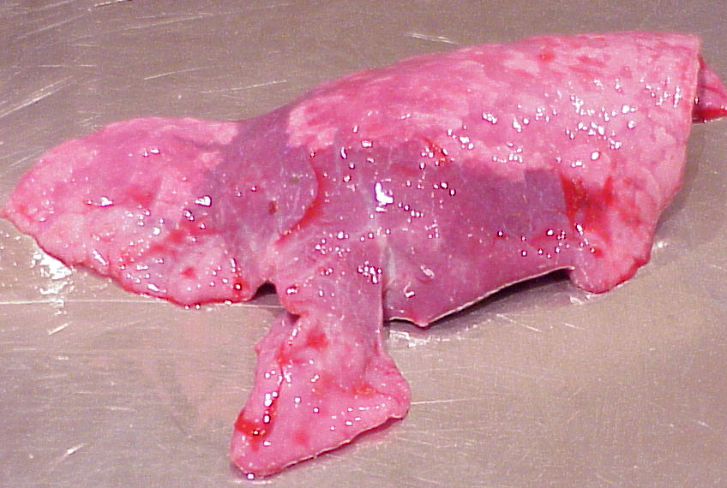
Mycoplasma cont...
Diagnosis
    Necropsy - “plum colored”or pale cranio-ventral pneumonia
    Culture to rule out secondary bacteria
    Fluorescent antibody test on lung

Slide 53
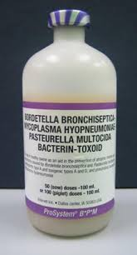
Mycoplasma cont...
Treatment - Lincomycin in feed
Prevention - improve management, vaccination

Slide 54
Actinobacillus pleuropneumonia
Intensive swine operations
Inapparent carriers
Peracute, acute, and chronic forms
Clinical signs
    severe respiratory distress
    death

Slide 55
Actinobacillus cont...
Diagnosis
    necropsy - fibrinous pleuropneumonia
    often diaphragmatic lobes most severe
    culture is difficult
    complement fixation serology
Treatment
    ceftiofur (Naxcel) and procaine penicillin
Control
    vaccination of young pigs

Slide 56
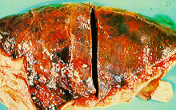
Contagious pleuropneumonia

Slide 57
Pasteurella multocida
Most common bacterial isolate from pig lungs
opportunistic pathogen
    mycoplasma, influenza, actinobacillus, stress
clinical signs
    moist productive cough
    dyspnea
    some die

Slide 58
Pasteurella cont...
Diagnosis
    necropsy - suppurative cranio-ventral bronchopneumonia
    may be pleuritis similar to actinobacillus
    culture
Treatment - penicillin, tetracyclines
Control
    look for underlying disease
    medicate feed and water (tetracyclines)

Slide 59

Pasteurella pneumonia

Slide 60
Gastrointestinal diseases
Stomach
    Ulcers
Small intestine
    E. coli (piglets)
    TGE (piglets)
    Clostridium (piglets)
    Coccidiosis (>7 days)
    Rota virus (post weaning)
    Salmonella (any)

Slide 61
Gastrointestinal disease cont...
Large intestine
    Swine dysentery (grower/finishers)
    Proliferative enteropathy (grower/finishers)
      Hemorrhagic bowel syndrome
      Proliferative illeitis
    Whipworms (growers)
    Salmonella (any)

Slide 62
Gastric ulcer disease
Almost always the pars esophagea
Non-specific lesions
Can lead to “bleed-out”
Predisposing factors...
    Finely ground feed
    Stress
    Vit E/Selenium def
Melena, ulceration of squamous portion of stomach, anorexia

Slide 63

“Bleed out”

Slide 64
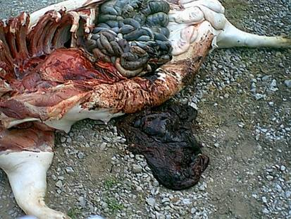
Gastric ulcer

Slide 65
Colibacillosis
E. coli
Most common cause of diarrhea in piglets <10 days old!!!
Gram negative

Slide 66
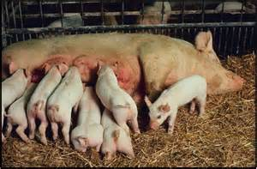
Signalment and Transmission
From birth to around 10 days of age.
First few weeks post-weaning.
E. coli is everywhere and is very transmissible.
The organism may be easily transmitted around the farm.

Slide 67
Clinical Signs
In acute disease:
The only sign may be a previously good pig found dead.
Huddle together shivering or lie in a corner.
The skin around the rectum and tail is wet.
Watery to salad cream consistency scour - distinctive smell.
Vomiting.
As the diarrhea progresses:
Dehydrated.
Sunken eyes.
The scour often sticks to the skin of other piglets giving them pasty brown feces to white color.
In sub-acute disease:
Signs are similar but the effects on the piglet are less dramatic, more prolonged and mortality tends to be lower.
This type of scour is often seen between 7 to 14 days of age.
E. coli is one of the most common causes of neonatal septicemia.

Slide 68
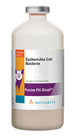
Colibacillosis cont...
Diagnosis
    ph of feces (>8)
    culture of organism (large number)
    necropsy - dilated gas filled small intestine
Treatment
    Ampicillin, tetracyclin, gentamicin, fluids
Control
    sanitation, vaccination of sow

Slide 69
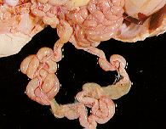
Colibacillosis

Slide 70
TGE - transmissable gastroenteritis
Coronavirus (similar to FIP)
Epidemic form (all ages)
Endemic form (1-8 weeks old)
WINTER disease
Morbidity and mortality high in pigs <2weeks old

Slide 71
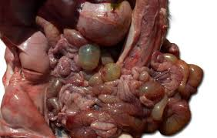
Clinical Signs
Vomiting
Profuse watery diarrhea,
Dehydration
Excessive thirst
Feces of nursing pigs often contain curds of undigested milk.
Piglets severely dehydrated, and the skin is soiled with liquid feces.
The small intestine is thin walled, and the entire intestine contains greenish or yellow watery fluid and clumps of undigested milk. Villous atrophy can be seen by examining the mucosa of the small intestine with a hand lens.

Slide 72
TGE cont...
Diagnosis
    ELISA, immunoflourescence of gut contents
    Necropsy
      undigested milk in small intestine
      thin walled, transparent small intestine
Treatment - supportive
Control
    isolate new additions for 2 weeks, keep dogs and bird away (carriers)
    Immunization of sows or piglets
    Grind up piglet guts and feed to pregnant sows

Slide 73
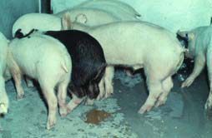
TGE

Slide 74
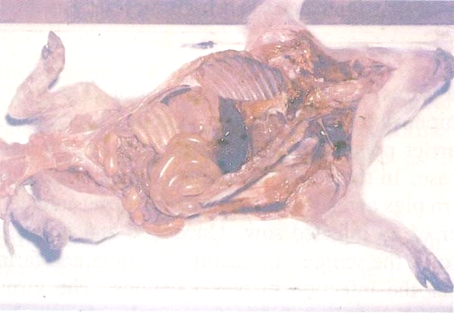
tge

Slide 75
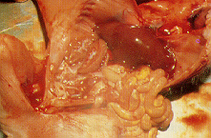
TGE

Slide 76
Clostridial enteritis
Clostridium perfringens type C
sudden death in 1-2 day old piglets
Clinical signs
    BLOODY DIARRHEA
Diagnosis
    Necropsy - blood in jejunum with flecks of mucosa, necrosis of small intestine
    Clinical signs
    Histopathology - large gram positive rods

Slide 77
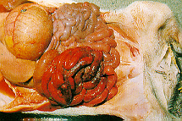
Clostridial enteritis

Slide 78
Clostridial enteritis cont....
Treatment
    usually die too quickly
    type C antitoxin
Control
    Sanitation
    Type C antitoxin within minutes of birth
    Vaccination of sow
    Prophylactic bacitracin or penicillin to piglets

Slide 79
Rota virus
Reovirus
Almost all pigs are infected
Diarrhea in post-weaned pigs
Diagnosis - difficult
    Necropsy-thin walled small intestine
    Histopathology
    Flourescent antibody test
    Electron microscopy

Slide 80
Rota virus cont...
Treatment
    Glucose and fluids
    Antimicrobials for concurrent infections
      E. coli
      Isospora
Control
    Wean pigs on good nutritional diet
    MLV vaccine at 7 and 21 days (in water)

Slide 81
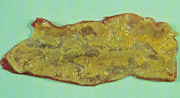
Dont forget Salmonella
Salmonella typhimurium
Salmonella cholerasuis
Fibrinonecrotic enteritis or colitis at necropsy
Rectal strictures
Culture of organism

Slide 82
Salmonella sp.
Salmonella cholerasuis
Salmonella typhimurium
    Zoonotic
Low-level endemnicity, carriers
Septicemia
    pyrexia, anorexia
    purple discoloration of the ears (infarction)
    Small or large intestinal diarrhea (button ulcers)
    Pneumonia
    Rectal strictures

Slide 83
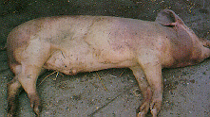
Salmonella

Slide 84
Salmonella cont...
Diagnosis
    Aerobic culture
Treatment
    Neomycin in the feed/water for whole group
    Naxcel (ceftiofur) for individual
Prevention and control
    Sanitation
    All in - all out operation
    Various vaccines (live avirulent)

Slide 85
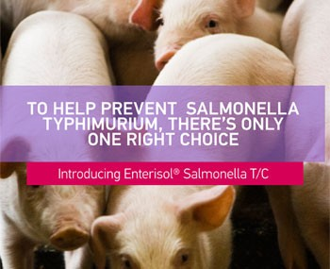
Prevention
    Sanitation
    All in - all out operation
“Enterisol® Salmonella T/C is a safe, effective, convenient, one dose Salmonella Choleraesuis-Typhimurium vaccine.”
Advantages:
Contains both Salmonella Choleraesuis and Salmonella Typhimurium antigens in one dose.
Approved in pigs as young as 2 weeks
Rapid onset of immunity after vaccination
Withdrawal period: 21 days

Slide 86
Swine dysentery
Serpulina hyodysenteriae
Grower / finishers
Mortality can be up to 30%
Clinical signs
    diarrhea sometimes with blood
    eventually watery, bloody, mucoid
    most recover in 2 weeks but 30% may die

Slide 87
Swine dysentery cont...
Diagnosis
    Necropsy - mucohemorrhagic colitis
    histopathology
    Spiral shaped organism on dark field microscopy
    Culture is definitive
Treatment
    Lincomycin in water
Control
    medicated water, depopulation, close herd
    vaccine only reduces clinical signs

Slide 88

Swine dysentery

Slide 89

Swine dysentery

Slide 90
Proliferative enteropathy
Lawsonia intracellulare
    proliferative illeitis, hemorrhagic bowel syndrome
Large intestine
Weanlings and older
Clinical signs
    intermittant diarrhea
    can be hemorrhagic diarrhea
    anemia (think gastric ulcer first)

Slide 91
Proliferative enteropathy cont...
Diagnosis
    Necropsy - “garden hose” ilium and colon
        can be hemorrhagic or fibrinonecrotic
    Histopathology - intracellular, silver positive
    DNA probes
Treatment and control
    No specific treatment
    Reduce stress
    Medicate feed - tetracyclines, carbadox

Slide 92

Proliferative illeitis

Slide 93
Neurological diseases
Hypoglycemia
Streptococcus suis
Salt poisoning
Edema disease

Slide 94
Hypoglycemia
Newborn piglets
Blood glucose <50 may develop signs
Clinical signs
    convulsions
    shivering
    hypothermia
    gait abnormalities

Slide 95
Hypoglycemia cont...
Diagnosis
    Blood glucose
    Empty stomach
Treatment
    20ml/kg 5% glucosa, warm em up
Control
    make sure the milk is flowing

Slide 96


Salt poisoning
Usually due to water deprivation rather than too much Na
Causes hyperosmalarity of CNS resulting in swelling and edema
Clinical signs
    thirst, constipation
    depression, blindness, convulsions

Slide 97
Salt poisoning cont...
Diagnosis
    History
    Clinical pathology-eosinopenia, hypernatremia
    Histopathology - eosinophilic meningitis
Treatment
    None
Control
    provide free access to water
    reduce salt in diet

Slide 98
Musculoskeletal diseases
Arthritis
    S. suis, Erysipelothrix, A. pyogenes
    Mycoplasma hyosynoviae
Myodegenerative disease
    Malignant hyperthermia (PSE)
    White muscle disease

Slide 99
Suppurative arthritis
Streptococcus suis
Erysipelothrix rhusiopathiae
Actinomyces pyogenes
May see loss of cartilage
Due to fighting, surgical contamination
Distended joints, abscesses
Penicillin - treatment often no good

Slide 100

Suppurative arthritis

Slide 101
Mycoplasmal arthritis
Mycoplasma hyosynoviae
4-12 weeks of age
acute or chronic lameness
non-suppurative arthritis/synovitis
edema of synovial tissue
Lincomysin to treat

Slide 102

Mycoplasmal arthritis

Slide 103
Reproductive disease
Parvovirus
Leptospirosis
PRRS
Brucellosis

Slide 104
Porcine parvovirus
100% prevalence
Signs depend on time of infection
    <30days - embryo resorbed
    30-70days - mummy
    >70days - dead or weak, survive normally
    no other signs of illness
SMEDI - stillbirth, mummy, embryonic death, infertility
Diagnosis - detection of virus in mummy by immunofluorescence or by rising titer

Slide 105

Parvo - SMEDI

Slide 106
Porcine parvovirus cont...
Control
  Natural infection of gilts before breeding
  Commingle gilts with sows
  Grind up mummies and feed to gilts
  Vaccination!
      may still get some losses

Slide 107
Leptospirosis
Leptospira interrogans
    serovar pomona - most common
    serovar bratislava
Clinical signs
    Pyrexia, last trimester abortion, stillbirths
Diagnosis
    Culture difficult
    Dark field microscopy of fetal fluids, urine
    Serology (<1:800)

Slide 108
Leptospirosis cont...
Treatment
    Chlortetracycline in feed
Control
    Vaccination
    Gilts twice before first breeding
    Sows before every breeding

Slide 109
PRRS
Porcine reproductive/respiratory syndrome
Premature farrowing
Small weak piglets or stillborns
increased numbers of mummies
Delayed or abnormal estrus
Serology to diagnose
Vaccination for prevention

Slide 110
Brucellosis
Brucella suis
Clinical signs
    abortion at any time in gestation
    infertility - many sows coming back into heat
    infected sows recover and deliver normally
Lesions
    mild endometritis
    arthritis
    orchitis

Slide 111

Brucellosis

Slide 112
Brucellosis cont...
Diagnosis
    Serology - card test
    Culture
Treatment and control
  Test and slaughter
  Zoonotic

Slide 113
Abortions/stillbirths
Parvo virus
PRRS
Pseudorabies
Lepto

Slide 114
Dermatologic diseases
Mange
Greasy pig disease
Swine pox
Erysipelas

Slide 115
Greasy pig disease
Exudative dermatitis
Staphylococcus hyicus
Affects late preweaning pigs
Clinical signs
    exfoliation of skin, excess sebaceous secretion
    pruritis not a feature unless complicated my mange
Diagnosis - clinical signs and culture

Slide 116


Greasy pigs

Slide 117
Greasy pig disease cont...
Treatment
    Injectible penicllin, oxytetracyline
    Tetracyclines in feed
Control
    Sanitation
    Control external parasites
    Good nutrition

Slide 118
Swine pox
Swine pox virus
Only pigs less than 4months old
Clinical signs
    papules 1-6 mm in diameter
    pustules, crusts
    clear spontaenously
Diagnosis - clinical signs, biopsy
    intracytoplasmic inclusion bodies
Treatment - not necessary

Slide 119

Swine pox

Slide 120
Erysipelas
Erysipelothrix rhusiopathiae
Diamond skin disease
pigs 3months - 3years old
Clinical signs
    widespread ecchymotic hemorrhages due to microthrombi
    arthritis, endocarditis
Diagnosis
    Diamond skin lesions pathognomonic
    Culture of blood, joints, lung, liver

Slide 121
Miscellaneous diseases
Swine lice
Baby piglet anemia
Rectal prolepses

Slide 122
Baby pig anemia
Iron deficiency
Piglets iron demand is greater than the sows milk
Clinical signs
    anemia within 2-3 days of birth
    dyspnea, edema, pale skin, lethargy
Diagnosis - clinical signs, CBC
Treatment - 200mg iron dextran at 1-3 days of age

Slide 123

Rectal Prolapses
A portion of the inside of the rectum inverts and protrudes outside of the anus
Predispositions may include coughing, scours, cold (piling), feed rich in lysine or starch or poor in fiber.
Can be fixed with a rectal tube
or surgically

Slide 124


Foreign diseases
Hog cholera
    pestivirus - splenic infarction is pathognomonic
African swine fever
    iridovirus - hemorrhage in multiple areas

Slide 125


Vesicular diseases of swine
    Foot and mouth disease - apthavirus*
    Swine vesicular disease - enterovirus
    Vesicular exanthema - calicivirus
    Vesicular stomatitis - rhabdovirus

Slide 126
THE END!!!

