Slide 1
Swine Terminology

Slide 2
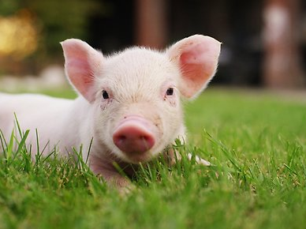
Piglet
Baby Pig, male or female

Slide 3
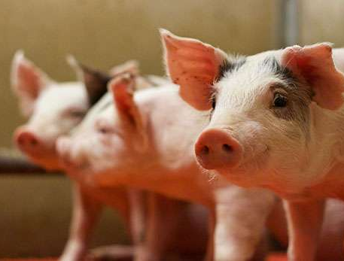
Pig
generic term, usually applied to immature swine

Slide 4
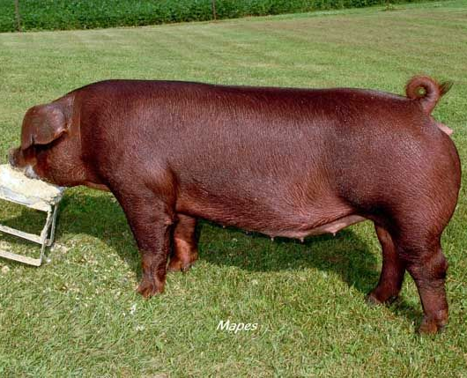
Hog
generic term, usually applied to growing swine

Slide 5
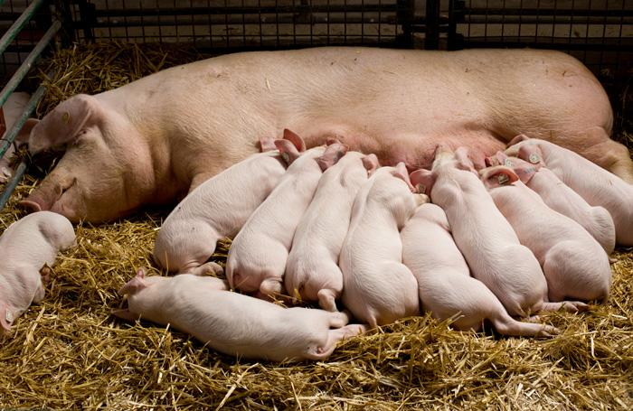
Sow
adult female swine

Slide 6
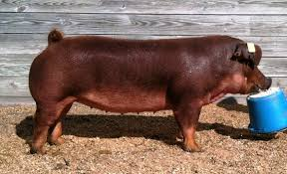
Gilt
young female swine
Up to and including primiparous (1st litter) females; about 6 mos old and 200 to 220lbs

Slide 7
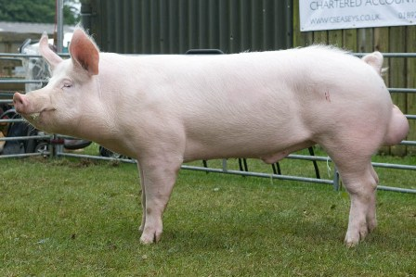
Boar
uncastrated male swine

Slide 8
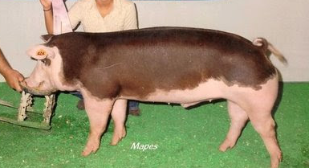
Barrow
castrated male swine

Slide 9
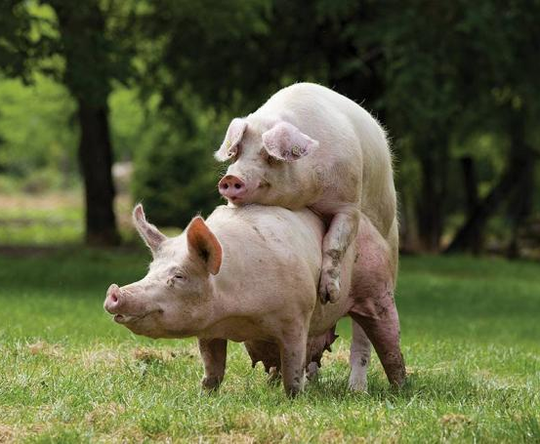
Service
Deposition of semen into the cervix of a sow or gilt.
may be by "natural" boar or artificial insemination

Slide 10
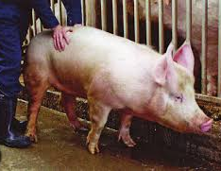
Standing Heat
when a sow or gilt is ready to be bred, she will assume a rigid stance and maintain it throughout the servicing

Slide 11
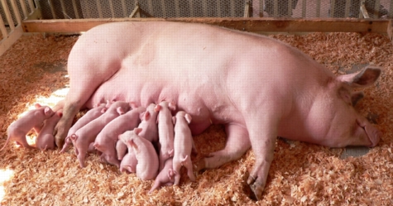
Farrowing
Parturition

Slide 12
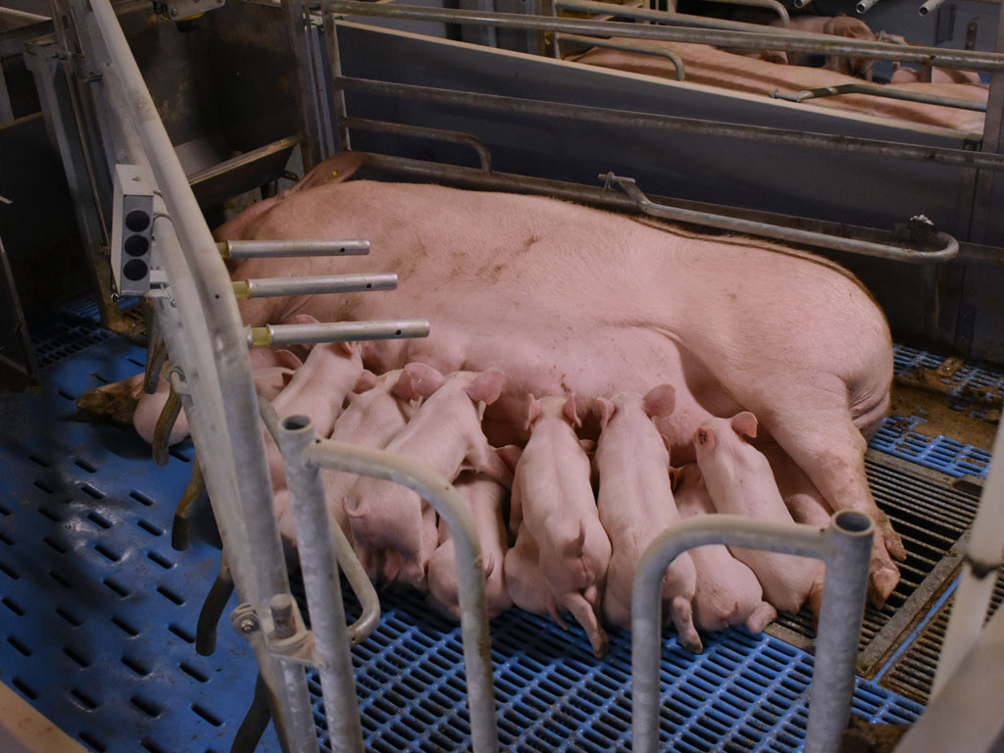
Continuous farrowing
sows (and gilts) grouped in weekly batches, use all in/all out, practiced by larger operations

Slide 13
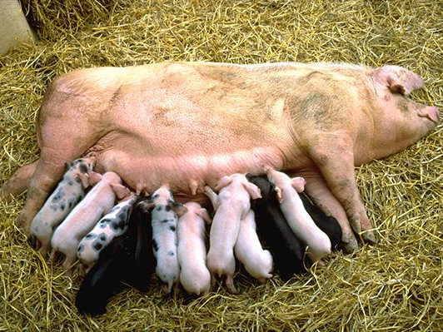
Periodic Farrowing
twice per year farrowing practiced by smaller operations

Slide 14
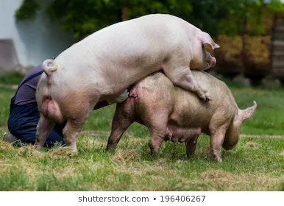
Hand mating
boar is brought to individual female for servicing

Slide 15
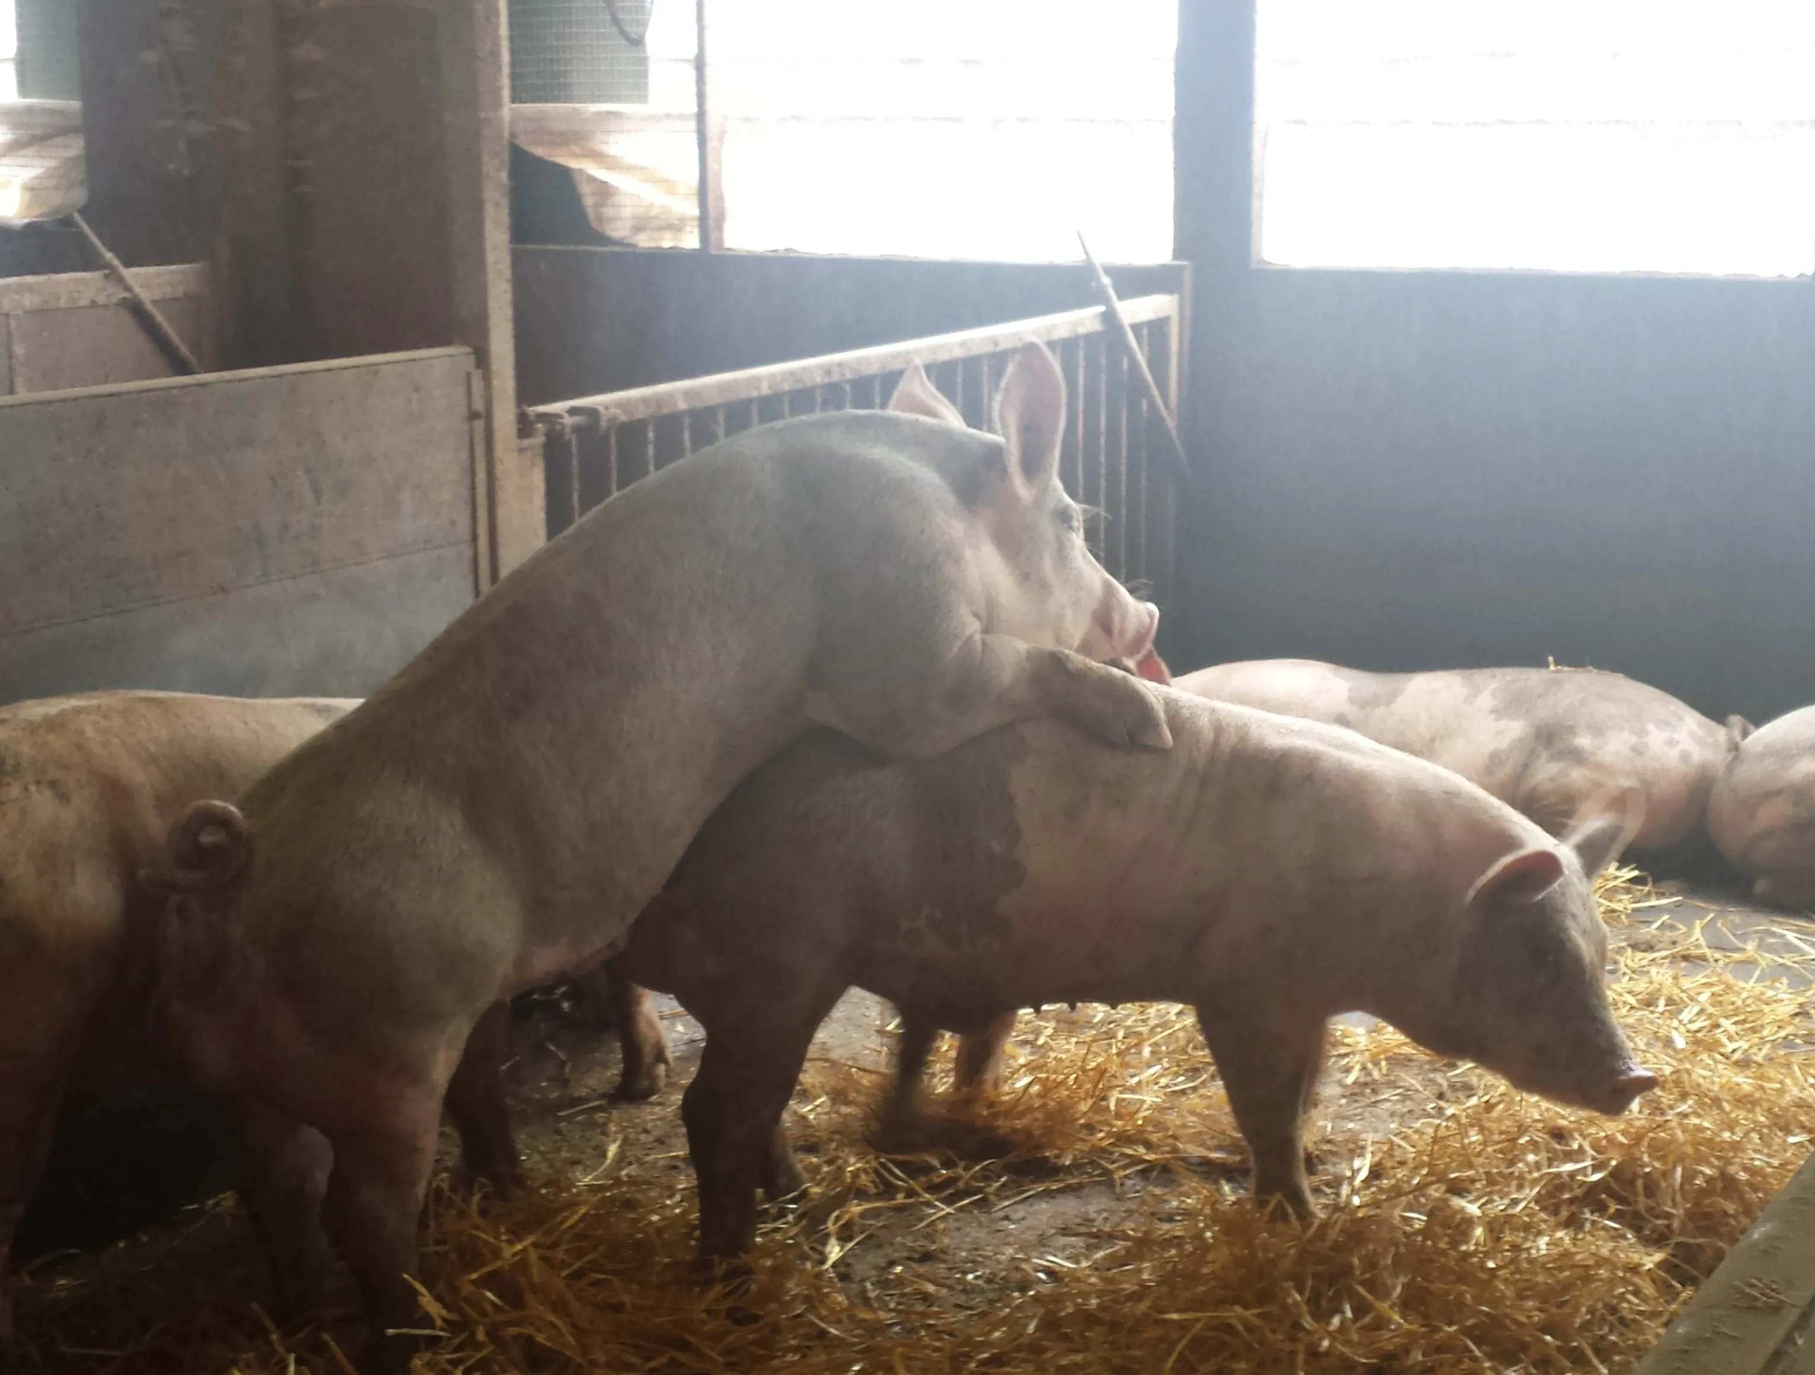
Pen Mating
boar is placed with group of sows for servicing

Slide 16
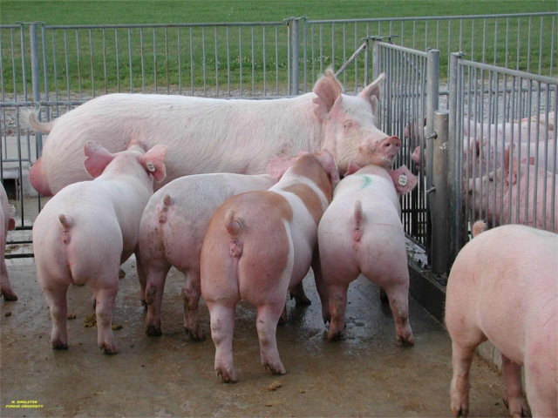
Boar effect
boar exposure to gilts causes earlier onset of puberty with some synchronization

Slide 17
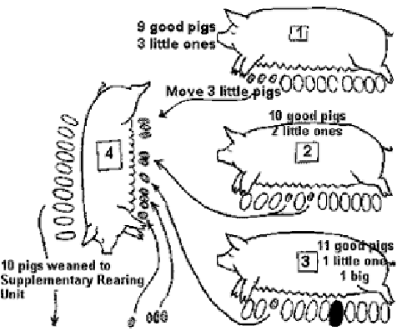
Cross-Foster
practice of placing piglets from mothers with too many piglets to feed adequately to mothers with extra udder space, should occur in first few days after birth

Slide 18
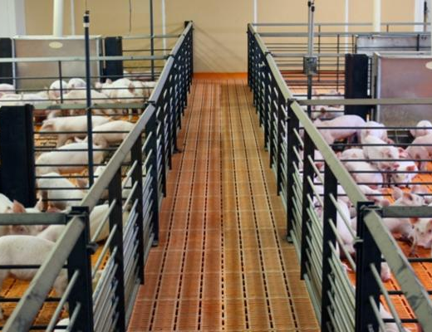
Segregated early weaning
(SEW)
removal of pigs from mother at 10 to 14 days of age in order to facilitate disease management

Slide 19
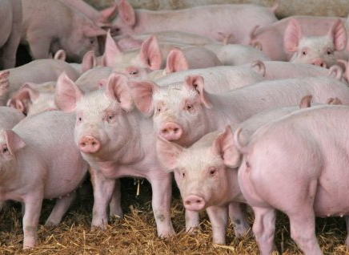
Weaner pig
From weaning up to about 50 lbs

Slide 20
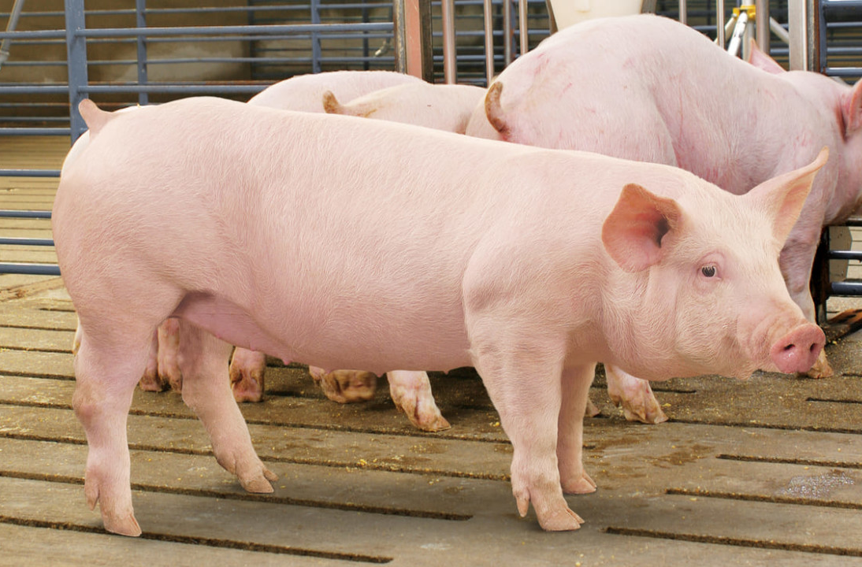
Feeder or Grower pig
pig being grown out to finisher or market weight, usually takes about 16 weeks, about 50-150 lbs

Slide 21
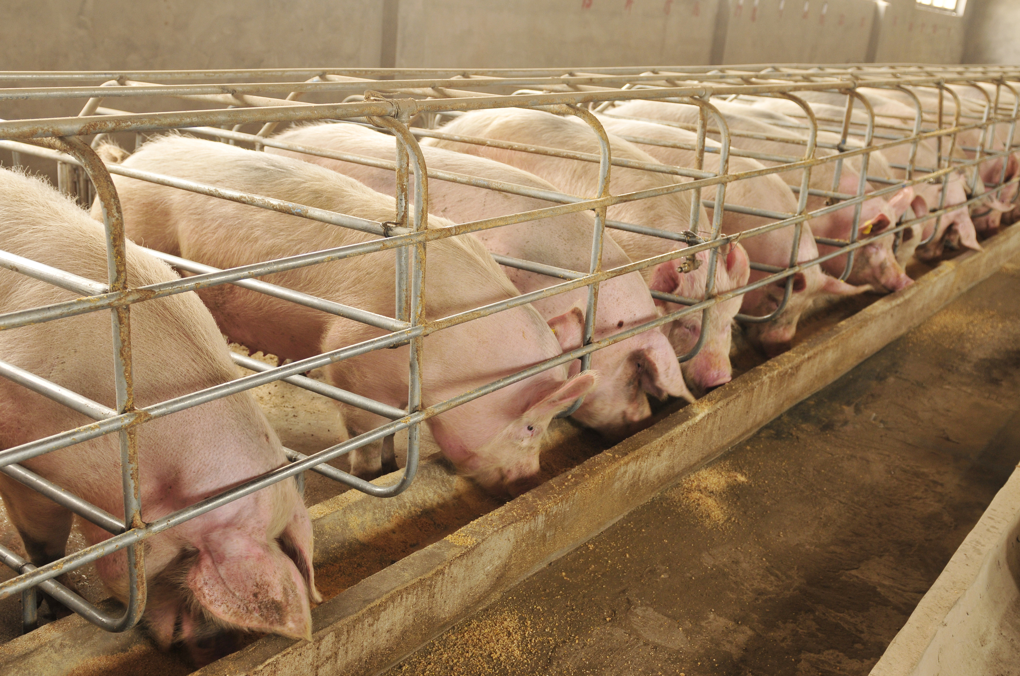
Finisher Pig
pig being grown out to finisher or market weight, about 150-250 lbs

Slide 22
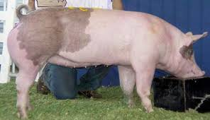
Market weight
240 to 250 lbs

Slide 23
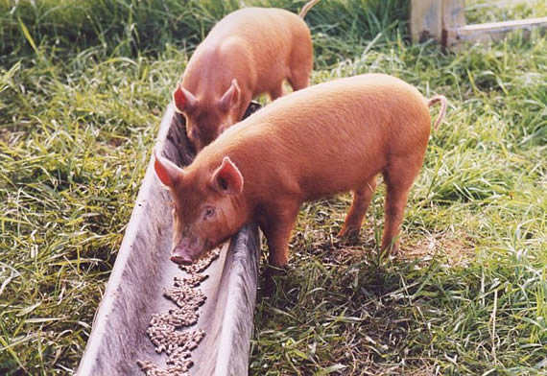
Limit Feeding
Feeding strategy in which pigs are fed a specific amount of food in a time period.

Slide 24
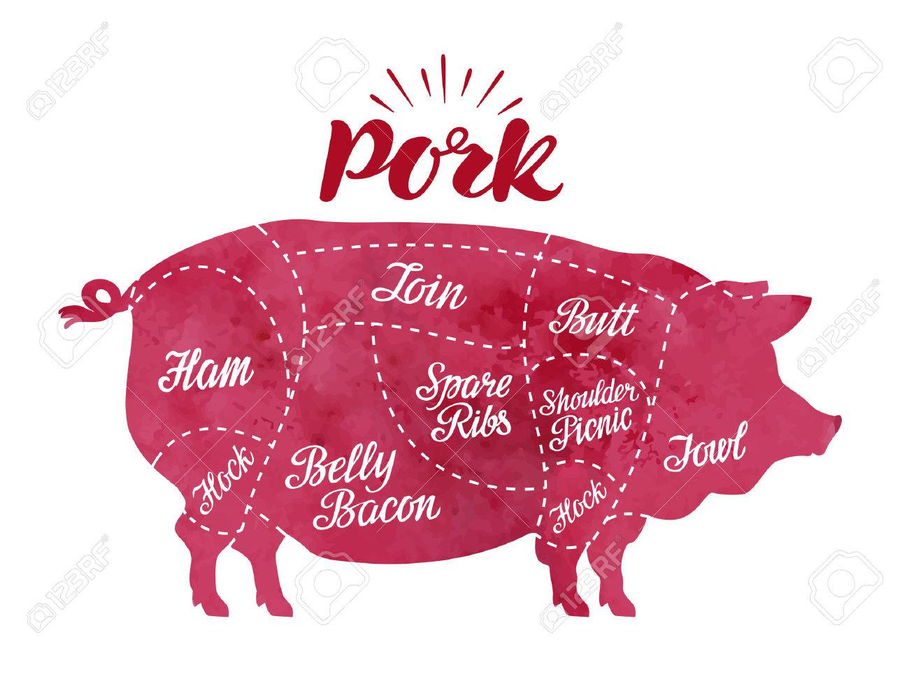
Pork Producer
integrated swine producer and meat packer

Slide 25
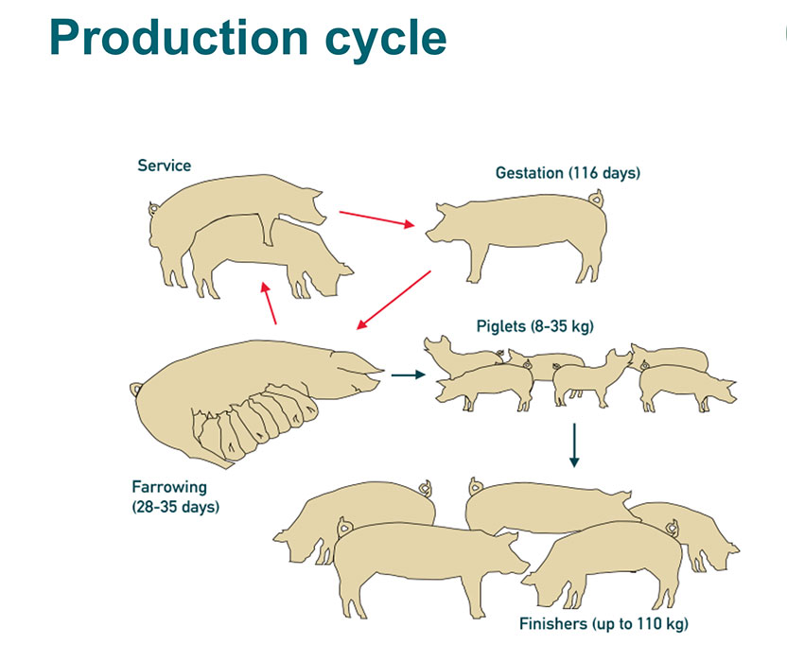
Farrow to Feeder pig operation
most intensive breeding system; producer has no grow/finish floor and sells feeder pigs

Slide 26
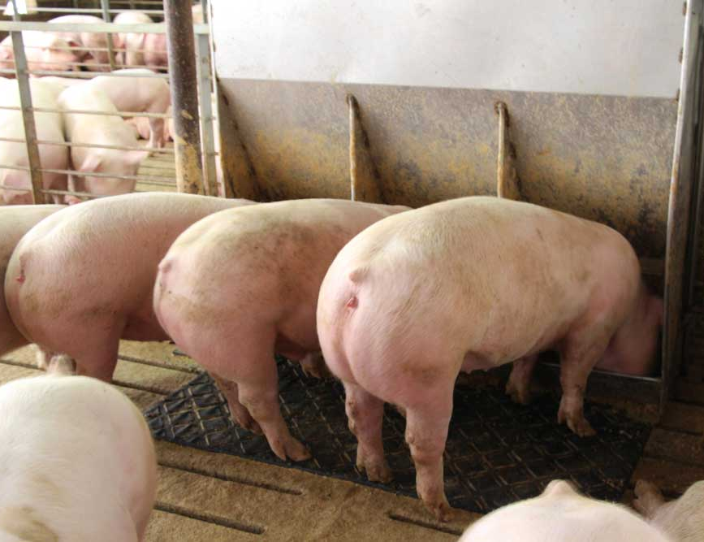
Feeder pig operation
breeder sells his grower pigs to a finishing operation to grow them out to market weight

Slide 27
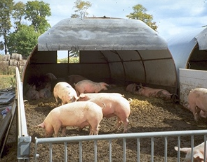
Finishing operation
buys feeder pigs and feeds them to 240 to 250 lbs

Slide 28
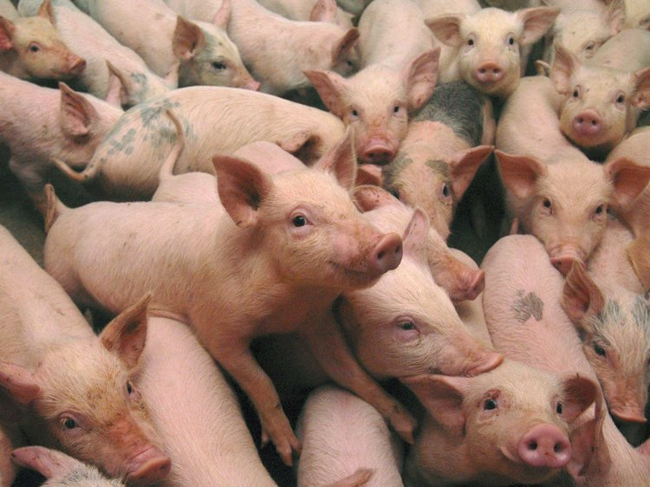
Pig Constipation
pig production exceeds the capabilities of the facility

