Slide 1
Vaccination of Ruminants

Slide 2
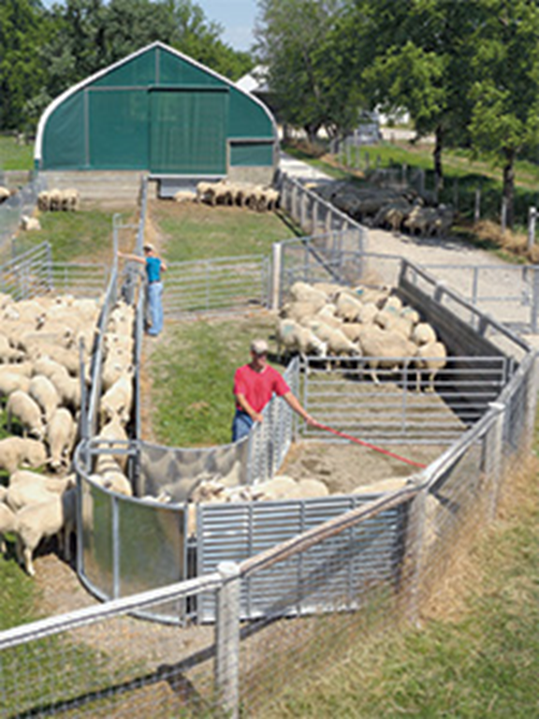
Timing of Vaccines in Ruminants
At time of working young cattle/sheep/goats
Branding, ear marking, castration
Pre-weaning period (>3 mos)
Weaning (4-6 mos)
Pre-Breeding
Could be done at 60 days prior then repeated 30 days prior
At time of pregnancy exam
Yearly/Routine

Slide 3
Cattle Vaccines: Working Calves/Pre-weaning Period
Clostridial 8 way (MLV) – should include tetanus
Leptospirosis 5 way (MLV)
IBR/BVD/PI3/BRSV (MLV)
Feedlot Steers
Mannheimia haemolytica (Pasteurella)
Calf pneumonia/Shipping Fever
Heifers
Brucellosis
Campylobacter fetus bacterin
Notes:
5 way - Infectious Bovine Rhinotracheitis (IBR), BVD, BRSV, Bovine Parainfluenza (PI3), Leptospira canicola

Slide 4
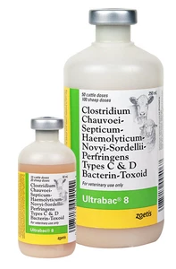
Clostridial 8-Way (MLV) Core Vaccine
Bacterin used for the prevention of:
Clostridium chauvoei Blackleg
Cl. Septicum Malignant edema
Cl. Haemolyticum Red water Disease
bacillary hemoglobinuria
Cl. Novyi Black disease
Cl. Sordellii Gas Gangrene
Cl. perfringens types C/D Enterotoxemia
overeating disease
C. tetani Tetanus
Dosage: 5 ml SQ/IM for cattle
Vaccinate at Weaning, repeat in 3-4 weeks
Annually
Prior to parturition
Do not vaccinate within 21 days before slaughter.
Notes:
BACILLARY HEMOGLOBINURIA IS CAUSED C HEMOLYTICUM
Clostridium chauvoei (Blackleg), Cl. Septicum (Malignant edema), Cl. Haemolyticum (Red water Dz), Cl. Novyi (Black disease) type B, Cl. Sordellii (Gas Gangrene), Cl. perfringens types C and D bacterin-toxoid (Enterotoxemia), C. tetani (Tetanus)

Slide 5
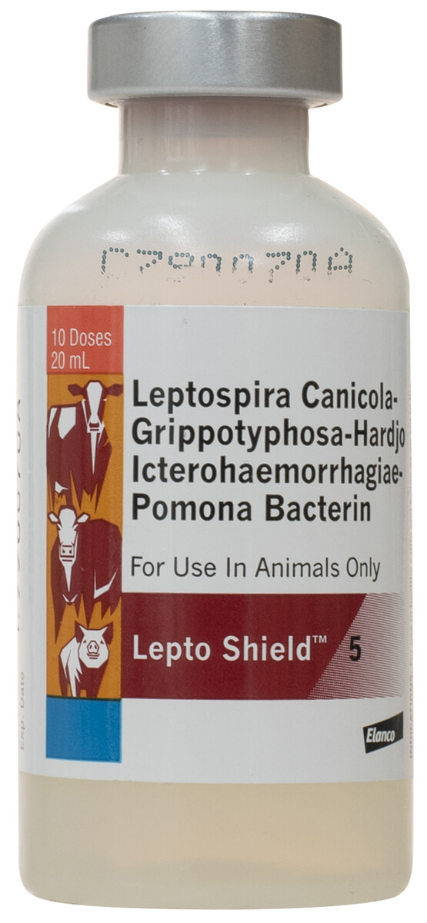
Leptospirosis 5-Way (MLV) Core Vaccine
Inactivating whole cultures of:
Leptospira canicola
L. grippotyphosa
L. hardjo
L. icterohaemorrhagiae
L. Pomona
Dosage: 2 ml SQ/IM for cattle
Vaccinate at Weaning, repeat in 3-4 weeks
Annually
Prior to parturition
Do not vaccinate within 21 days before slaughter.
Notes:
1) on premises having a history of leptospirosis (2) when the disease exists in the area, and (3) when animals may be exposed to carriers of the micro-organisms.

Slide 6
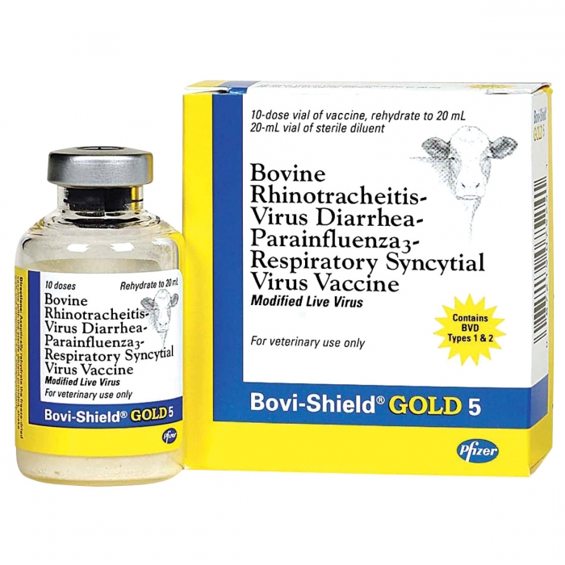
IBR/BVD/PI3/BRSV (MLV) Core Vaccine
Aids in the prevention of diseases:
Bovine Rhinotracheitis
Bovine Viral Diarrhea
Parainfluenza-3
Respiratory Syncytial Virus Vaccine
Dosage: 2 ml SQ/IM for cattle
Vaccinate at Weaning (6mo), repeat in 3-4 weeks
Annually
Prior to parturition
Do not vaccinate within 21 days before slaughter.

Slide 7
Mannheimia Haemolytica (Pasteurella) Calf pneumonia/Shipping Fever
Dosage: 2 ml SQ for cattle
Vaccinate at Weaning (6mo), repeat in 3-4 weeks
Prior to shipping steers to feedlot
Notes:
Vibriosis

Slide 8
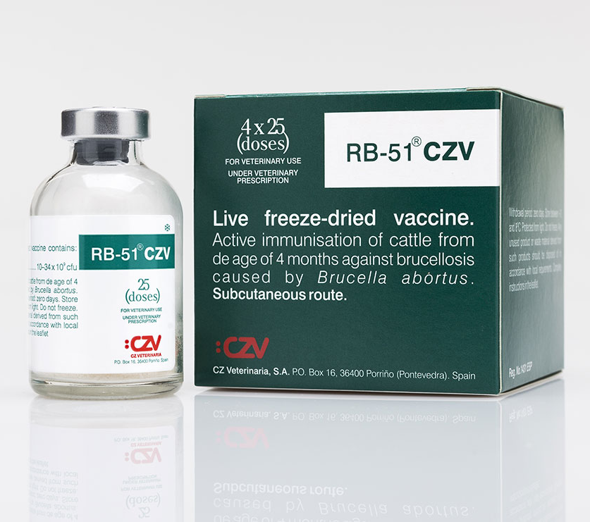
Brucellosis (Bang’s Disease) Core Vaccine - Heifers
Vaccination of calves with Brucella abortus RB51
Dosage: 2 ml SQ for cattle
Vaccinated between the ages of 4-12 months old
Do not administer to pregnant cows
Do not vaccinate within 3 weeks before slaughter

Slide 9
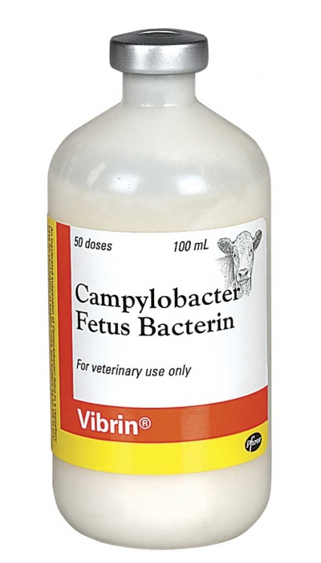
Campylobacter Fetus Bacterin Vibriosis
For vaccinating healthy female cattle to aid in the control of bovine genital campylobacteriosis (vibriosis)
Dosage: 2 ml SQ for cattle
Administer 30 to 60 days prior to exposure or addition to breeding herd.
Annually
Do not vaccinate within 60 days before slaughter
Notes:
VIBRIO IS NOT RECOMMENDED IN CATTLE THAT WILL UNDERGO AI

Slide 10
Pre-Breeding Heifers/Cows (1 month prior)
Campylobacter fetus
Leptospirosis 5 way
IBR/PI3/BVD/BRSV
(MLV is better given when cows are open)
Clostridial 8 way
Notes:
VIBRIO IS NOT RECOMMENDED IN CATTLE THAT WILL UNDERGO AI

Slide 11
Pre-Breeding Bull:
IBR/PI3/BVD/BRSV
Notes:
LEPTO OPTIONAL; IF USED, MUST BE BOOSTERED ANNUALY

Slide 12
Pregnancy Examination
Leptospirosis 5 way booster
+/- Clostridium 8 way booster

Slide 13
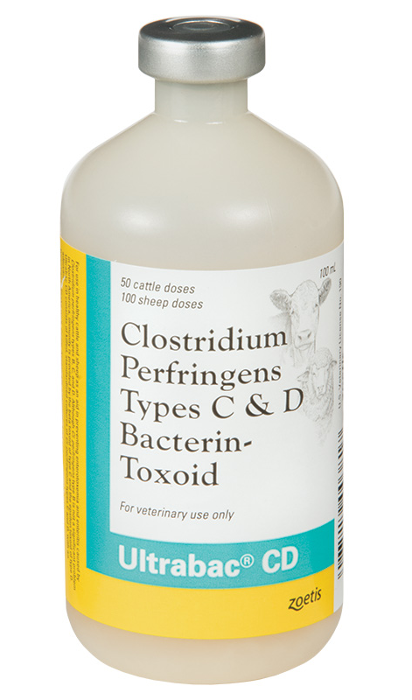
Small Ruminants: Pre-Weaning
Clostridium perfringens C & D
Clostridium tetani

Slide 14
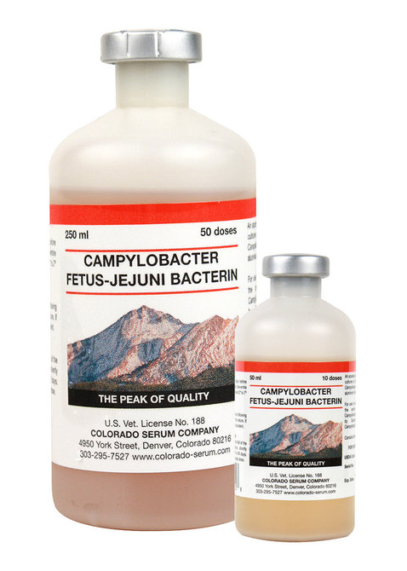
Small Ruminants: Pre-Breeding
Clostridium 8 way
Some operations only vax against C. perfringens C/D, and tetani
Campylobacter fetus

Slide 15
Small Ruminants: Pre-Partum
Clostridial 8 way
Or just C. perfringens C, D, and tetani
Parainfluenza

Slide 16
Rams and Bucks - Yearly
Clostridium C, D, and tetani

Slide 17
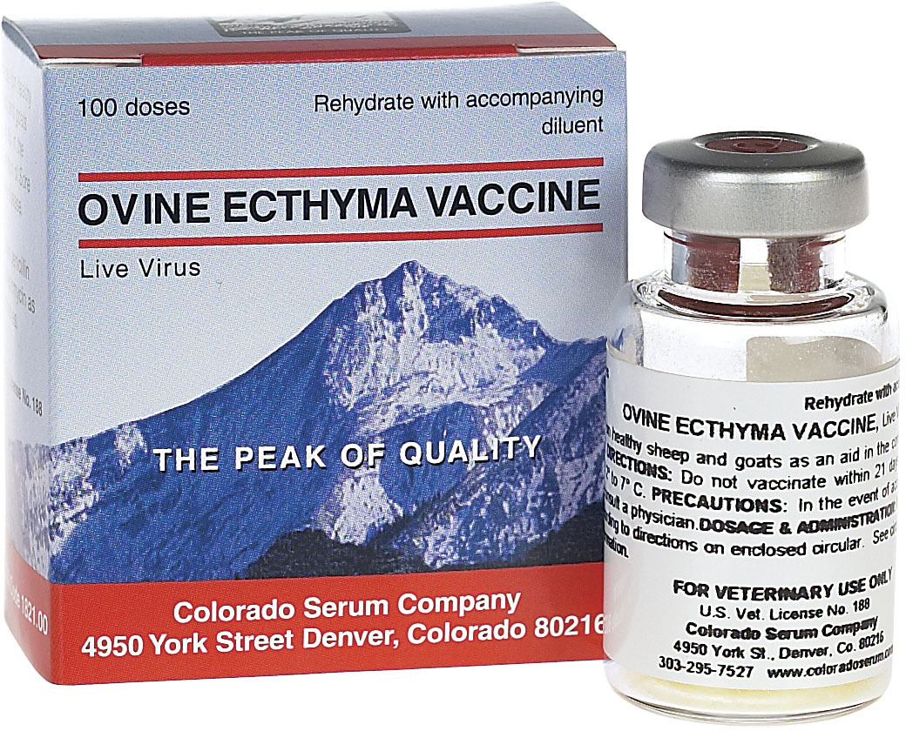
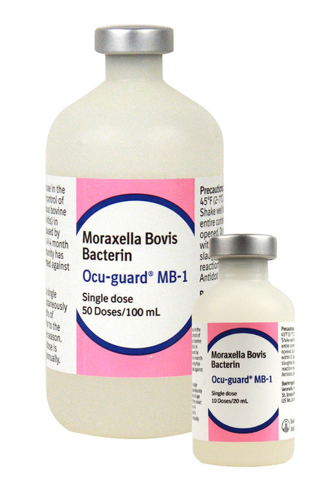
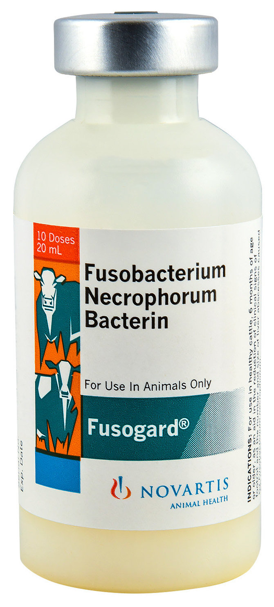
Other Vaccine Options in Ruminants
Cattle
Rabies
Moraxella bovis (pink eye)
Sheep/Goats
Rabies
Orf/Contagious Ecthyma
Foot Rot

