Slide 1
Anesthesia

Slide 2
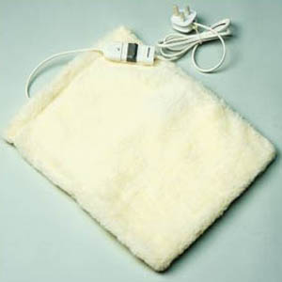
Preparation
Removal of food and water is recommended for 12 hours prior to surgery
Supplemental heat is also used to maintain the patient at approximately 85 degrees F. It is also important to keep this temperature consistent throughout the anesthetic induction, the surgical procedure, and the recovery phase.
Water circulating heating pad

Slide 3
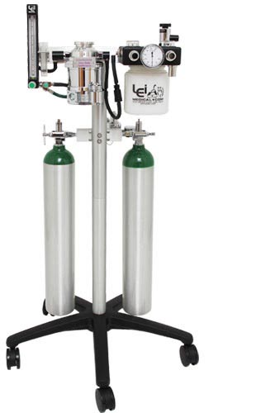
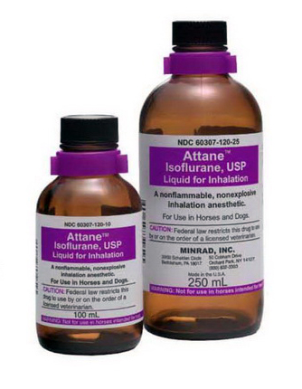
Anesthesia machine
Isoflurane and, more recently, sevoflurane are the inhalant anesthetic agents of choice for use in birds
Oxygen

Slide 4
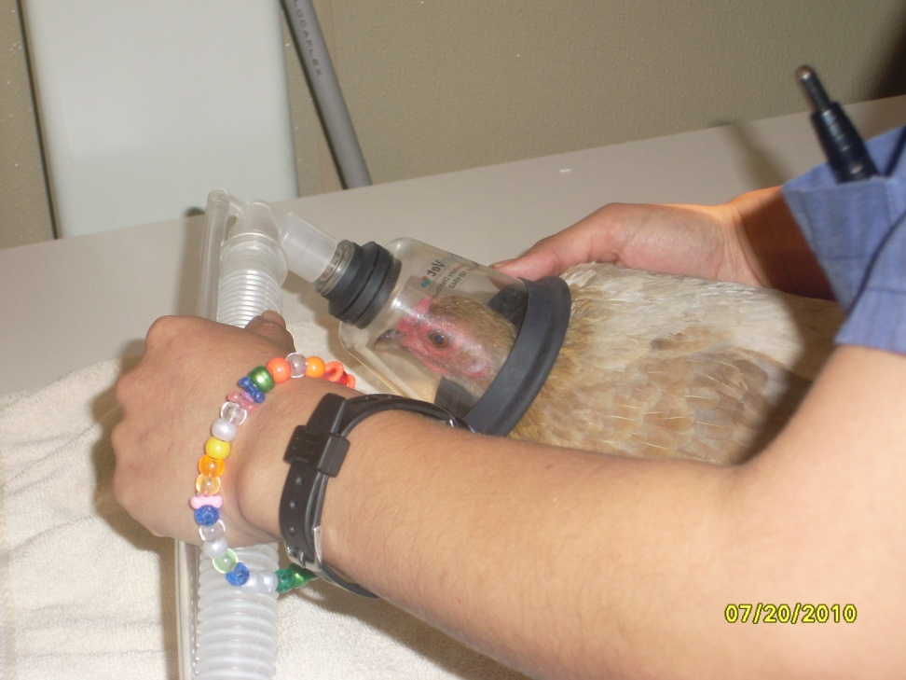
Induction
Mask induction is common, starting at 5% for less than a minute, decrease to 3% then maintain in 1.5%
A high flow rate of 2l/min of O2 is utilized due to the large amount of dead space w/in the mask
Monitoring depth of anesthesia in birds is different than in dogs and cats since palpebral reflex, toe pinch, and jaw tone are unreliable
If a bird is shivering, the plane of anesthesia is very light

Slide 5
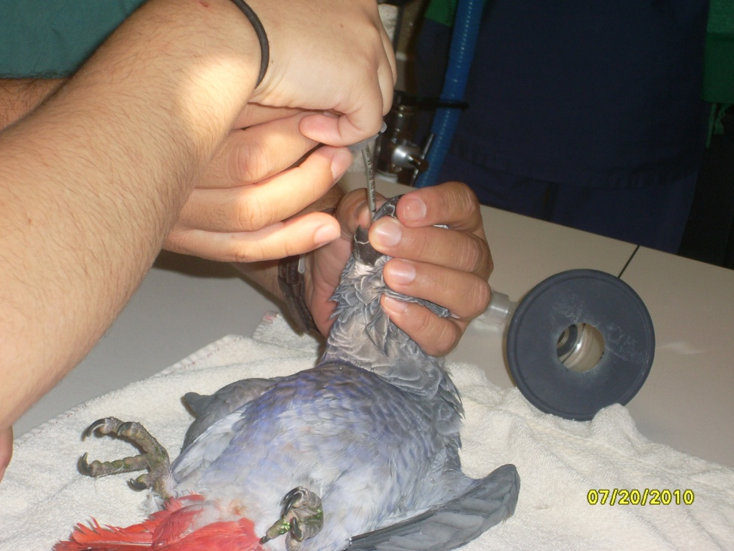
ET
Once intubated, the O2 flow a rate is set at app. 1L/min
The eyes of the bird should be lubricated ASAP
Since birds posses complete tracheal rings, which are not distensible, it is necessary to place uncuffed ET tubes
Inflation of cuffed ET tubes can cause pressure necrosis and sloughing of the tracheal mucosa

Slide 6
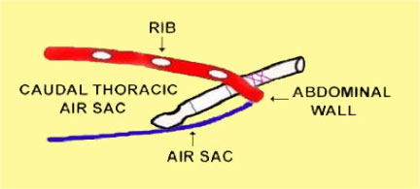
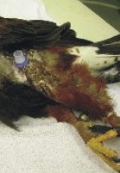
Air sac tube
Due to the uniqure respiratory anatomy of birds in which O2 exchange occurs on both inspiration and expiration an ET tube can be placed into the caudal thoracic air sac through the lateral body wall to provide not only O2 but inhalant gas anesthesia as well

Slide 7
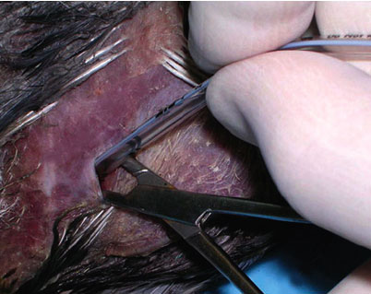
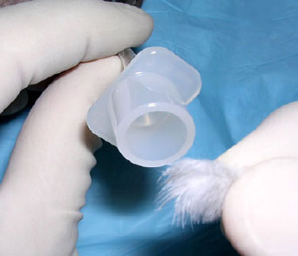
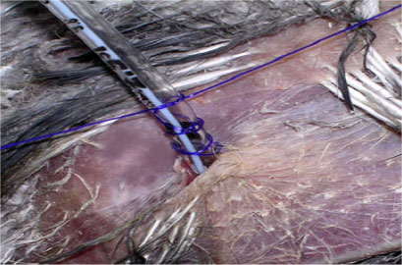
Air sac
Air sac tubes are instrumental in ER cases of tracheal occlusion, or when sx of the trachea or head area is necessary
To place an air sac tube, make a 2mm skin incision in the area of the lateral body wall that is just caudal to the last rib and just ventral to the lateral process of the relatively thin abdominal musculature taking care not to traumatize underlying organs
An ET tube is placed through the open jaws of the hemostat and sutured in place

Slide 8
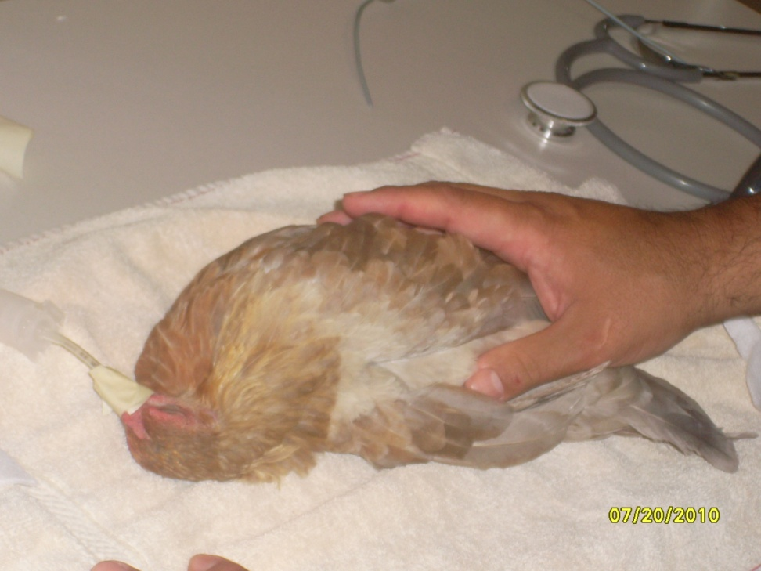
Monitoring
A Doppler, placed on the medial metatarsal artery or radial artery, and a pulse ox, placed over the femur, foot, toe, or humerus are helpful, but nothing replaces vigilantly and constantly observing breathing, and periodically ausculting the HR w/ a stethoscope

Slide 9
Recovery
It is fast
Ensure to maintain optimal temperature of the particular species for faster drug metabolism (and recovery)
Provide a secure and clear airway
Provide adequate analgesia : Butorphanol is administered IM in painful procedures

