Slide 1
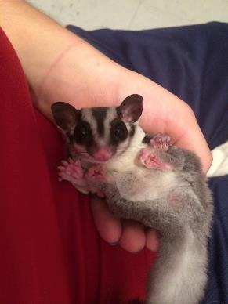
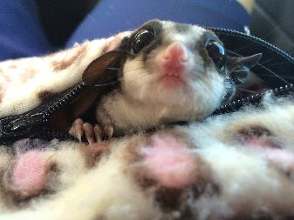
Sugar Gliders
Petaurus breviceps
Meaning: Rope Dancer

Slide 2
What are Sugar Gliders?
Sugar gliders are a small, omnivorous, arboreal and nocturnal gliding marsupials native to Australia and New Zeland.
Sugar gliders are very loving and sweet animals that bond with people. Particularly one person. If socialized correctly they are very sweet toward other humans as well.
They are small animals, about 12" from nose to tail tip!
Sugar gliders are a very primitive form of marsupial mammal whose basic design has not changed in over 114 million years.

Slide 3
The skin between the hand and foot is called the patagium
Eyes protrude from the head and are wide set to see better in the dark.
Ears can move independently of each other for better sound gathering.
Great sense of smell to locate food and recognize their territory.
The tail is used as a ‘rudder’ to steer when they are gliding from tree to tree (or person to person)

Slide 4
Anatomy
Sugar gliders have a cloaca
Their patigum is the extra flap of skin between their front and back legs that outstretch when they parachute out to glide.
They are known to glide up to 90 meters in the wild. That’s 295 feet and about 98.425 in yards.
Sugar gliders have a pair of grooming claws on their second and third toes that are connected tightly together. Often called a "grooming claw" they use their feet to brush their fur and catch any foreign objects between these two nails, which they will then lick out and continue their grooming.
Female gliders have a pouch right above their cloaca where they will hold their joeys after birth.

Slide 5
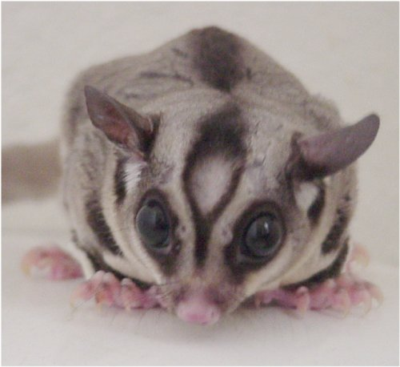
Anatomy Cont..
Both male and female gliders have a scent gland on the top of their head and chest.
Only males have a bald spot on their head due to the hormone secreted from the gland that they use to mark their territory. Their bald spot is an easy way to indentify If the glider is either male or female without checking the genital area.
Sugar Gliders hands AND feet each have four fingers and opposable thumbs.
Sugar gliders tails are about 6 inches long and help them balance when climbing or even in the air when they are gliding.

Slide 7
Joey

Slide 8
Crawling to pouch

Slide 9
Life Stages

Slide 10
Life Stages cont…

Slide 11
Life Stages cont…

Slide 12
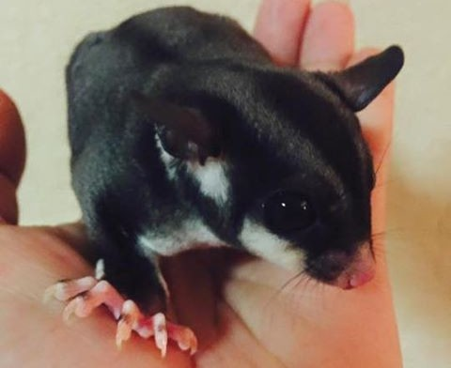
Variation of color

Slide 13
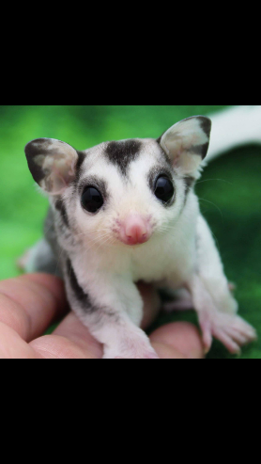
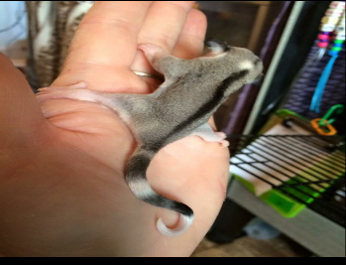

Slide 14
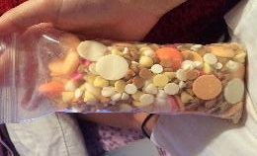
Nutrition
In the wild sugar gliders eat sap and gum from eucalyptus and acacia trees, nectar from eucalyptus blossoms and variety of insect
Their diet consist of Protein (staple diet), fruits, & veggies.
There are multiple staple diets to choose from for example: BML, HPW, TPG, PML, LGRS suggie soup, AWD, ect…
For every staple diet their are specific fruits & veggies to feed with.
Sugar Gliders love yogis for treats but must be given in moderation because they are fattening. They also love dried fruits, honey, crackers, almonds, and life savers, ect…
For an additional protein source you can feed them mealworms, crickets, dubia roaches, wax worms, horn worms, and more insects.
Sugar gliders can NOT eat anything that contains chocolate, garlic, or onions! NO CACA

Slide 15
Diets

Slide 16
What NOT to feed!

Slide 17
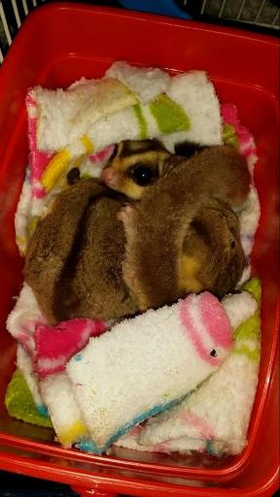
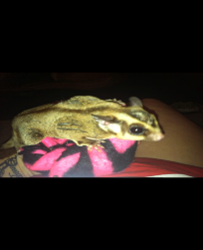
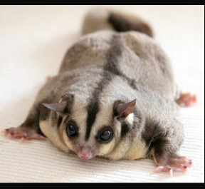
Malnutrition in sugar gliders
Malnutrition leads to hypocalcemia, hypoprotinemia, and anemia

Slide 18
Cage settings and environmental needs
A sugar glider's normal body temperature is about 87-88º F (31ºC), around 10º F cooler than a human's body temperature.
They should be housed between 67º-85º F (19º-29º Celsius).
Sugar gliders must have a big cage so they have plenty of room to glide and jump around in at night when they are out to play.
A good cage size for a pair of sugar gliders is 24 inches deep by 24 inches wide by 36 inches tall (minimum). Larger is always better, keeping in mind that height is important for the gliders. Also space between bars is an issue with gliders. They love to try and escape so wiring should be no more then a ½ inch.

Slide 19
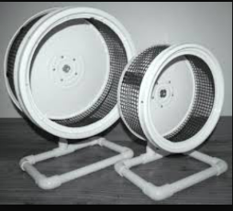
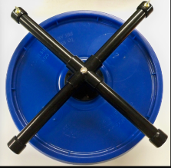
Cage Sets & Wheels
GUS GUS

Slide 20
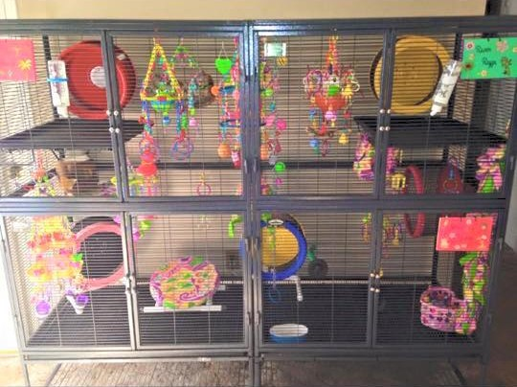
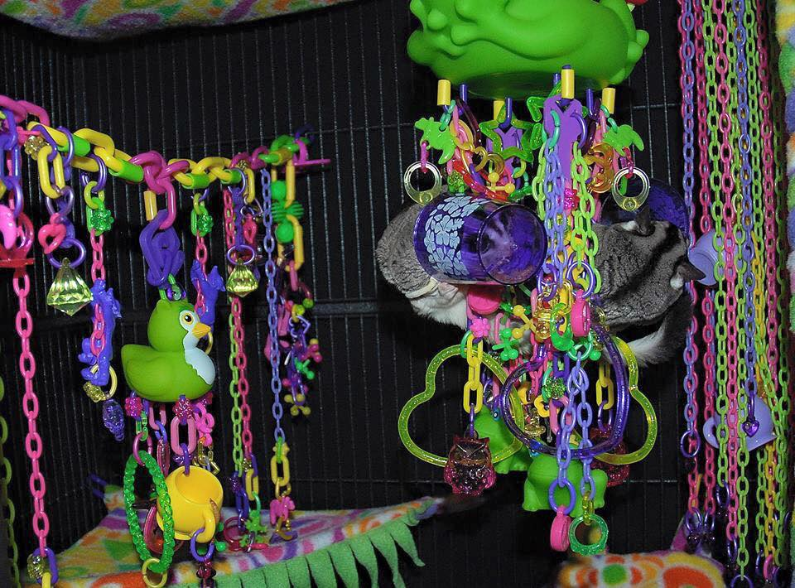
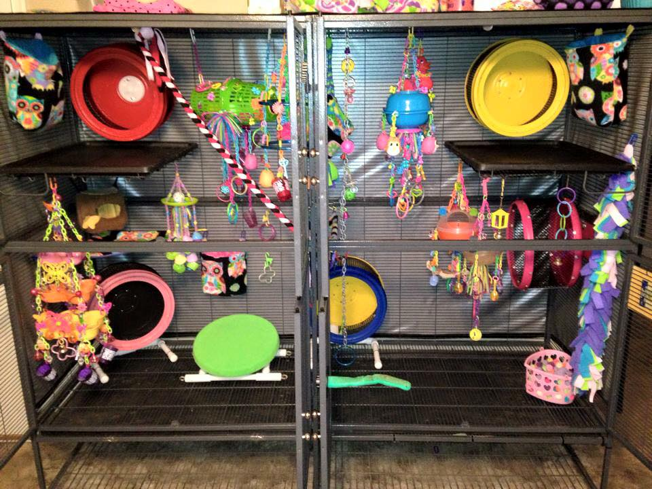
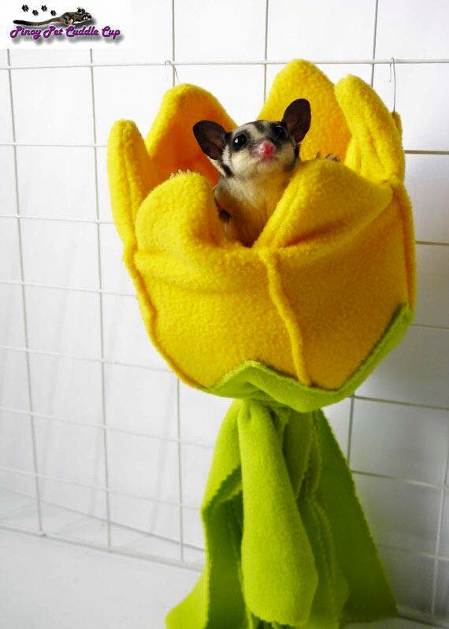

Slide 21
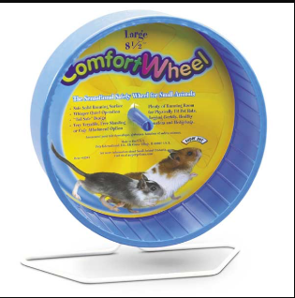
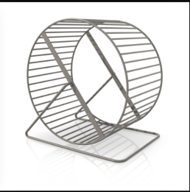
Wheels NOT to use

Slide 22
FUN FACTS:D
When sugar gliders are born they are about the size of a grain of rice.
Sugar gliders have 10 different sounds that they make, all meaning different things.
Mating season takes place from June to January, with a peak in June and November.
Males penis is bifurcated and females have two cervices.
3 most common blood collection sites are the jugular, cranial vena cava, and medial tibial artery. You can also get blood from cephalic, saphenous, lateral tail veins, and femoral.

Slide 23
Physical exams in clinic
Observe glider from cage before removing
Check for balance, any obvious injury, nasal or eye discharge or bleeding
A thorough and complete physical would require masking down to better handle the animal
The owner may be required to assist

Slide 24
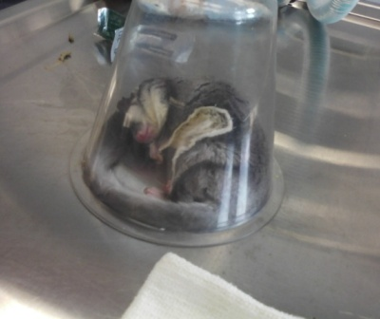
Physical Examination
Sugar gliders can be challenging to examine without sedation. A through history should be taken first .
Biological Data:
Weight range 95-160 grams
Body length 16-21 cm
Heart rate 200-300 beats per minute
Respiration rate 16-40 breaths per minute
Rectal temperature 96.5º - 97.9º
Gestation 15-17 days, young leave the pouch at 70 days
Weaning age 110-120 days
Life span 9-12 years

Slide 25
Blood Collection
Blood samples may be obtained from the cranial vena cava, jugular vein, medial tibial artery, or lateral tail vein. Blood volumes of up to 1% of body wt can be collected; typically 0.5–1 mL is obtained.
A 27 gauge needle or insulin syringe is indicated

Slide 26
Common Diseases
Nutritional Osteodystropy
Trauma
Dental diseases
Obesity
Stress related

Slide 27
obesity
The biggest problem is obesity.
Poor diet and lack of exercise can be deadly.
Their delicate bone structure cannot support obesity and their bodily systems will begin to fail.

Slide 28
Eye Abscesses
Eye injury can be caused from fighting, or trauma from a fall.
Because their eyes are so large, damage can be severe.
Immediate treatment is required.

Slide 29
Questions?

