Slide 1
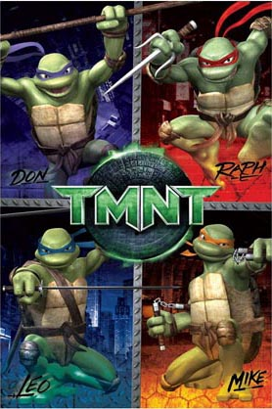
Chelonians

Slide 2
Chelonian Taxonomy
Order: Chelonia/Testudines
2 Suborders:
Pleurodira ( 2 families, approx. 75 spp.)
Side-neck turtles: unable to retract neck
Aquatic – semi aquatic
Cryptodira ( 11 families, approx. 200 spp.)
Able to retract neck straight back into shell
Terrestrial, aquatic, and semi-aquatic

Slide 3
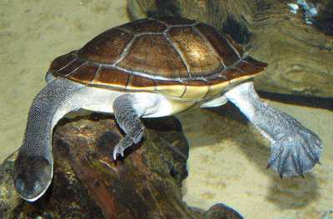
Chelonian Taxonomy
Suborder Pleurodira
Pelomedusidae
Chelidae
Mata Mata
Snake Neck Turtle

Slide 4
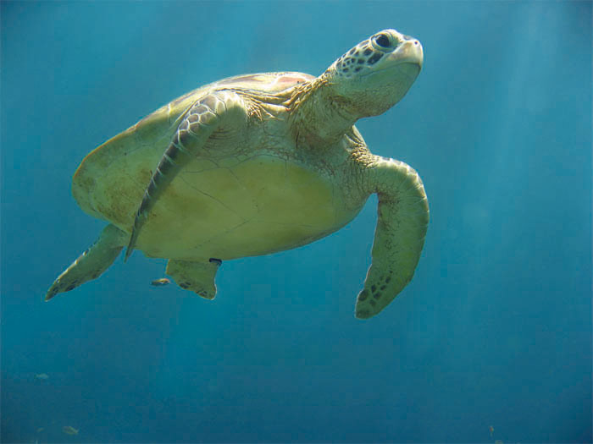
Chelonian Taxonomy
Suborder Cryptodira
Chelonidae: marine turtles
Chelydridae: snapping turtles
Emydidae: pond & river turtles
Kinosternidae: mud & musk turtles
Testunidae: land/true tortoises
Trionychidae: soft-shelled turtles
www.answersingenesis.org

Slide 5
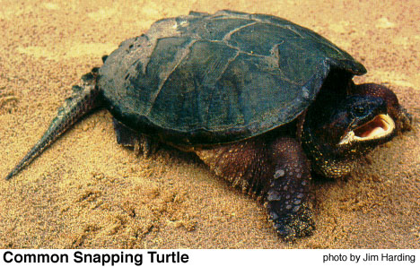
Chelonian Taxonomy
Suborder Cryptodira
Chelonidae: marine turtles
Chelydridae: snapping turtles
Emydidae: pond & river turtles
Kinosternidae: mud & musk turtles
Testunidae: land/true tortoises
Trionychidae: soft-shelled turtles
www.commons.wikimedia.org
Alligator Snapping Turtle
www.kbs.msu.edu

Slide 6
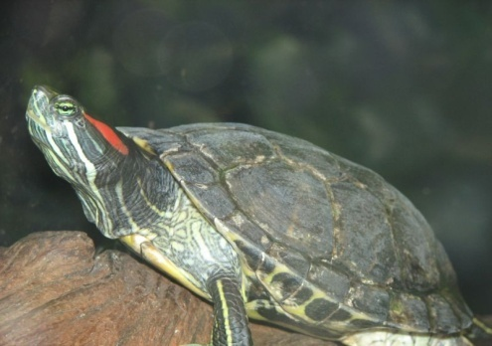
Chelonian Taxonomy
Suborder Cryptodira
Chelonidae: marine turtles
Chelydridae: snapping turtles
Emydidae: pond & river turtles
Kinosternidae: mud & musk turtles
Testunidae: land/true tortoises
Trionychidae: soft-shelled turtles
garyshey.blogspot.com
Eastern Box Turtle
student.britannica.com
Red Eared Slider

Slide 7
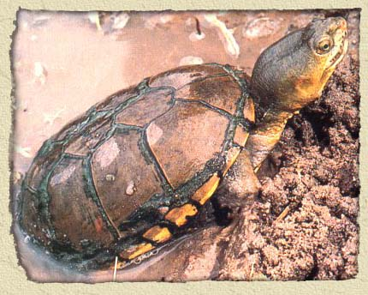
Chelonian Taxonomy
Suborder Cryptodira
Chelonidae: marine turtles
Chelydridae: snapping turtles
Emydidae: pond & river turtles
Kinosternidae: mud & musk turtles
Testunidae: land/true tortoises
Trionychidae: soft-shelled turtles
www.jamesriverpark.org
Musk Turtle
www.rfadventures.com
Mud Turtle

Slide 8
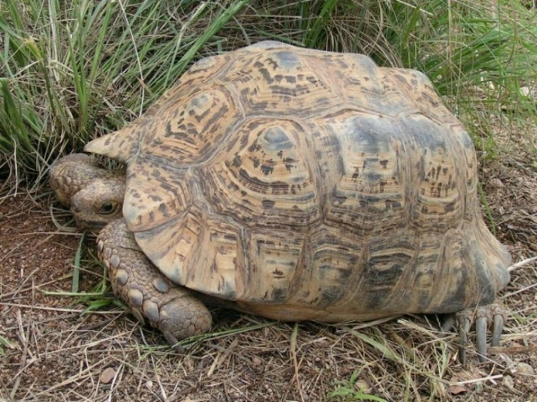
Chelonian Taxonomy
Suborder Cryptodira
Chelonidae: marine turtles
Chelydridae: snapping turtles
Emydidae: pond & river turtles
Kinosternidae: mud & musk turtles
Testunidae: land/true tortoises
Trionychidae: soft-shelled turtles
animals.nationalgeographic.com
Galapagos Tortoise
ivorytortoise.com
Leopard Tortoise

Slide 9
Chelonian Taxonomy
Suborder Cryptodira
Chelonidae: marine turtles
Chelydridae: snapping turtles
Emydidae: pond & river turtles
Kinosternidae: mud & musk turtles
Testunidae: land/true tortoises
Trionychidae: soft-shelled turtles
www.herpnet.net

Slide 10
Chelonian Characteristics
Shell
50 – 60 bones
Fused w/ ribs & vertebrae
Scutes
Shell variations
Trionyx spp. (softshells)
Pancake tortoise
Box and Mud turtles
African hingebacks
www.dfo-mpo.gc.ca

Slide 11
Chelonian Characteristics
Shell
50 – 60 bones
Fused w/ ribs & vertebrae
Scutes
Shell variations
Softshells
Pancake tortoise
Box and Mud turtles
African hingebacks
www.herpnet.net

Slide 12
Chelonian Characteristics
Shell
50 – 60 bones
Fused w/ ribs & vertebrae
Scutes
Shell variations
Trionyx spp. (softshells)
Pancake tortoise
Box and Mud turtles
African hingebacks

Slide 13
Chelonian Characteristics
Shell
50 – 60 bones
Fused w/ ribs & vertebrae
Scutes
Shell variations
Trionyx spp. (softshells)
Pancake tortoise
Box and Mud turtles
African hingebacks
www.birdwatchersdigest.com

Slide 14
Chelonian Characteristics
Shell
50 – 60 bones
Fused w/ ribs & vertebrae
Scutes
Shell variations
Trionyx spp. (softshells)
Pancake tortoise
Box and Mud turtles
African hingebacks
www.americanheadhunters.com

Slide 15
Chelonian Characteristics
Coelomic cavity
Respiration
Skin
Scaled vs. scale-less
Uncoordinated shedding
No external ears
Oviparous
turtlestuff.com

Slide 16
General Husbandry Considerations
Enclosures
Substrates
Temperature
Photoperiod
Light Quality
Humidity

Slide 17
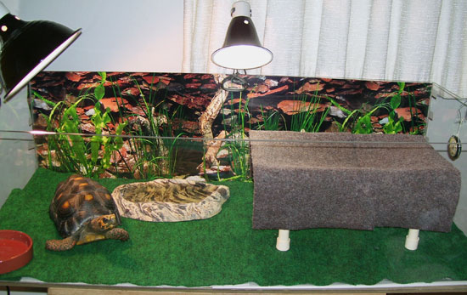
Chelonian Enclosures
Size
~5L x 5L: length x width
Terrestrial
Plastic containers, aquariums, outdoor pins
Semi-aquatic & Aquatic
Aquariums, ponds
Haul out & basking areas
Hiding places
www.ball-pythons.net
advocacy.britannica.com

Slide 18
Chelonian Enclosures
Size
~5L x 5L: length x width
Terrestrial
Plastic containers, aquariums, outdoor pins
Semi-aquatic & Aquatic
Aquariums, ponds
Haul out & basking areas
Hiding places
members.aol.com

Slide 19
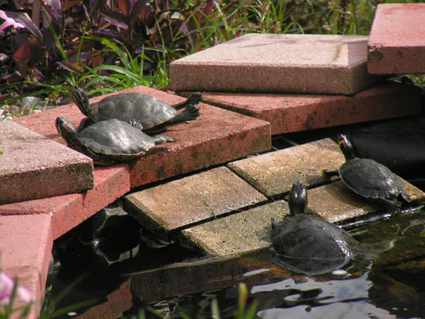
Chelonian Enclosures
Size
~5L x 5L: length x width
Terrestrial
Plastic containers, aquariums, outdoor pins
Semi-aquatic & Aquatic
Aquariums, ponds
Haul out & basking areas
Hiding places
www.unc.edu

Slide 20
Nutrition: Water
Always provide fresh water!
Water bowls
Misting leaves and rocks
Soak terrestrial chelonians daily
Dehydration, gout, renal disease

Slide 21
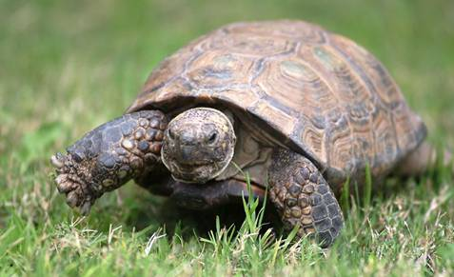
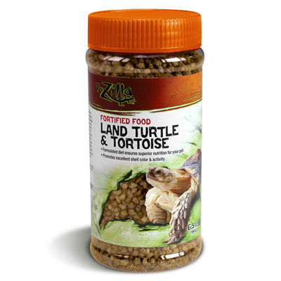
Nutrition: Feeding Herbivores
~ 95% vegetables
Mustard & collard greens, dandelions, kale, parsley, watercress
~ 5% fruit
Grapes, apples, tomatoes, mangos, stawberries
Need vitamin & mineral supplements
Blend together!
www.sdturtle.org

Slide 22
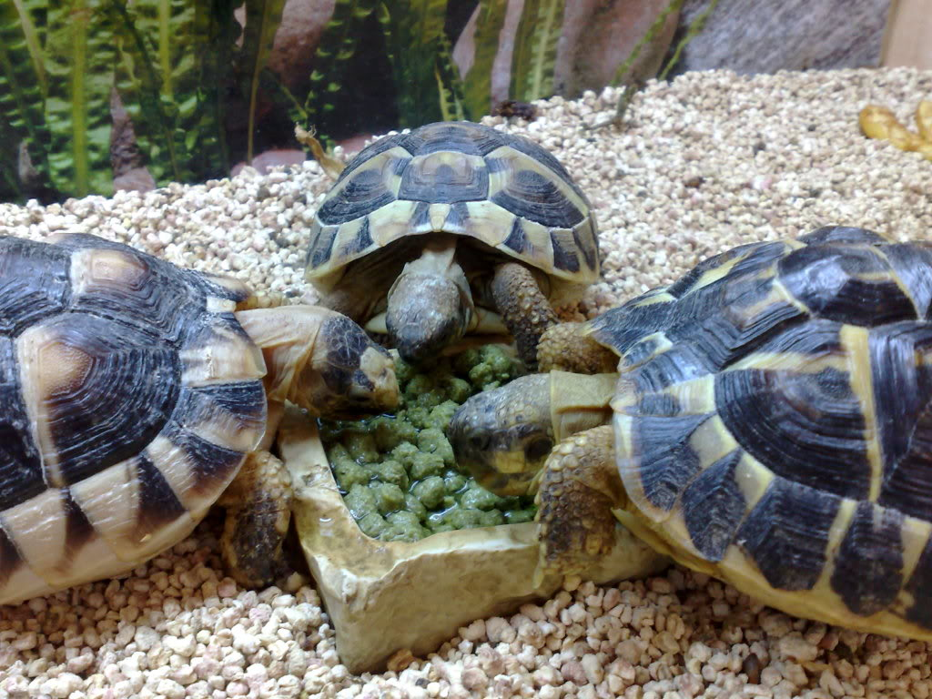
Nutrition: Feeding Omnivores
50% animal/high protein foods
Earthworms, crickets, slugs, snails, pinkies
50% plant material
75% vegetables
-Lettuces, kale, carrots, sweet potato, alfalfa
25% fruit
-apple, orange, banana,

Slide 23
Nutrition: Feeding Carnivores
Turtles:
Whole fish, rats, mice & pinkies, shrimp (w/shells)
Insects in moderation

Slide 24
Nutrition: Feeding Frequencies
Most tortoises: Every other day
Aquatic/Semi-Aquatic chelonians: 2-3x a week
Large carnivorous: Alligator Snapping Turtle 1-2 times a week

Slide 25
Resume Husbandry for Reptiles
Understanding the natural history (anatomy, physiology, habitat requirements, reproductive habits, behavior, longevity) of the patient in question is the greatest diagnostic tool in differentiate between normal health and disease.
Combining this knowledge with the presenting complaint, medical history, physical examination and laboratory data is necessary for the treatment and rehabilitation of the diseased patient.
Read page 40

