Slide 1
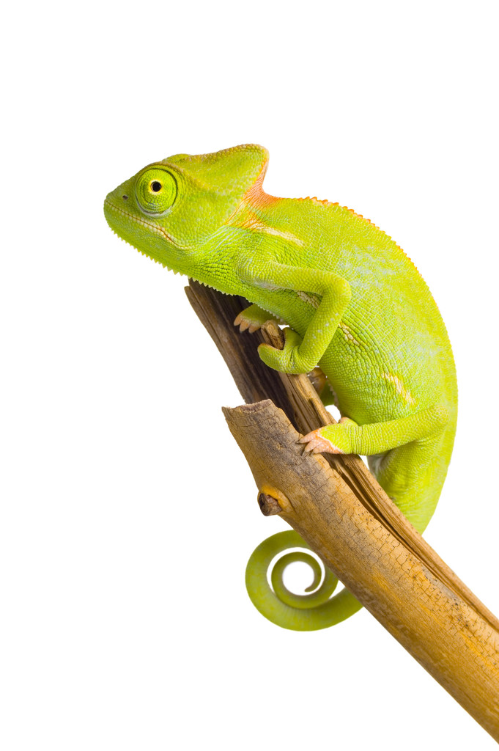
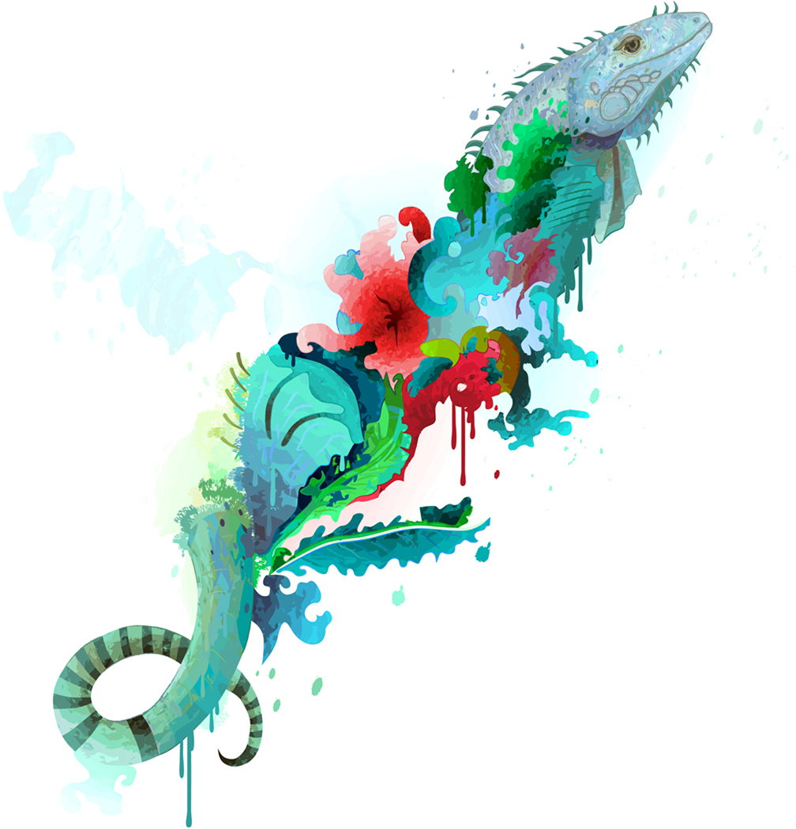
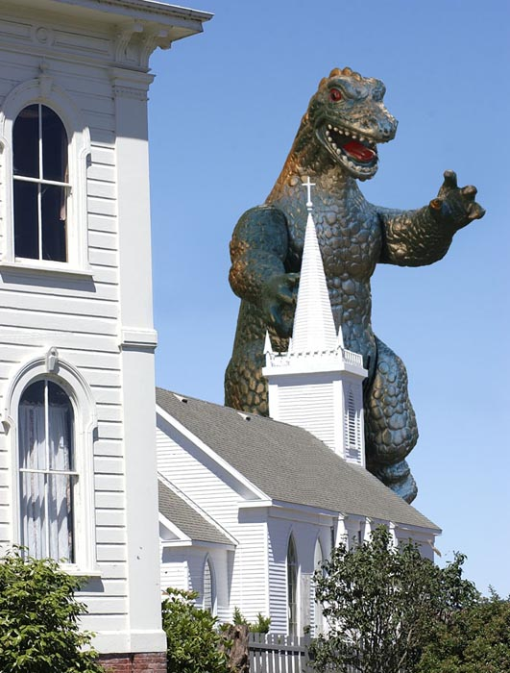
Lizards

Slide 2
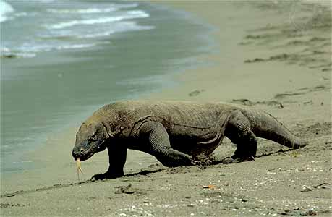
Lizard basics
~ 4,500 spp
Appeared ~ 200 mya
Life span
Smaller < Larger
3-6 years, 10-15 years
Large size variations
Caribbean Gecko: 3-4 cm
Komodo Dragon: 3 m (10ft)
mvhunt.net
student.britannica.com

Slide 3
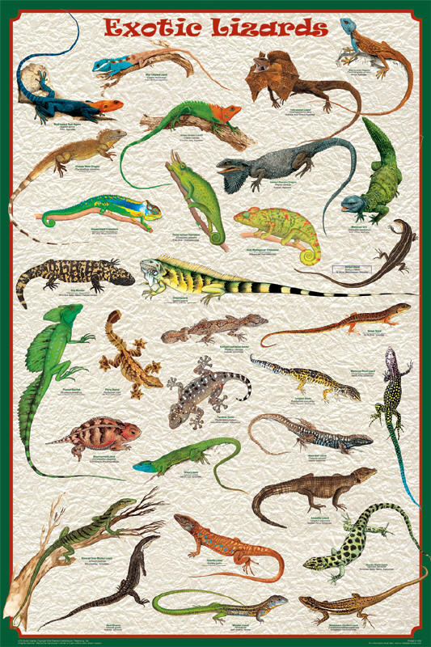
Lizard Taxonomy
Order: Squamata
Suborder: Sauria/Lacertilia
www.feenixx.com

Slide 4
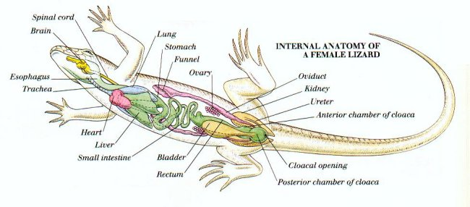
5 Infraorders:
Iguania (10-14 families)
Gekkota (3 families)
Scincomorpha (11 families)
Diploglossa (3 families)
Platynota (4 families)

Slide 5
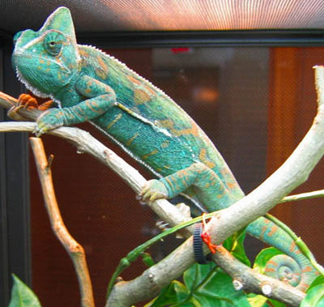
5 Infraorders:
Iguania (10-14 families)
Gekkota (3 families)
Scincomorpha (11 families)
Diploglossa (3 families)
Platynota (4 families)
Green Iguana
www.the-lizard-lounge.com
Veiled chamaeleon

Slide 6
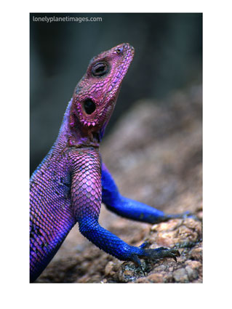
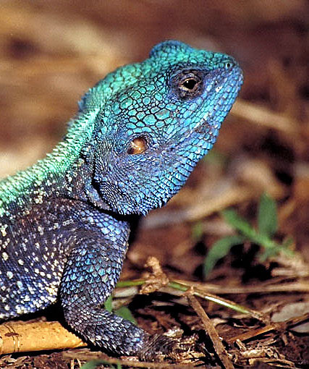
Agamidae Agama

Slide 7
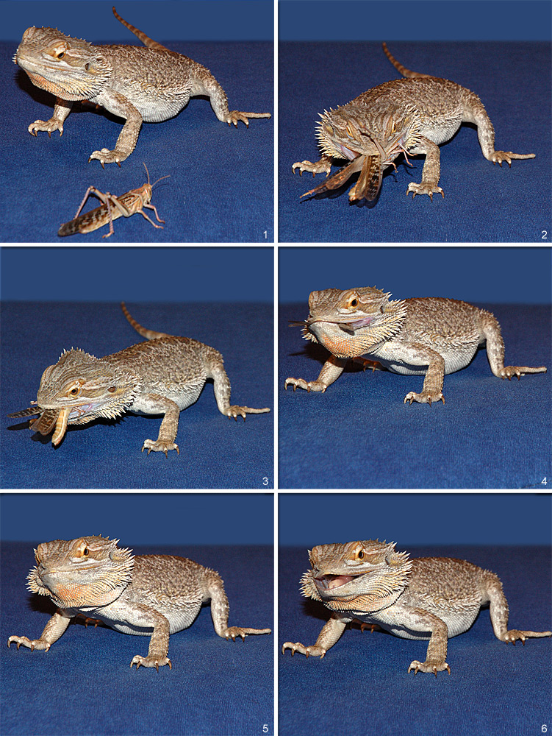
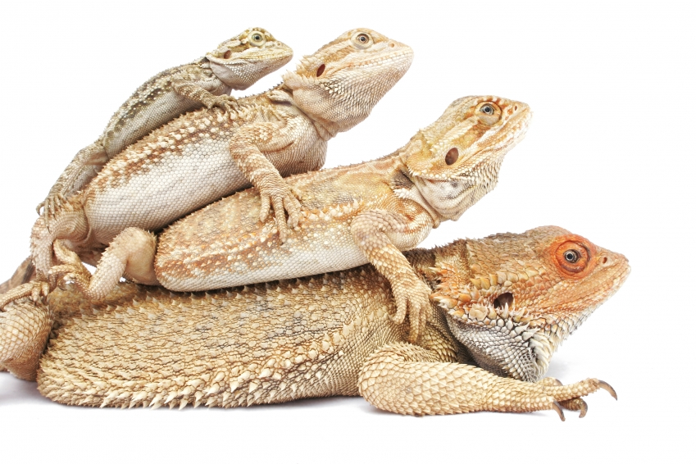
Bearded dragon

Slide 8
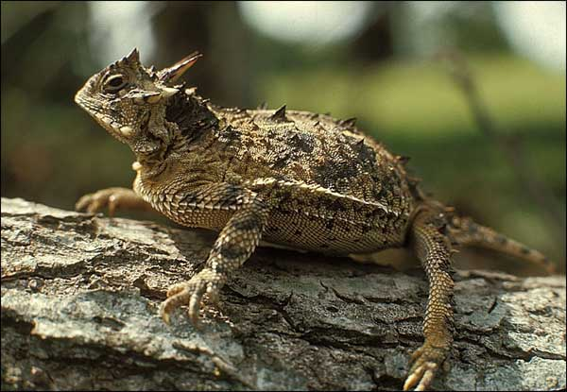
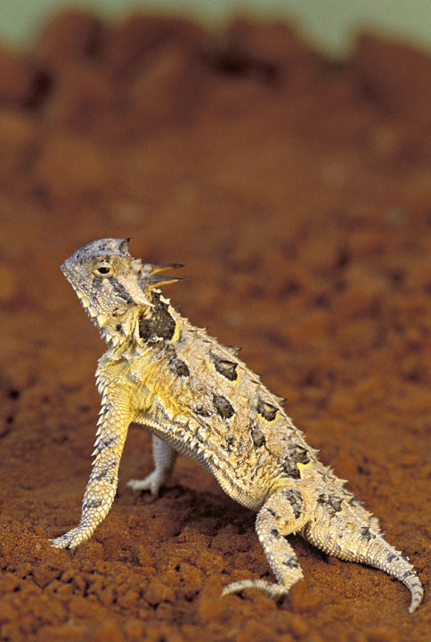
Horned lizard

Slide 9
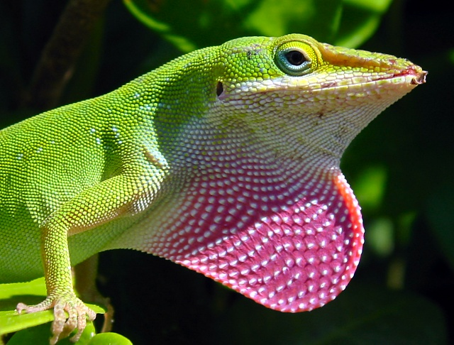
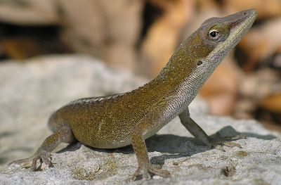
Iguanidae-Green Anole

Slide 10
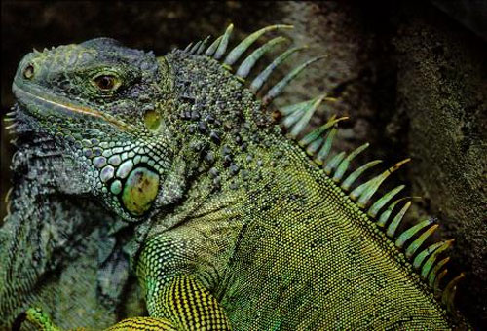
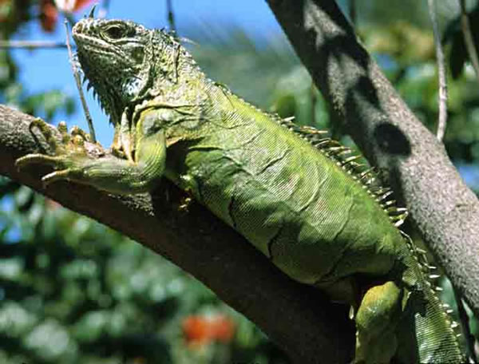
Green Iguana

Slide 11
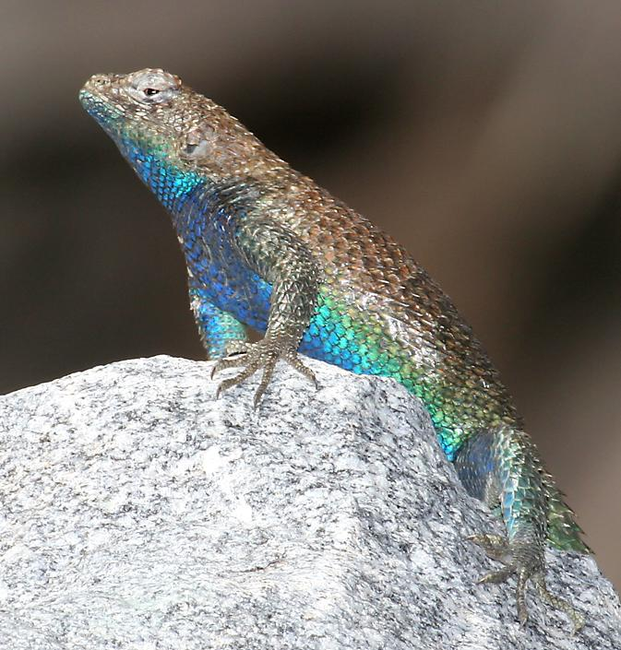
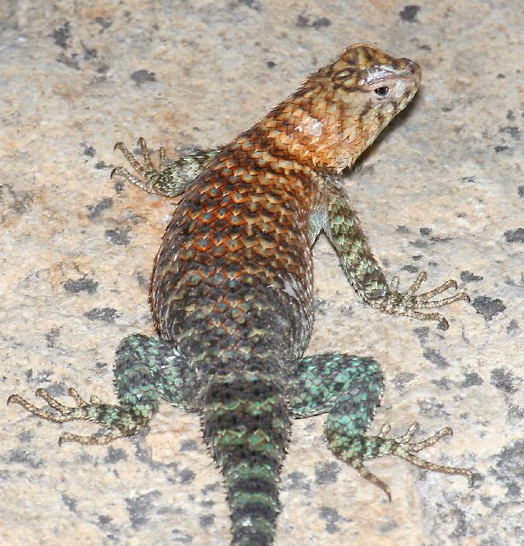
Spiny lizard

Slide 12
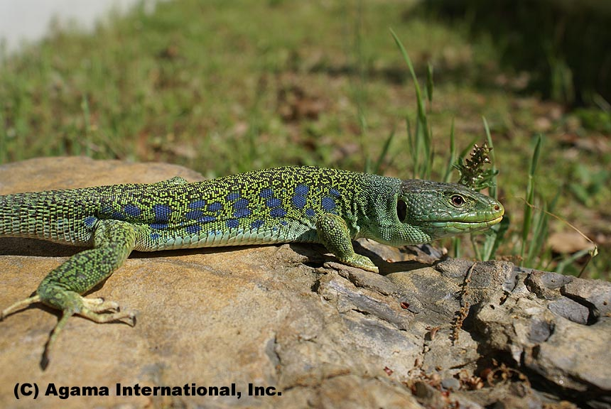
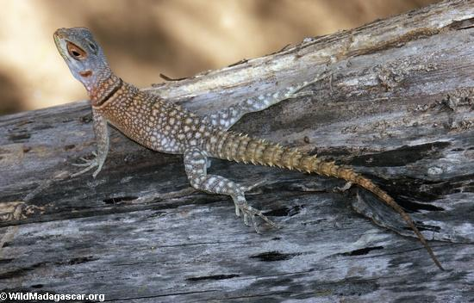
Lacertidae - Jeweled lizard

Slide 13
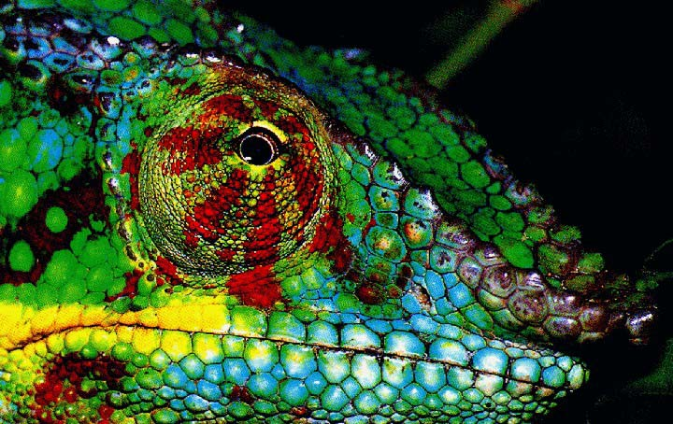
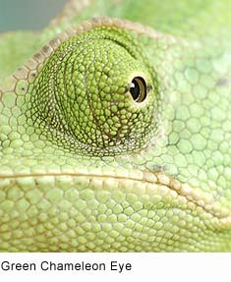
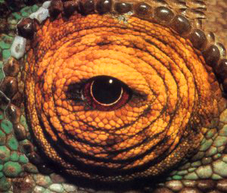

Slide 14
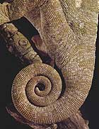
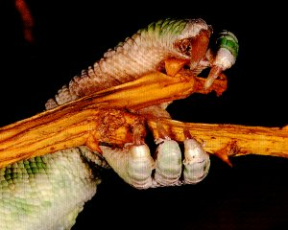
Chamaeleontidae-

Slide 15
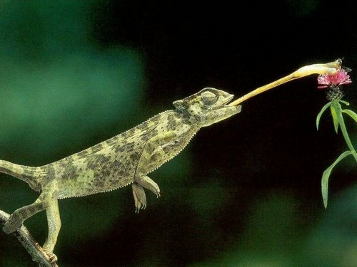

Slide 16
Veiled chameleon

Slide 17
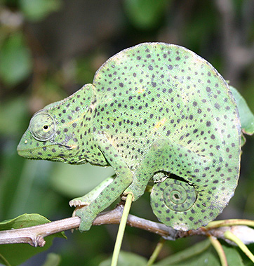
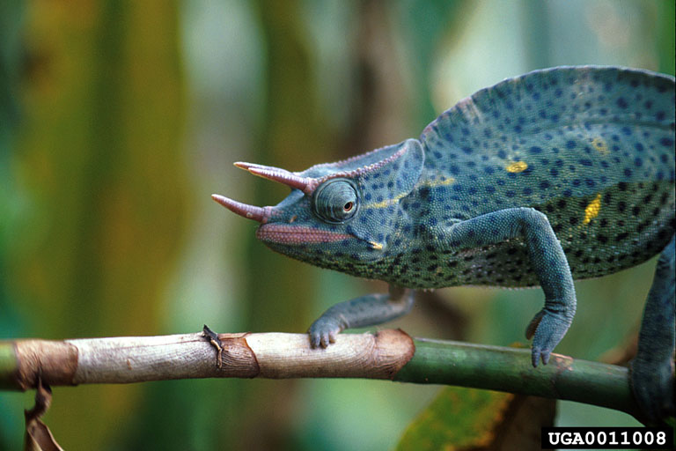
Three horned chameleon

Slide 18
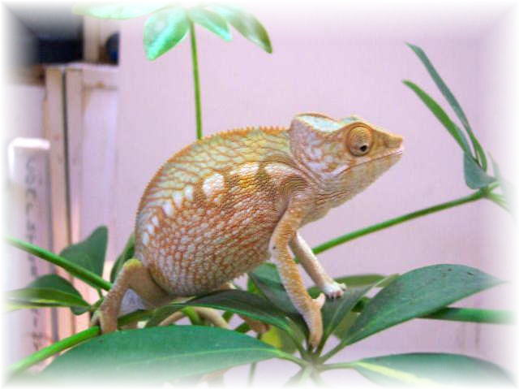
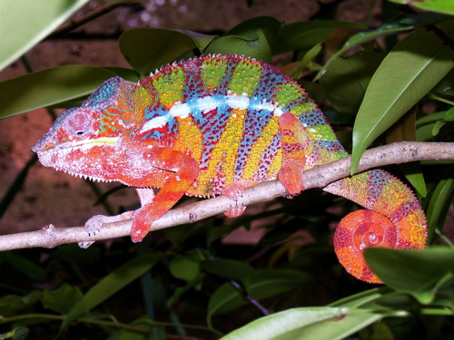
Panther chameleon

Slide 19
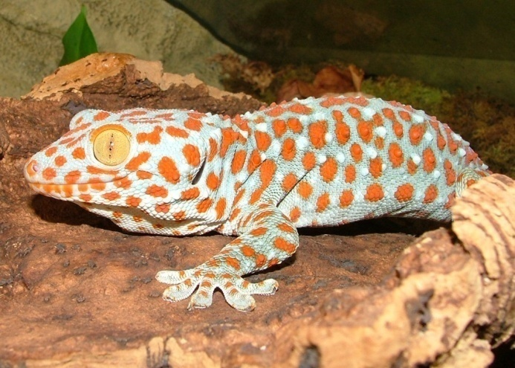
5 Infraorders:
Iguania (10-14 families)
Gekkota (3 families)
Scincomorpha (11 families)
Diploglossa (3 families)
Platynota (4 families)
www.dkimages.com
Leopard Gecko
www.jaysanimalencounters.co.uk
Tokay Gecko

Slide 20
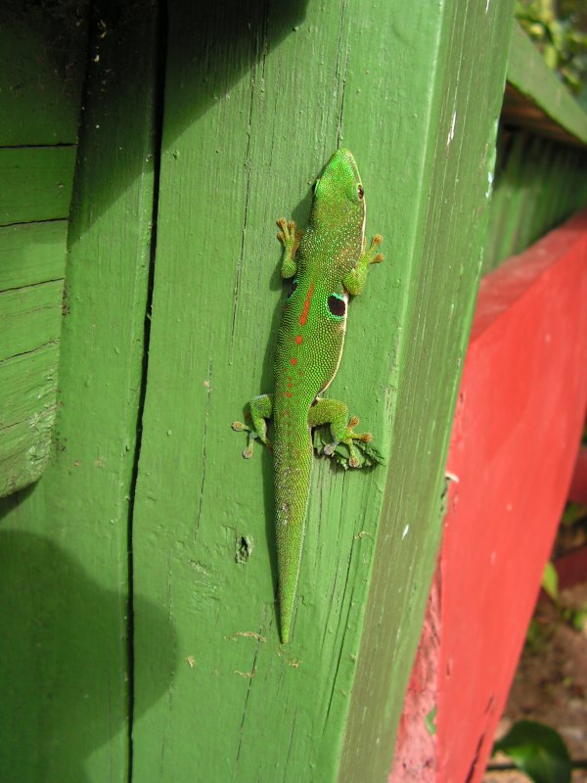
Day geckos

Slide 21
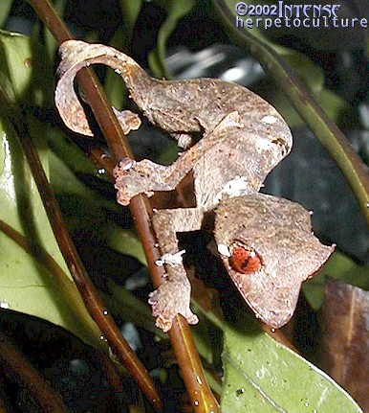
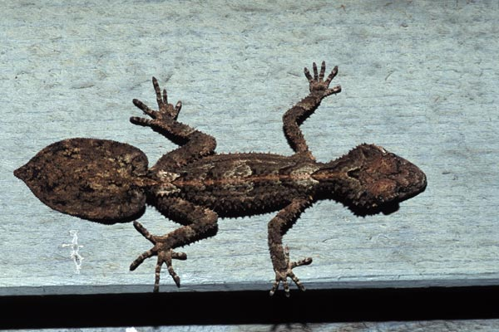
Leaf-tailed gecko

Slide 22
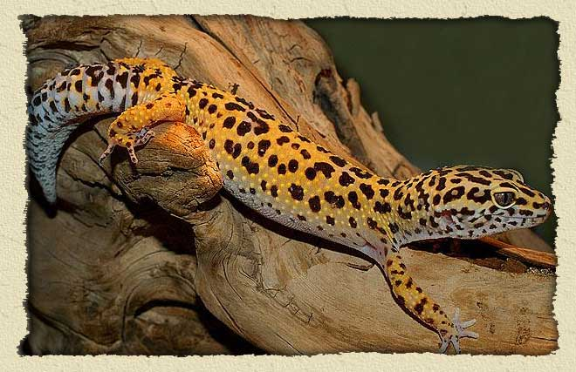
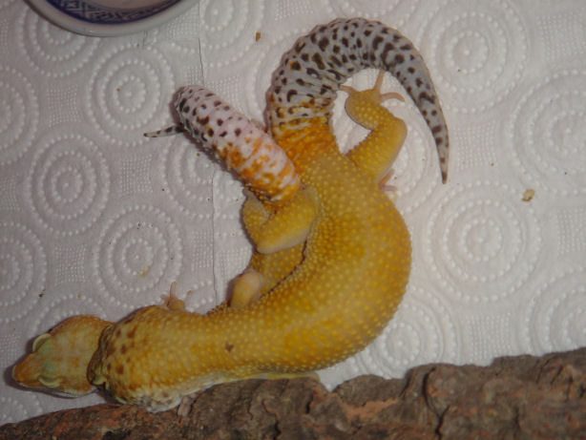
Leopard gecko

Slide 23
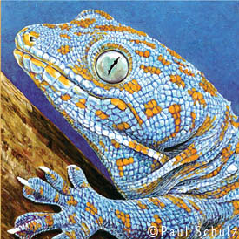
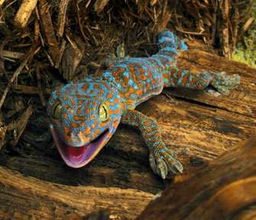
Tokay Gecko

Slide 24
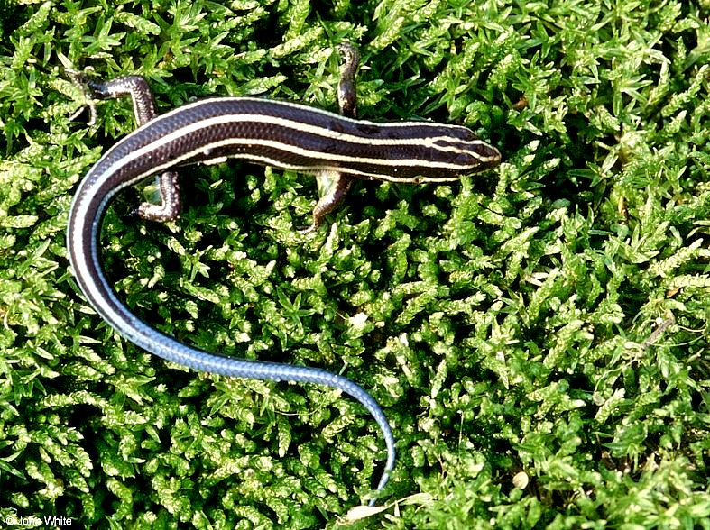
5 Infraorders:
Iguania (10-14 families)
Gekkota (3 families)
Scincomorpha (11 families)
Diploglossa (3 families)
Platynota (4 families)
www.indonesia.faithfreedom.org
Blue-Tongued Skink
www.montgomerycountymd.gov
Five Lined Skink

Slide 25
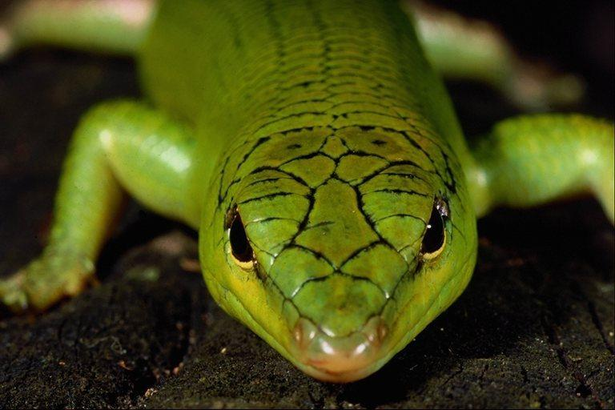
Scincidae – Skinks

Slide 26
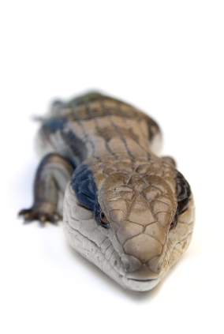
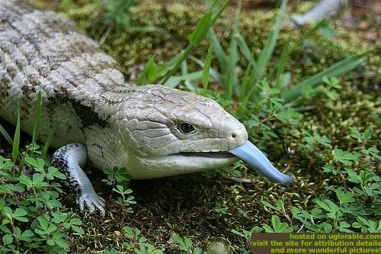
Blue-tongued skinks

Slide 27
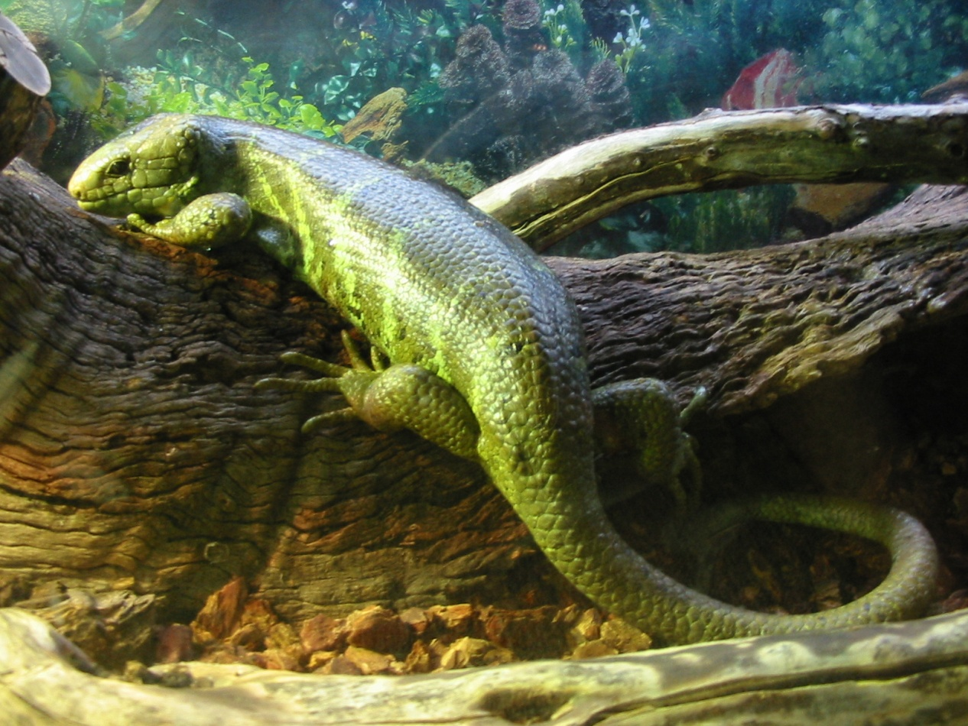
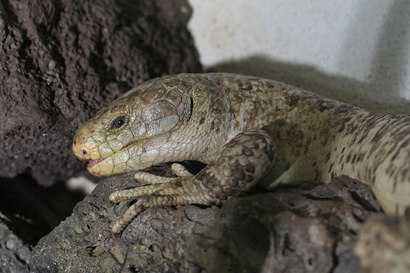
Prehensile-tailed skinks

Slide 28
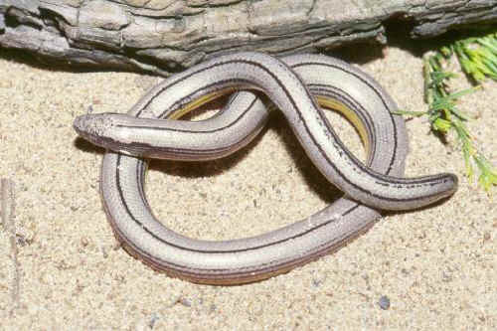
5 Infraorders:
Iguania (10-14 families)
Gekkota (3 families)
Scincomorpha (11 families)
Diploglossa (3 families)
Platynota (4 families)
coolsprings.org
Eastern Glass Lizard
www.curator.org
Legless lizard

Slide 29
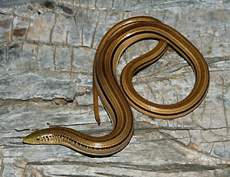
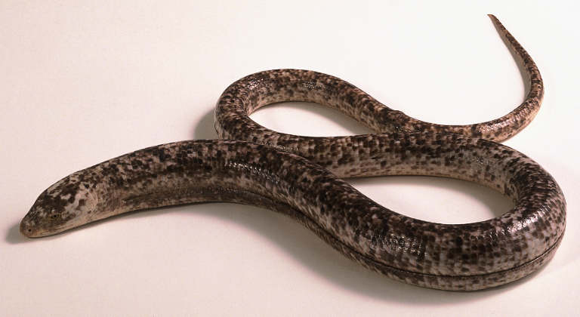
Anguidae- Glass lizard

Slide 30
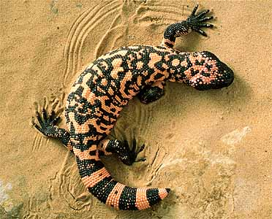
5 Infraorders:
Iguania (10-14 families)
Gekkota (3 families)
Scincomorpha (11 families)
Diploglossa (3 families)
Platynota (4 families)
www.gotpetsonline.com
Savannah Monitor Lizard
www.britannica.com
Gila Monster

Slide 31
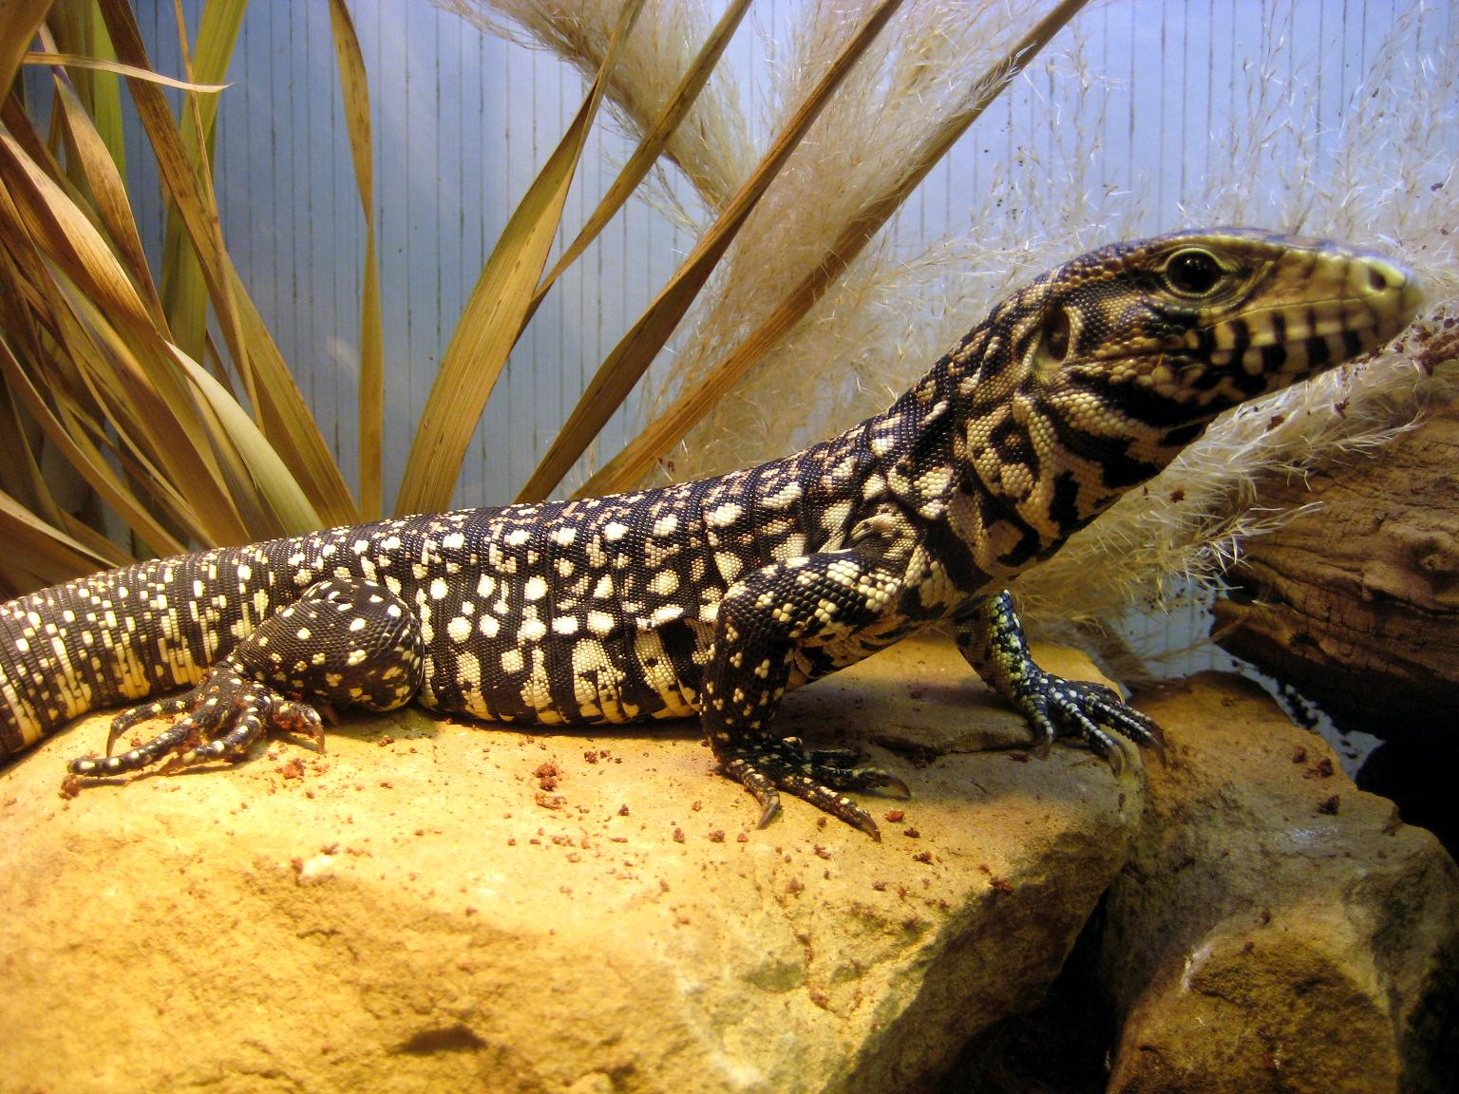
Tegus

Slide 32
Varanidae – Nile monitors

Slide 33
Savannah monitor

Slide 34
Lizard Characteristics
Epidermal scales
Vomeronasal (Jacobson’s) organ
Oviparous vs. Viviparous
Not shared by all:
External ear openings
Tail autonomy
Eyelids

Slide 35
General Husbandry Considerations
Enclosures
Substrates
Temperature
Photoperiod
Light Quality
Humidity

Slide 36
Lizard Enclosures
Size: 3L x 3L
glass, plastic, plexiglass, wood
Climbing spaces: branches, rocks, plants
Basking sites
Hiding places
Escape proof!!!
Tight lids w/ ventilation
www.geocities.com
www.herpcenter.com

Slide 37
Lizard Enclosures
Size: 3L x 3L
glass, plastic, plexiglass, wood
Climbing spaces: branches, rocks, plants
Basking sites
Hiding places
Escape proof!!!
Tight lids w/ ventilation
www.geocities.com

Slide 38
Chameleon
Mash w/PVC frame
Climbing spaces: branches, rocks, natural plants
Water dropping 24hr
Basking sites
Hiding places
Escape proof!!!
Tight lids w/ ventilation

Slide 39
Substrates
Can be artificial or natural
Should be: Inexpensive, easily cleaned, absorbent, digestible, physical support, psychological security
Should not: cause impaction, dermatological disease, respiratory disease

Slide 40
Substrates: The Good
Newspaper
Cypress chips/mulch
Coconut Shells (shredded)
Large rocks
Astroturf
Clean Water

Slide 41
Substrates: The (possibly) Bad
Gravel &small stones
Rabbit pellets
Sand
Dirty Water

Slide 42
Substrates: The Ugly
Cedar shavings
Crushed corn cob
Pecan/walnut shells
Cat litter
www.arcatapet.com
www.canamindustries.com
www.petzoo.co.uk

Slide 43
Temperature
Provide temperature gradients!
Behavioral thermoregulators
Preferred Optimal Temperature Range (POTR)
Necessary for proper:
Metabolic rate
Digestion
Growth
Immune function
Reproductive performance

Slide 44
Temperature
Diurnal - daytime temp
Ambient temp: 27-35ºC (80-95F)
Basking area: 49-54ºC (110-125F)
Nocturnal – daytime
Ambient temp: 21-27ºC (69-80F)
Warmer area: 32-35ºC (90-95F)
Water temp: 24-30ºC (75-85F)
5-7ºC< for nighttime temp
Seasonal fluctuations may be necessary

Slide 45
Temperature
Sources of Heat
Ambient heat
Central heat/AC
Basking area
Incandescent bulbs, Ceramic heaters, heating pads
NO Hot Rocks!!!
Water
Submersible aquarium heater

Slide 46
Temperature
* Always monitor heat with an in cage thermometer!

Slide 47
Photoperiod
General rule:
14 hrs during summer
12 hrs during winter
Temperate zone reptiles:
15 hrs – summer
12 hrs – spring/fall
9 hrs – winter
Tropical spp
13 hrs – summer
11 hrs – winter
Timers can make this very easy!!!

Slide 48
Lighting
Quality very important
UVB – Vitamin D₃
UVA – Behavior
Natural vs. Artificial
Can also provide heat

Slide 49
Humidity
In general: 35% – 70%
If too low:
Dysecdysis, Dehydration
If too high:
Respiratory infections, Dermatitis

Slide 50
Humidity
Humidity boxes
Water bowls
Damp substrate
Humidifiers, Fogging devices
Misting
Monitor with gauges
www.toppetshop.co.uk
www.reptiles.swelluk.com

Slide 51
Hibernation
May be required for temperate and sub-tropical species
General:
Lower temperatures gradually
35 – 50ºF for min. of 10 wks
Access to heat source for sub-tropicals
No feeding
Avoid false hibernation

Slide 52
Nutrition: Water
Always provide fresh water!
Water bowls
Misting leaves and rocks
Chameleons drink water from leaves drops
Dehydration, gout, renal disease

Slide 53
Nutrition: Feeding Herbivores
~ 95% vegetables
Mustard & collard greens, dandelions, kale, parsley, watercress
~ 5% fruit
Grapes, apples, tomatoes, mangos, stawberries
Need vitamin & mineral supplements
Blend together!

Slide 54
Nutrition: Feeding Omnivores
50% animal/high protein foods
Earthworms, crickets, slugs, snails, pinkies
50% plant material
75% vegetables
-Kale, carrots, sweet potato, alfalfa
25% fruit
-apple, orange, banana,
www.the-lizard-lounge.com

Slide 55
Nutrition: Feeding Carnivores
Lizards: pre-killed whole prey
Rodents > chicks > fish>eggs
Ca supplement?

Slide 56
Nutrition: Feeding Insectivores
Most Lizard species!
Common types:
Crickets meal worms, wax worms, earthworms, grasshoppers (special diet or insects),
Captive raised - low Ca
Dusting or “Gut loading”

Slide 57
Nutrition: Feeding Frequencies
Most lizards: Every other day
Large carnivorous lizards: 1-2 times a week

Slide 58
Cleaning
Daily/EOD:
Remove feces and wash bowls
Monthly:
Disinfect entire cage and furnishings
Clean or change substrate
Bleach (1:32 dilution)

Slide 59
Take Home Message
Provide proper thermal gradient and photoperiod
Provide a variety of foods and clean water!
Clean regularly
Be familiar with your species!!!

Slide 60
References
Ackerman L (1997). The Biology, Husbandry, and Health Care of Reptiles. Volume I: Biology of Reptiles. Neptune City, NJ: T.F.H. Publications, Inc.
Ackerman L (1997). The Biology, Husbandry, and Health Care of Reptiles. Volume II: Husbandry of Reptiles. Neptune City, NJ: T.F.H. Publications, Inc.
Barnard SM (1996). Reptile Keeper’s Handbook. Malabar, FL: Krieger Publishing
Ernst CH, Barbour RW (1989). Turtles of the World. Washington, DC: Smithsonian Institution Press
Flank L (1998). Herp Help. New York: Howell Book House
Madar DR (2006). Reptile Medicine and Surgery, Second Edition. St. Louis, Missouri: Elsevier Inc.
Mattison C (1992). The Care of Reptiles and Amphibians in Captivity, Revised Third Edition. New York, NY: Sterling Publishing
McArthur S, Wilkinson R, Meyer J (2004). Medicine and Surgery of Tortoises and Turtles. Ames, Iowa: Blackwell Publishing

