Slide 1
Snakes

Slide 2
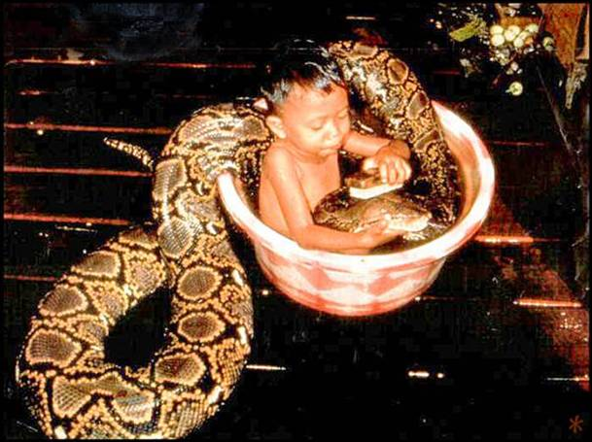
The Plan
Reptiles
Taxonomy + basic biology
Snakes
Taxonomy + basic biology
Sexing
Handling
Husbandry
Nutrition, feeding, & anorexia
Owner precautions

Slide 3
Snake Basics
2500 spp
Life span
Wild vs. captive
Larger > smaller
3 – 40 yrs
Sexual maturity vs. life span
http://michaelcravens.com/sitebuildercontent/sitebuilderpictures/1.jpg

Slide 4
Snake Basics Continued
Habitats
Terrestrial, arborial, aquatic or semi-aquatic, fossorial
Concentrated in tropics
Size
10cm – 10m
Indeterminate growth
http://www.reptileknowledge.com/images/reticulated-python.jpg

Slide 5
Snake or legless lizard?
Moveable eyelids vs. spectacle?
External ears/eardrums?
Ventral scales: single row of large rectangles, or large number of small scales?
www.tailsnscales.com

Slide 6
Snake Taxonomy
ORDER: Squamata
SUBORDER: Serpentes
INFRAORDERS: Scolecophidea, Alethinophidea
http://www.tigr.org/reptiles/trees/SnakePhylogenyWilcox.gif

Slide 7
Boas & pythons
www.b-r-a-s.co.uk
http://www.tigr.org/reptiles/trees/SnakePhylogenyWilcox.gif
http://images.google.com/imgres?imgurl=http://bp0.blogger.com/_

Slide 8
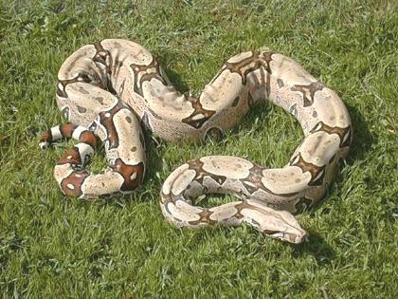
Boas – Common boa

Slide 9
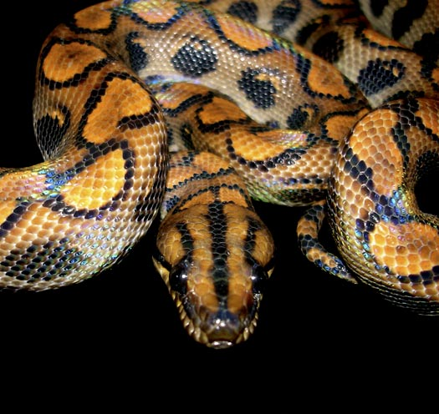
Brazilian rainbow boa

Slide 10
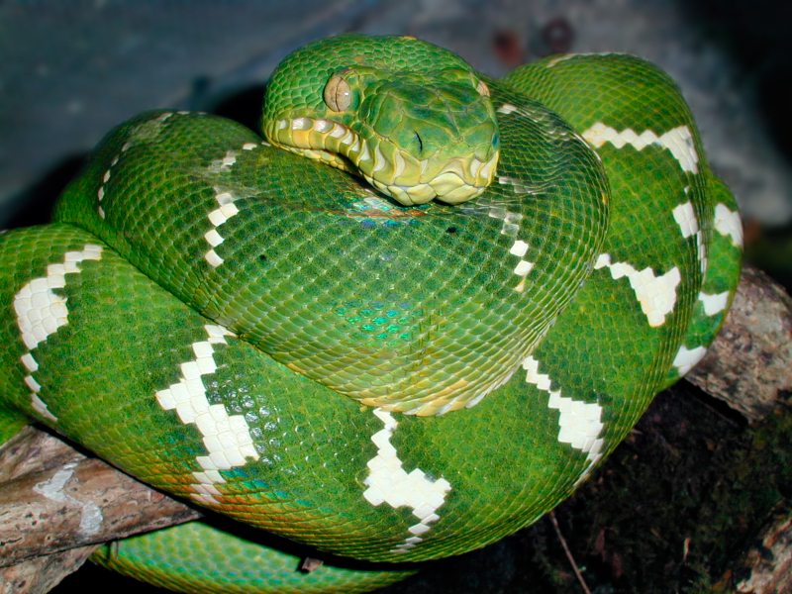
Emerald tree boa

Slide 11
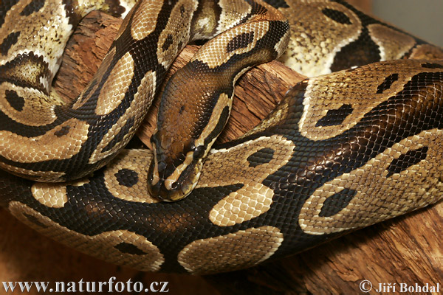
Pythons – Ball python

Slide 12
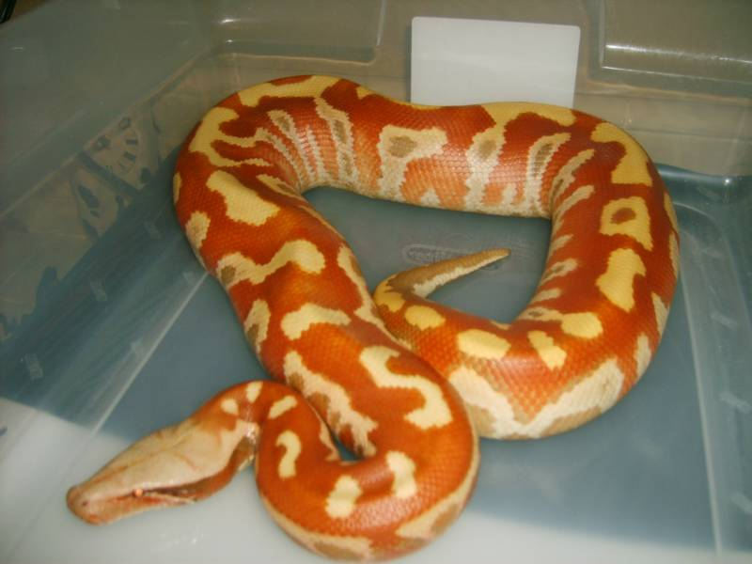
Blood python

Slide 13
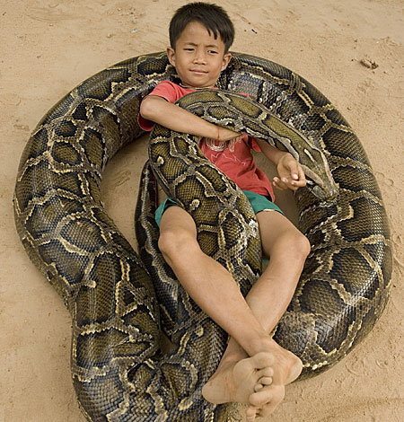
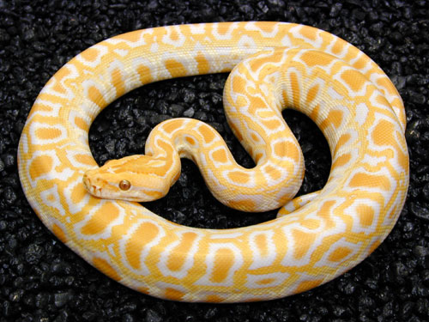
Burmese Python

Slide 14
Burmese Python

Slide 15
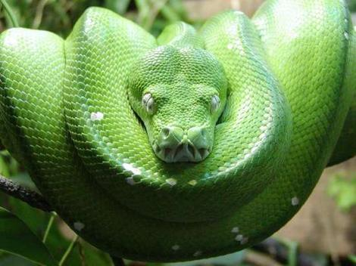
Green tree python

Slide 16
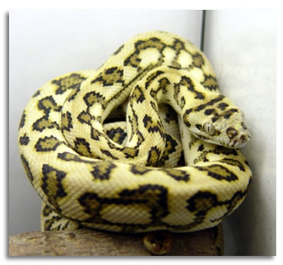
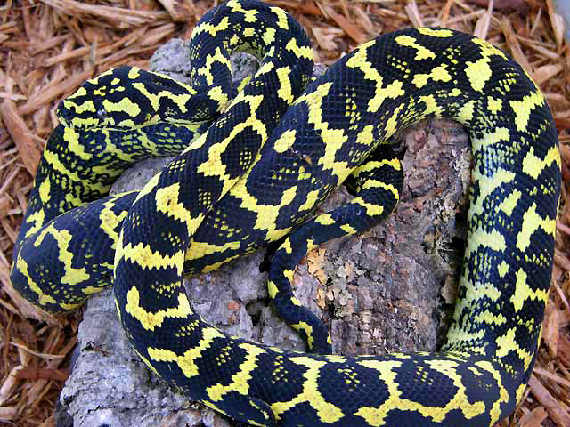
Carpet python

Slide 17
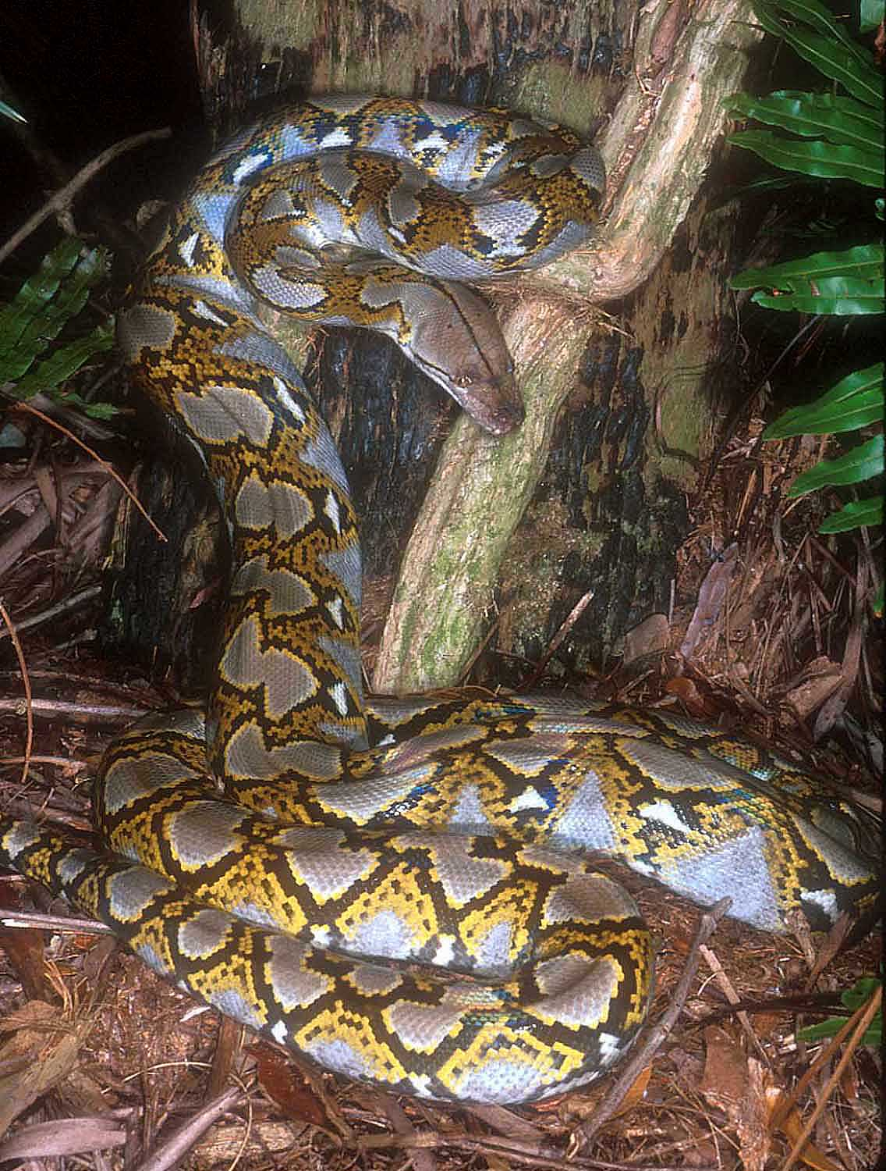
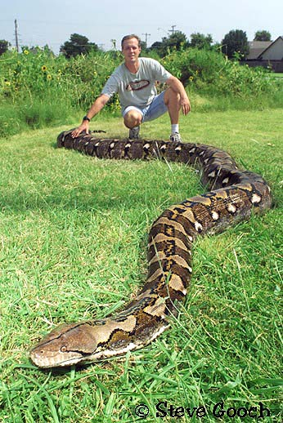
Reticulated python

Slide 18
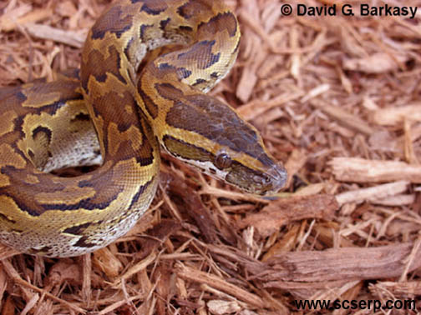
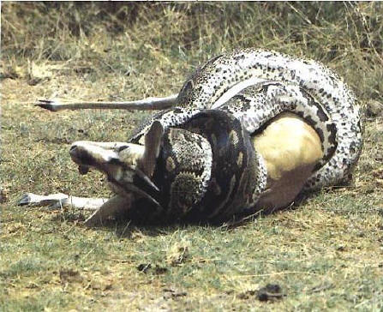
African rock python

Slide 19
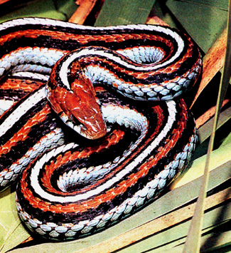
Colubrids: “typical” snakes
http://www.geocities.com/shavano08/sfgs3.jpg
http://www.tigr.org/reptiles/trees/SnakePhylogenyWilcox.gif
http://www.dkimages.com/discover/previews/878/20414221.JPG

Slide 20
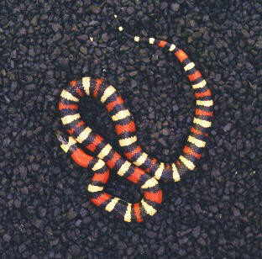
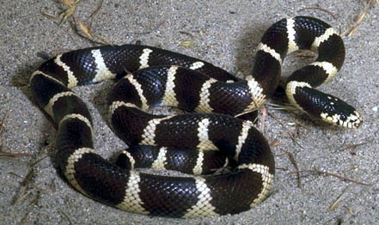
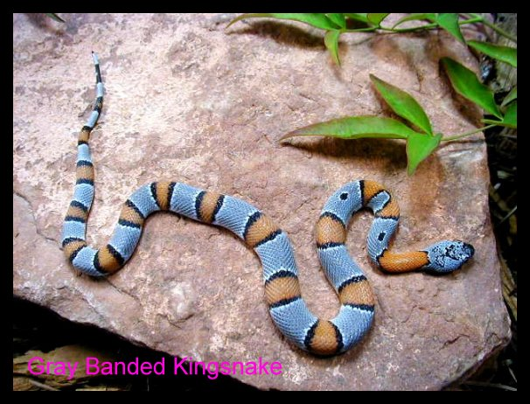
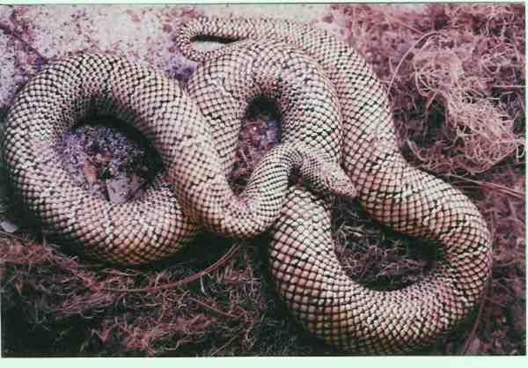
Colubrids - King snake

Slide 21
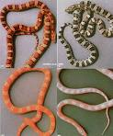
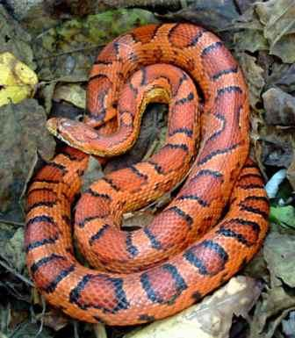
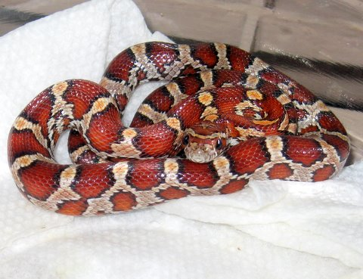
Corn snake

Slide 22
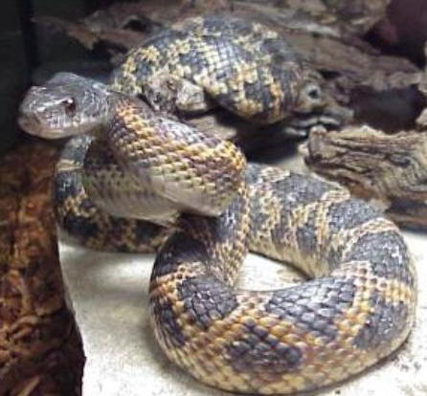
Rat snake

Slide 23
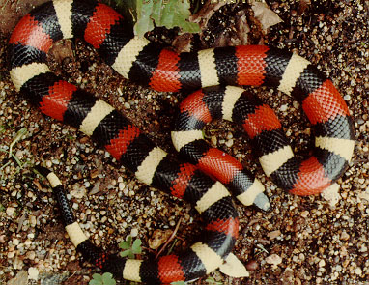
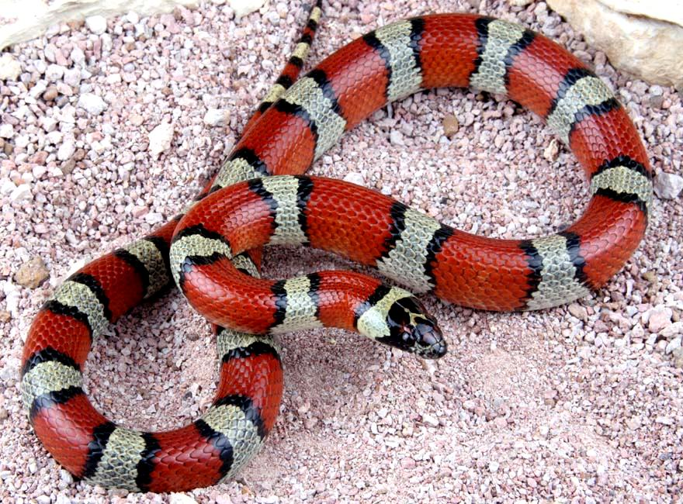
Milk snake

Slide 24
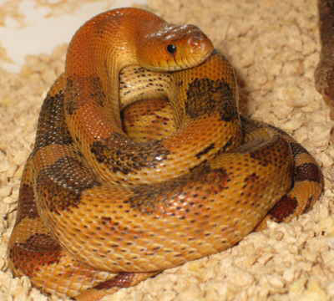
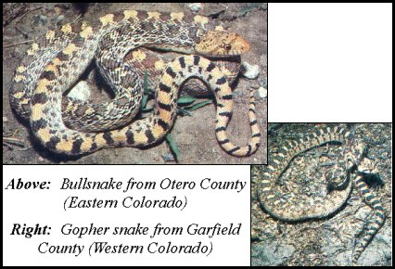
Gopher

Slide 25
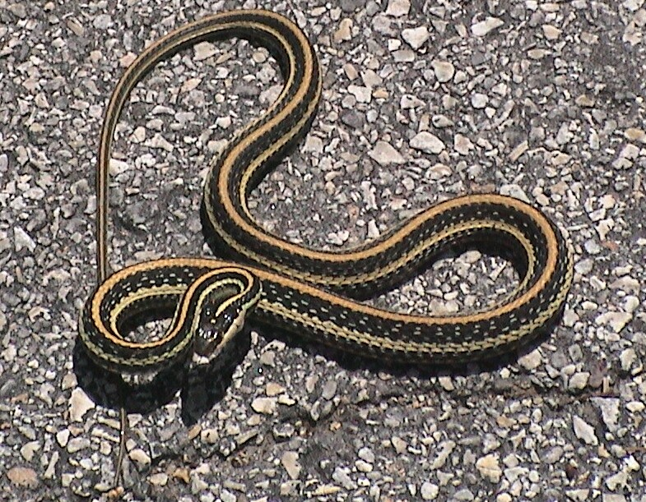
Garter snake

Slide 26
Blind snakes, worm snakes, thread snakes
http://www.tigr.org/reptiles/trees/SnakePhylogenyWilcox.gif
http://www.californiaherps.com/snakes/images/lhhumilis2sd04.jpg

Slide 27
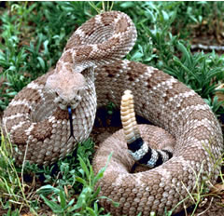
Vipers (Viperids) & pit vipers (Crotalids)
http://www.geocities.com/braguk/Photos/coiledadder.jpg
http://www.tigr.org/reptiles/trees/SnakePhylogenyWilcox.gif
http://www.matrifocus.com/LAM03/images/rattlesnake-opt.jpg

Slide 28
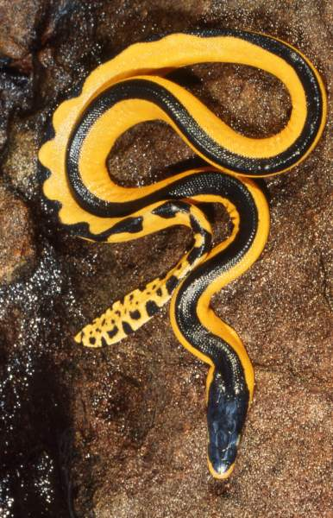
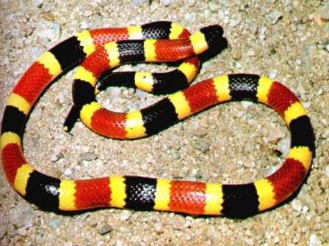
Cobras, mambas, coral snakes, sea snakes
http://www.susanscott.net/images/07-15_yellow-bellied%20sea%20snake%20by%20Hal%20Cogger.jpg
http://www.k12.nf.ca/acreman/learning_logs/king_cobra.JPG
http://www.tigr.org/reptiles/trees/SnakePhylogenyWilcox.gif
http://www.floridasnakes.net/coral-snake.jpg

Slide 29
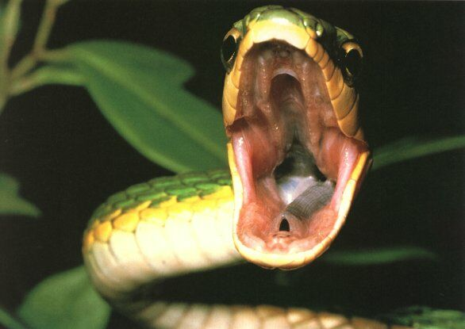
Adaptations of Snakes

Slide 30
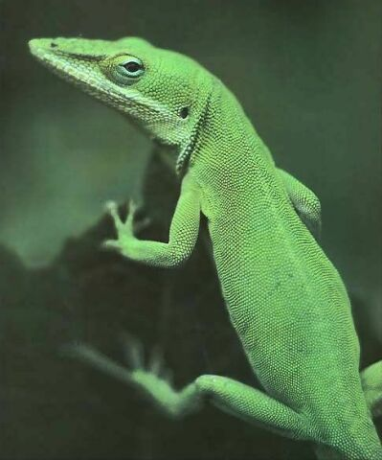
Snakes probably evolved from lizards that lived above ground found during the Cretaceous period.

Slide 31
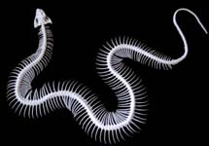
Movement
A snake has a backbone of 100 to 400 vertebrae, each of which has a pair of ribs attached.
- Providing the framework for thousands of muscles
The interaction of bones, muscles, and skin enables asnake to move in one of three basic ways:
1. Lateral undulation
2. rectilinear movement
3. side winding.

Slide 32
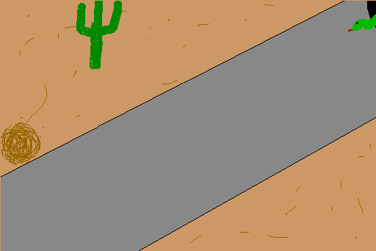
Movement cont.
Most commonly move by lateral undulation.
- moving forward in an S shaped path.
In rectilinear movement, the snake applies muscular force on its belly, not its sides.
- Scutes are scales on its belly that catch on bark orother rough surfaces (like a caterpillar).
Some desert-dwellers snakes progress by side-winding.

Slide 33
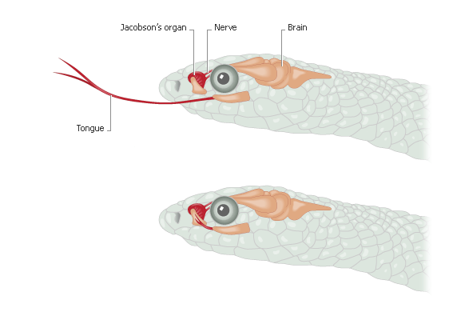
Snake Biology
Lungs: R >>> L
Oviparous vs. ovoviviparous
Hibernation
Ecdysis
Hearing
Jacobson’s organ (special sensory organ in the roof of a snake’s mouth sharpens its sense of smell)

Slide 34
Snake Teeth
Wikipedia.com
Wikipedia.com
www.reptilis.net

Slide 35
Sexing Snakes: Hemipenes
http://campus.murraystate.edu/academic/faculty/terry.derting/cva_atlases/copsnake/Image012.jpg
www.scielo.sa.cr

Slide 36
Sexing Snakes
http://www.cornutopia.com/Corn%20Utopia%20on%20the%20Web/Photo%20&%20Image%20Stockpile%20-%20CornUtopia/Sexing%20corns%20collage%20-%20CAPTION.jpg

Slide 37
Procedure

Slide 38
Sexing Snakes: the easy way
www.amnh.org
http://taggart.glg.msu.edu/isb200/VESTIG.GIF

Slide 39
Snake Husbandry: Enclosure
Space requirements: generally ~3/4L x 1/3L
Glass, plexiglass, plastic
Escape-proof: locking lid with ventilation
www.cranwill.com
http://www.pianomanfan.com/Fluffy/Enclosure.jpg

Slide 40
Snake Husbandry: Substrate
APPROPRIATE
Newspaper/paper
Gravel/pebbles
Cypress/aspen shavings
Course sand (desert snakes ONLY)
Peat/sphagnum (fossorial)
Astroturf
Dried leaves
Natural soil/vegetation (sterilize)
INAPPROPRIATE:
CEDAR/PINE or other aromatic shavings
Fine sand (cloacitis, skin/eye infections)
Sawdust or ground corn cob (resp/GI problems)
Cat litter (dehydrating, skin problems)
THE PURPOSE:
Absorb waste
Not cause problems!

Slide 41
Snake Husbandry: Water
ALWAYS provide fresh water in bowl
Many snakes will drink by sucking or sipping
Large enough for soaking EXCEPT semi-aquatic snakes
www.repvet.co.za

Slide 42
Snake Husbandry: Hide Boxes
Thigmotactism
GOOD: cardboard boxes, ice cream tubs, wooden bird nests, rock caves, hollow logs
Size >> darkness
http://redtailboafaq.com/pictures/02-05-0610.jpg

Slide 43
Snake Husbandry: Other Items in Cage
Shedding surface
Basking areas
Cage mates?
Young vs. adult
Timid vs. aggressive
Feed separately
http://www.boatips.com/images/king%20snake.jpg

Slide 44
Snake Husbandry: Temperature and Ectothermy
Ectothermy: radiation, conduction, convection, evaporation, color
Temperature ranges
Lethal (low = 4C, high = 38-44C)
Critical (low = 10C, high = 35C)
Optimal (18-34C) 64-93F
Temperate/tropical: 25-30C
Desert: 29-33C

Slide 45
Snake Husbandry: Temperature Gradient
VOLUNTARY ACCESS to THERMAL GRADIENT during light photoperiod
Reduce temperature by 5-8C at night
MONITOR with reptile thermometer

Slide 46
Snake Husbandry: Temperature Apparatus
Supplemental heating: room or cage
Heat lamps: OUTSIDE and ABOVE cage, reflected onto basking area
Fluorescent + incandescent bulbs
Infrared heat lamp
Heat rocks/sizzle stones: BAD IDEA

Slide 47
APPROPRIATE
www.petzoo.co.uk
http://www.pets-warehouse.com/pic-s/STR80120.JPG
http://www.hardwarestore.com/media/product/646969_front200.jpg

Slide 48
INAPPROPRIATE

Slide 49
Snake Husbandry: Photoperiod
Photoperiod controls biorhythms
# hours of light/day more important than timing
Temperate: 10-14 hrs light
Tropical: 12-12 hrs light
Increase from min → max in spring, decrease in fall

Slide 50
Snake Husbandry: Lighting
COORDINATE photoperiod with thermal gradient
Natural light or combination incandescent + fluorescent, full-spectrum bulb
EXPERIMENT with wattages and distances
http://sleepytrees.com/forsale/snake/snake_enclosure_open.jpg

Slide 51
Snake Husbandry: Humidity
Tolerate 35-70% humidity
Desert: 30-50%
Subtropical: 60-80%
Tropical: 80-90%

Slide 52
Snake Husbandry: Humidity
Humidity too low
Dehydration, dysecdysis
Humidity too high
Dermatitis
http://web.mac.com/exoticdvm/reptile_archives_2006/Archives_files/IMG_0211.jpg

Slide 53
Snake Husbandry: Humidity
Increase humidity for ecdysis, nesting, newborns
Large water bowl
Misting
Damp substrate
Humidifier

Slide 54
Snake Husbandry: Cleaning
Remove solid feces when noticed
Change bedding as needed (~q3mo)
Gravel: soak in bleach 1:32 for 1hr, rinse, dry in sun
Peat/sphagnum: replace at cleaning

Slide 55
Snake Nutrition: Feeding
Strict carnivores! Whole prey = balanced diet
http://www.bbc.co.uk/blogs/jowhiley/snake_v_alligator.jpg

Slide 56
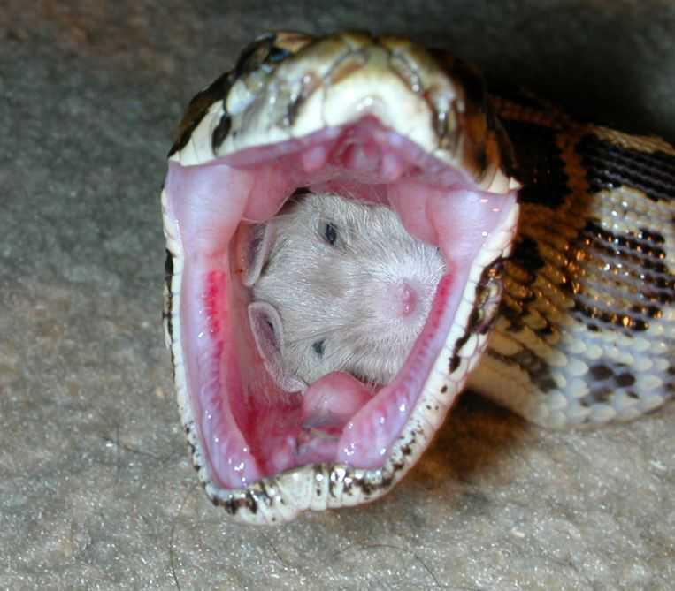
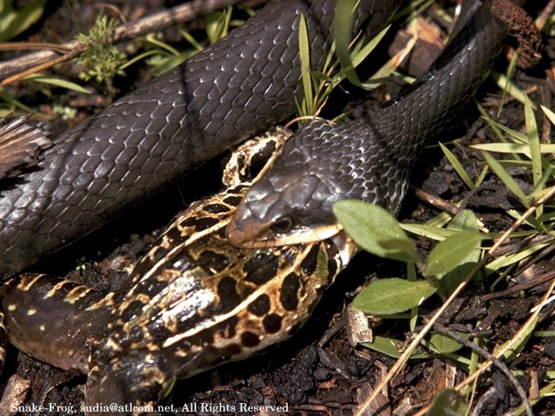
Feeding
Snakes eat animals, but lack structural adaptations common to other carnivores.
Snakes do not see or hear well, and have no limbs, and their teeth and small mouth cannot rip and grind flesh.

Slide 57
Snake Nutrition: Feeding Invertebrate-eaters
Crickets, earthworms, spiders, centipedes, snails, crayfish, termites, grubs
Vary the offering
Calcium supplementation
http://www.australianwildlife.org/images/wildlife/158.gif

Slide 58
Snake Nutrition: Vertebrate-Eaters
Captive-raised, dead whole prey ONLY (no “sausage”)
Generalized vs. specialized
Generalized: rodents, gerbils, rabbits, chickens, fish
Specialized: snakes, lizards, frogs, salamanders
Consider natural history of species (arboreal vs. aquatic, etc)

Slide 59
APPROPRIATE
www.pets-warehouse.com/pic-s/STR70105.JPG
http://www.drsfostersmith.com/images/Categoryimages/normal/p-33253-42495-reptile.jpg

Slide 60
INAPPROPRIATE
http://incontiguousbrick.files.wordpress.com/2007/06/snakeboy.jpg
http://cache.viewimages.com/xc/56631112.jpg?v=1&c=ViewImages&k=2&d=17A4AD9FDB9CF193CC300C081D9F47005D57F23A2A51DDFA66394E604F3FD47EA55A1E4F32AD3138

Slide 61
Snake Nutrition: Feeding Frequency
Overfeeding > underfeeding
Neonates: feed after first shed (10d), q1-3d
Invert eaters: ad lib, 1-week fasting periods
Adults: twice a month or once a month depending of age and size
Boas/pythons: substantial meal twice a month
Feed less: obesity, winter, breeding, ecdysis, stress

Slide 62
Anorexia in snakes
Not eating for >1-2 month
Ddx:
Medical: parasites, neoplasia, organ dysfunction
Husbandry: lighting, temp, hiding places, major life changes, food type, excessive handling/noise, ecdysis, winter, ANYTHING

Slide 63
Anorexia in snakes
Treatment
Rule out medical problems
Feed live pinkies
Fresh kill pray
Scent-transfer technique
Force-feeding: whole prey

Slide 64
Snake Precautions: Salmonella
Gram(-) bacteria
Natural part of reptile gut flora
Opportunistic human pathogen (GI)
Wash hands with soap!
Bleach (1:32)to clean snake stuff
Maybe a snake is not for you . . .
http://barfblog.foodsafety.ksu.edu/snakes-on-a-plane-5(2).jpg

Slide 65
Snake Precautions: Snakebites
Nonvenomous snakebites
Venom contains proteolysins, hemorrhagins, cardiotoxins, cytolysins
Viperid/Crotalid = cytotoxic/hemotoxic
Elapid: neurotoxic
“De-venomed” or “venomoid” snakes
http://www.flatrock.org.nz/topics/animals/assets/snake_bite.jpg

Slide 66
Snakebite First Aid
Remain calm; try to ID snake
Immobilize, loose splint
Remove jewelry/collar
NO tourniquet or ice
NO cutting the wound or attempting to remove venom
GET TO A MEDICAL FACILITY for antivenom/antivenin
http://www.davidbessler.com/wordpress/wp-content/uploads/Picture_085_800x600.jpg

Slide 67
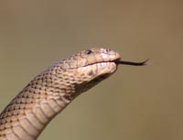
Locating Prey
Snakes evolved a sense of smell which they use to locate their prey.
- By flicking its forked tongue , a snake gathers chemicals from the environment.
The tongue transfers these chemicals to two pits in the roof of the mouth called the Jacobsons organ where the nerves are highly sensitive to the chemicals.

Slide 68
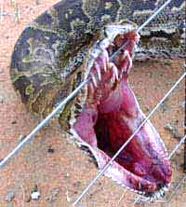
Locating Prey Cont.
Some snakes inject their prey with Toxic venom
most bite down their fangs and inject the poison into their prey.
Venom is chemically complex.
- The hemotoxins are proteins that attack the circulator system, destroy red blood cells and disrupt the clotting power of blood.
- The neurotoxins work on the nervous system, by disrupting the nerve pathways which is dangerous to respiratory and heart functions.

Slide 69
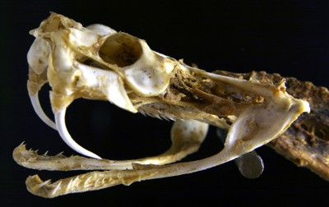
Swallowing and Digesting Prey
A snakes upper and lower jaws are hinged and move independently.
when unhinged, the jaws stretch to allow the mouth to open extremely wide.
While swallowing it whole the snake thrusts its windpipe into the throat, allowing the snake to breathe
- the process of can take several hours.

Slide 70
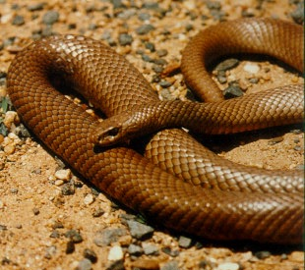
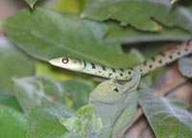
Defense
Natural selection resulted in modifications for defense.
Camouflage is beneficial for both seeking prey and hiding from predators.
- many snakes are green and blend with foliage
- others are brown and hide against the bark of trees

Slide 71
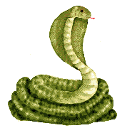
Defense Cont.
Some snakes defend themselves by signaling their presence.
Some ward off danger by rapidly changing body shape
- extending a hood like cobras
Some hiss
Others make mechanical noises
- such as the rattle of the rattlesnake.

Slide 72
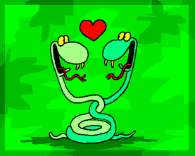
Reproduction
Most male snakes rely on the scent of female snakes of their own species.
Before mating, a male and female snake may glide alongside by side, with the male stroking the female with his chin and flicking his tongue over her body.
Fertilization is internal.

Slide 73
Reproduction
Males tend to mature at a younger age than females.
In some areas snakes can be sexually mature at nine months while a more normal age is around 2 to 3 years

Slide 74
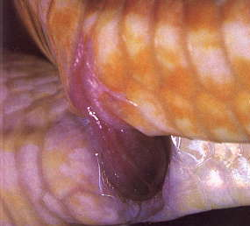
Reproduction
The sexual organs of the male consist of two penises - called hemipenes. The hemipene is covered with flexible spines. Once the male succeeds in penetrating the cloaca of the female with one of his hemipenes it will inflate and the flexible spines will prevent it from being easily dislodged.
The coupling usually last for an hour or two but sometimes it is as little as a few minutes to as long as a two days

Slide 75
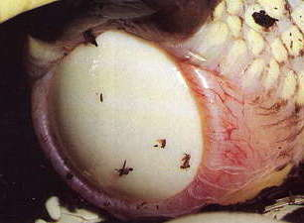
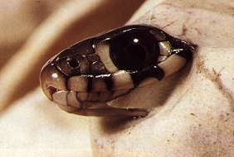
What came first? The snake or the egg?
Most snakes 70% are oviparous
- female lays eggs that hatch outside her body.
- To break out a hatchling uses a special tooth “egg tooth” which is lost soon after.
Other snakes are ovoviviparous
- the female carries the eggs in her body throughout development
the young are born live.
- All newborns must feed for themselves, relying on their many specialized adaptations for survival on land.

Slide 76
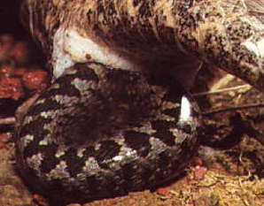
What came first? The snake or the egg?
The other 30% of snakes give live birth. They are ovovivaparous. Which means they hatch their eggs within their bodies. Nearly all snakes living in cold climates use this method.

