Slide 1
Fish Medicine

Slide 2
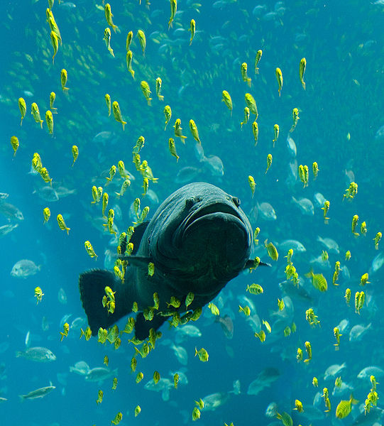
BIOLOGY
At 31,500 species, fish exhibit greater species diversity than any other class of vertebrates.

Slide 3
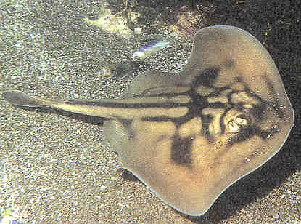
Three Classes of Fish
Agnathan: Jawless fish,
*Hagfish, Lamprey
Chondrichthyes: Cartilaginous Fish
*Sharks, Rays, Skates
Osteichthyes: Bony Fish
* clownfish, Eel, Trout, Marlin

Slide 4
Osteichthyes: Bony Fish
Kingdom: Animalia
Phylum: Chordate
Subphylum: Vertebrate
Class: Osteichthyes
Fish are aquatic vertebrates that are typically Ectotherms (cold-blooded)
Covered with scales
Has a gill cover called an OPERCULUM
Minimal Protective Mucus, nonselective defense against bacteria
Multiple sets of paired fins and unpaired fins

Slide 5
History
The earliest aquaria date back to the Roman Empire. Early Romans kept local freshwater fish in marble tubs, for enjoyment, rather than eating. In the mid-1300s, the Chinese popularized the keeping of goldfish in porcelain bowls. During the 1800s, aquarium keeping began to take off as a hobby among Europeans, and many great strides were made in the science of keeping fish alive in artificial habitats.

Slide 6
History
Around 1908 the first air pump (initially water-powered) was invented, and this is credited as a pivotal moment in the development of home aquaria

Slide 7
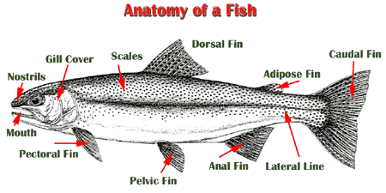
Anatomy and Physiology
The definition of “fish” is an exclusionary that is a vertebrate that lives in the water and is not a mammal, reptile, or amphibian
The universal shape though of when mention “fish” is the torpedo shape stream lined, and flattened laterally

Slide 8
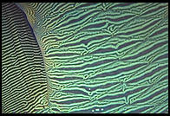
Integumentary system
epidermis
mucous glands (antibiotic properties)
alarm cells
dermis
scales
Notes:
The skin of most bony and cartilaginous fishes is covered by scales. Scales vary tremendously in size, shape, and structure, ranging from rigid armor plates. Scales have many functions, including protection (from the elements and predators) and streamlining for swimming. This outer barrier is further enhanced by a layer of mucus covering the scales. Fish mucus, or slime, has antibiotic properties, and is constantly being renewed. It sloughs off debris and discourages external parasites

Slide 9
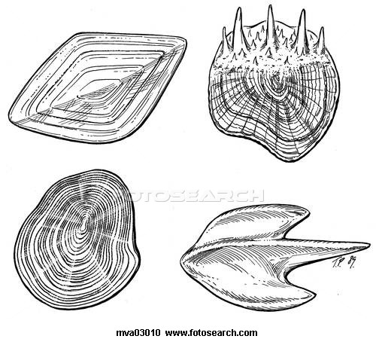
Scales
Ctenoid scales
Leptoid scales
Leptoid scales are flat, basal-looking scales that cover a fish body with little overlapping. They are typical of bony fish and teleost.
Ctenoid scales are similar to the cycloid scales, with growth rings. They are distinguished by spines that cover one edge. Cichlids and perches have this type of scale.
Cycloid scales are small oval-shaped scales with growth rings. Gold fish and salmon.
Placoid scales, also called dermal denticles, are similar to teeth in that they are made of dentin covered by enamel. They are typical of sharks and rays.
Cycloid scales
Placoid scales

Slide 10
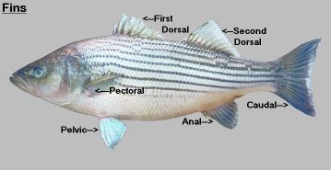
The primary purpose of fins is to assist with the fish’s motion through water, fertilization and protection
Fin Identification
unpaired fins
dorsal
caudal
anal
paired fins
pectoral
pelvic

Slide 11
The primary purpose of fins
Dorsal fin- The dorsal fin of most fish is used for stabilization during swimming
Pectoral fins- Are used during turning and stopping
Pelvic fins- They assist the fish in turning and stopping
Anal fin- On ventral surface of the fish, just behind the cloaca. It is primarily a stabilizing fin
Caudal fin- It is the only fish fin controlled by the skeleton of the fish (the spine). It is used for propulsion in most species.

Slide 12
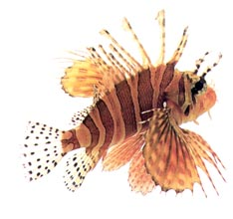
Fins
supported by rays
species also use their fins for internal fertilization (guppies), crawling (mudskippers), and protection (venomous lionfishes).

Slide 13
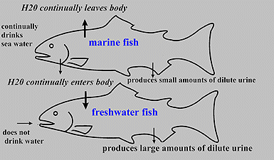
Osmoregulation (is the active regulation of the osmotic pressure of an organism's fluids to maintain the homeostasis of the organism's water content)
electrolyte balance
freshwater vs saltwater

Slide 14
Osmoregulation
freshwater fish
water diffuses in
ions diffuse out
drink little
lots of dilute urine
actively reabsorb ions
kidneys
gills
saltwater fish
water diffuses out
ions diffuse in
drink a lot
concentrated urine
actively excrete ions
kidneys
gills
gut

Slide 15
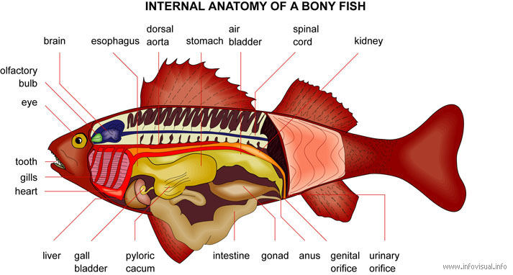
Senses Sight, Sound, Taste and smell. Fish have very well-developed chemical senses, and taste and smell are almost indistinguishable
2.
6
1.
3.
4.
5.
7.
8.

Slide 16
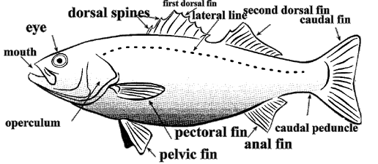
Lateral line
sensory system
a line of pores lead to mechanoreceptors
environmental information
pressure, currents, sound

Slide 17
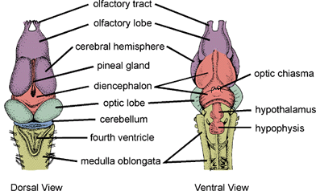
Neuroendocrine system
brain
forebrain
olfactory bulbs
midbrain
optic lobes
cerebellum
spinal cord

Slide 18
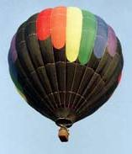
Proprioception (Swim bladder)
Two types
physoclistic
capillary network
physostomatous
pneumatic duct
functions
buoyancy
sound, pressure detection

Slide 19
Respiratory System
Gill Functions
When water is passed over the gills, oxygen is absorbed and carbon dioxide and ammonium is exhaled.
75% of the ammonia excreted by the fish is through the gills.
The gills also help the fish osmoregulate, (equalize body pressures).
They are covered by a bony flap known as the operculum.
Each gill consists of a bone arch with filaments extending at right angles to the arch.
Lamellae are the tiny branches on the filaments.
Healthy gills are bright red and do not stick together.

Slide 20
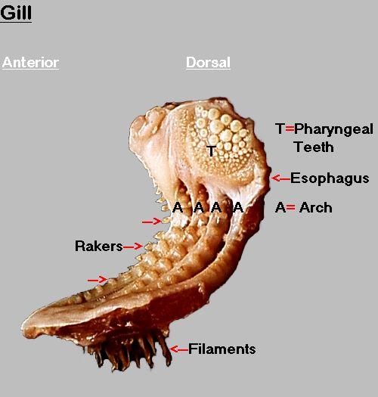
Fish Gill Anatomy
Gill structure can be thought of as a branching tree, and consists of the gill arch (truck), gill filaments or primary lamellae (branches), and secondary lamellae (leaves).
Notes:
Teleost fish typically have four gill arches, protected by one operculum on each side of the head.

Slide 21
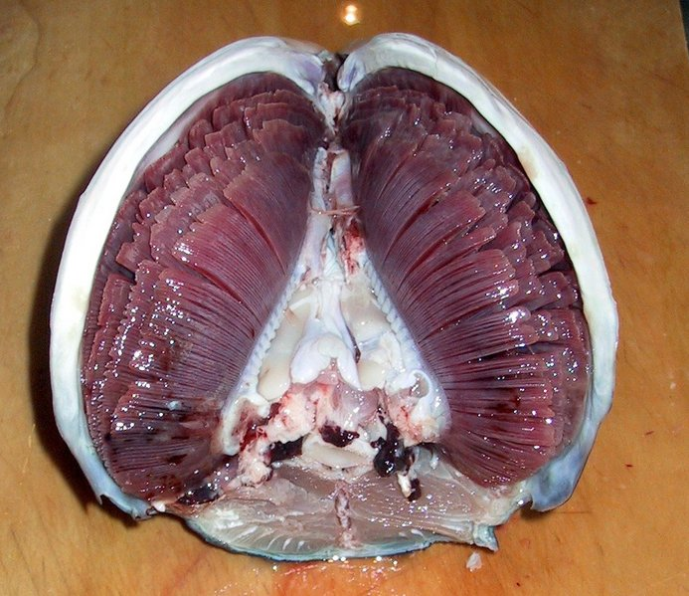
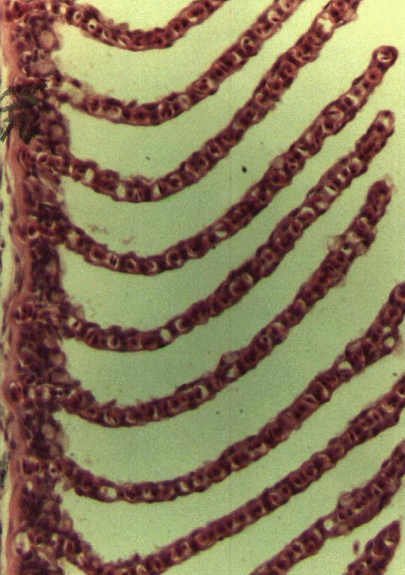
Gill structure
gill arches
primary lamellae (filaments)
secondary lamellae

Slide 22
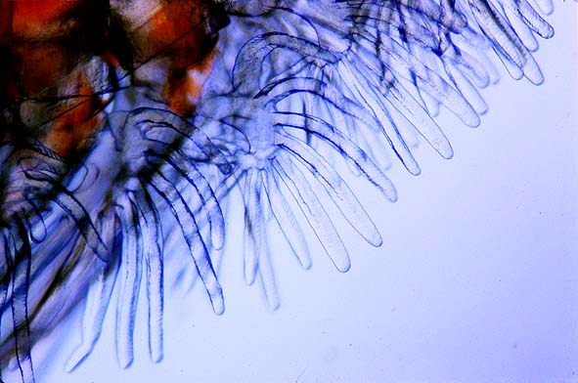
Fish Gill Anatomy
Gill Filaments
Lamellae

Slide 23
Cardiovascular System
The cardiovascular system is a single closed loop which connects every part of the fish’s body. Its primary functions are to deliver oxygen and nutrients to the body’s cell, and to remove carbon dioxide and metabolic waste.
Red blood cells are nucleated. The heart is located just behind and below the gills. Fish have a primitive heart consisting of four compartments with only two chamber

Slide 24
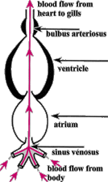
Cardiovascular system
2 chamber heart
atrium
ventricle
sinus venosus
bulbus arteriosus
The heart pumps the blood in a single loop throughout the body

Slide 25
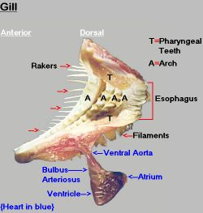
Circulation
venous blood to heart
hepatic portal system
renal portal system
heart to gills
via ventral aorta
gills to body
via dorsal aorta

Slide 26
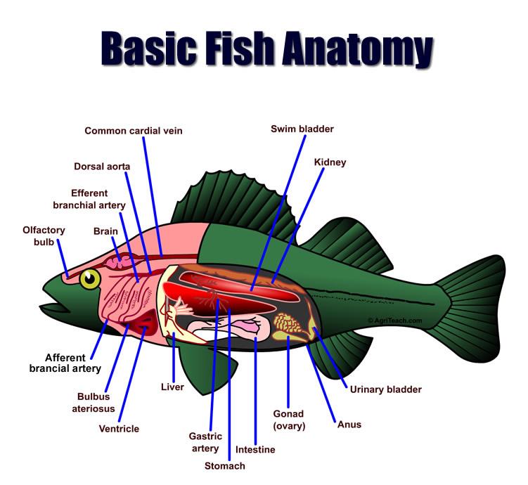
Fish Anatomy

Slide 27
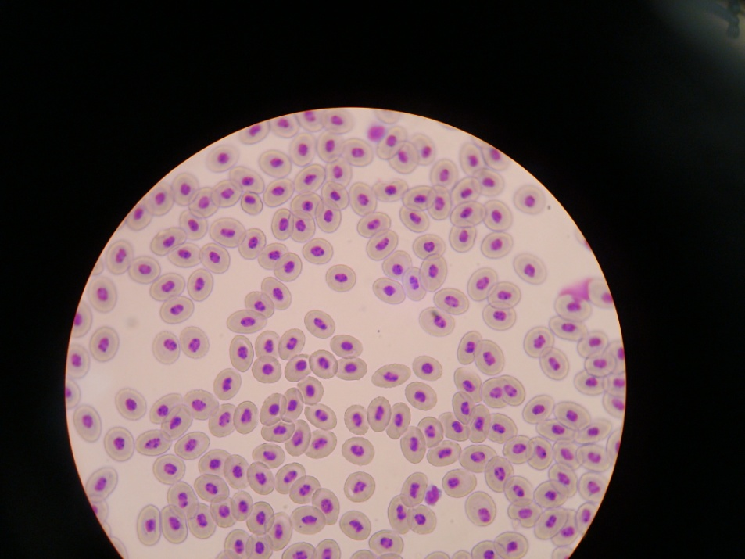
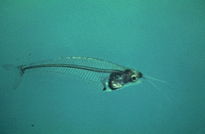
Red blood cells
elliptical and nucleated
no bone marrow
main source
head kidney

Slide 28
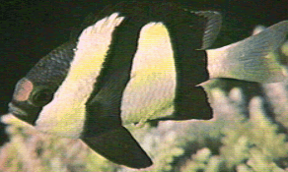
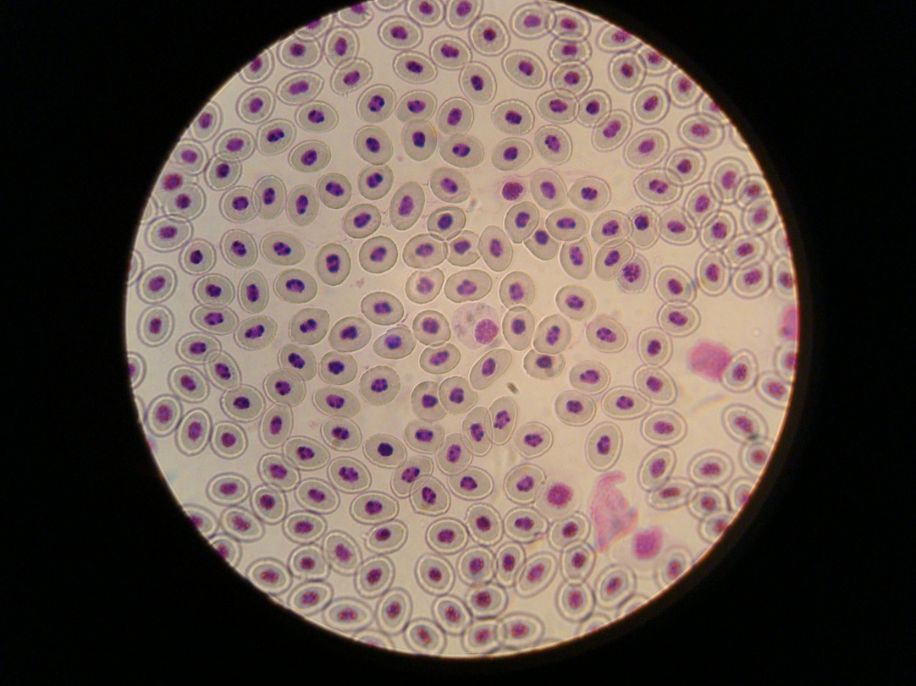
White blood cells
Similar to mammalian
no lymph nodes
lymphocytes > (granulocyte) neutrophils
monocytes
thrombocyte
lymphoid tissues
thymus
head kidney
spleen

Slide 29
Gastrointestinal System
The gastrointestinal system of fish is a product of its diet. Like ,mammals carnivores fish tend to have a straight simple gut and herbivores a more complex gut

Slide 30
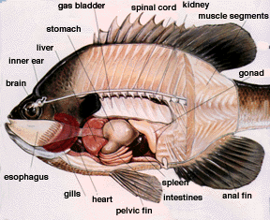
Digestive system
Stomach
intestine
pyloric
middle
rectal
spiral colon
pyloric cecae
liver
pancreas

Slide 31
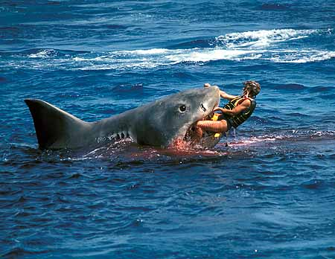
Nutrition
Species variation
food
feeding behavior
time
location
obtaining food
general fish nutrition
protein and lipids > carbohydrates

Slide 32
Excretory system
Gills (Co2)
Kidneys
The kidney functions to remove waste from the bloodstream in most animals, but in fish it also has an osmoregulatory function. The kidney is divided into anterior and posterior segments. The anterior segment’s primary function is to produce blood cells (fish have no bone marrow). The posterior kidney is the excretory organ, and regulates osmolality.

Slide 33
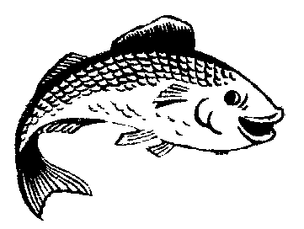
Reproductive System
females (ovaries) and males (testes)
Hermaphrodites (change sex according to the age and environment)

Slide 34
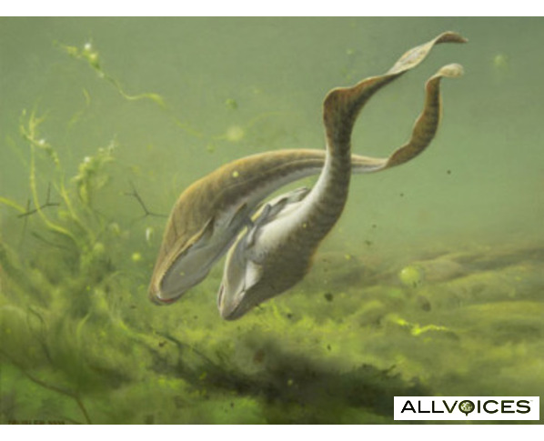
Reproductive system
female
ovaries
oviduct
no uterus
male
testes

Slide 35
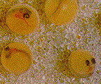
Fertilization
External fertilization
open-spawners
substrates
Internal fertilization
Egg layers or oviparus

Slide 36
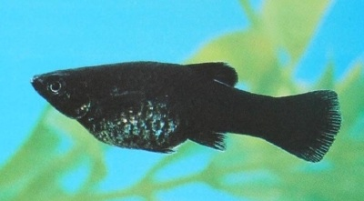
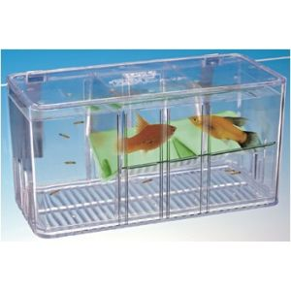
Gestation
oviparous
ovoviviparous
viviparous
Gestation periods vary from 28 to 114 days. Most of the live-bearing species sold for aquariums such as Mollies, Platies, guppies and Swordtails typically gestate for about 28 to 34 days

Slide 37
WATER QUALITY
And Husbandry

Slide 38
Husbandry
Aquarium fish can be divided into three broad categories:
temperate freshwater (brackish): cyprinid species, goldfish and koi
tropical freshwater: guppies, mollies, tetras, angelfish, gouramis, swordtails, rainbow fish and some cichlids
tropical saltwater fish: most salt water fish are wild- cought ex. clown fish

Slide 39
Good fish husbandry is proper water quality
In nature, water is purified by precipitation, filtering through sand and sediment, and inhabitant bacteria.

Slide 40
Water Quality
Fish waste, dead plants, and uneaten food all contribute to ammonia in the fish tank. Ammonia is toxic to fish.
Nitrosomas bacteria oxidize ammonia, breaking it down into nitrite.
Nitrite is also toxic to fish, even in small amounts.
Nitrobacter, is required to further reduce nitrite into nitrate.

Slide 41
Nitrification
Bacteria Bacteria
(Nitrosomas) (Nitrobacter)
ammonia nitrite nitrate

Slide 42
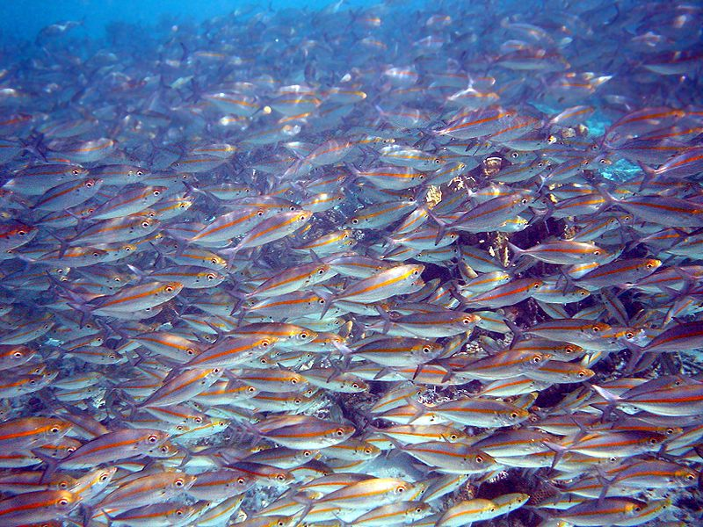
Ammonia
Nitrogenous
fish waste product
toxic

Slide 43
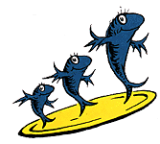
Bioload (is the nitrogen processing demand placed upon the material, chemical and biological filters by uneaten food, decomposing inhabitants, accumulated organics and waste produced by livestock, foods and plant matter in the aquarium filtration system)
Nonaerated freshwater
1 inch fish/ gallon
aerated freshwater
3 inches fish/ gallon
saltwater
0.5 inches fish/ gallon
excluding tail fin

Slide 44
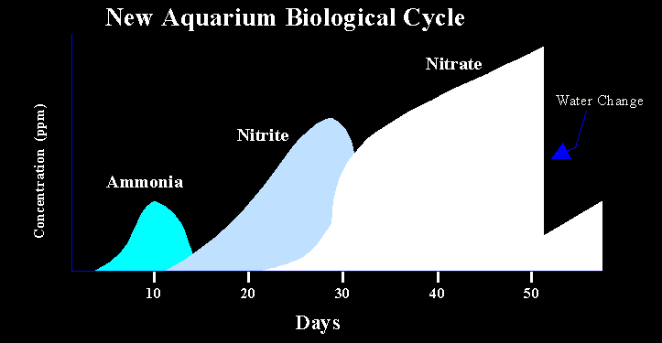
Conditioning a new tank
seeding bacteria
limited population
time

Slide 45
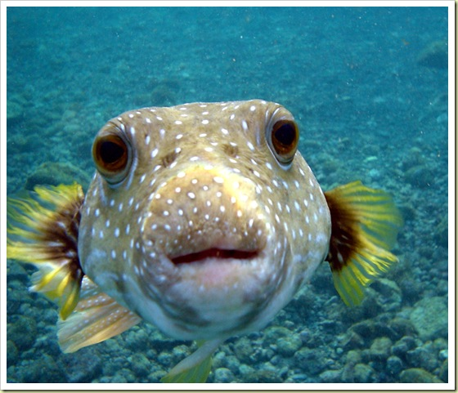
PH
ranges
freshwater: 7.0-7.6
brackish: 7.0-7.6
saltwater: 8.1-8.3

Slide 46
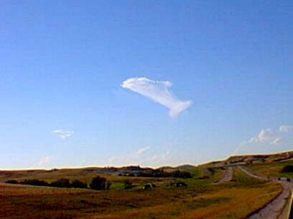
Oxygen
Oxygen levels typically must be around 5 ppm to sustain life in an aquarium
oxygen solubility decreases as:
temperature increases
salinity increases
low oxygen effects:
respiratory distress in fish
inhibits Nitrosomas and Nitrobacter

Slide 47
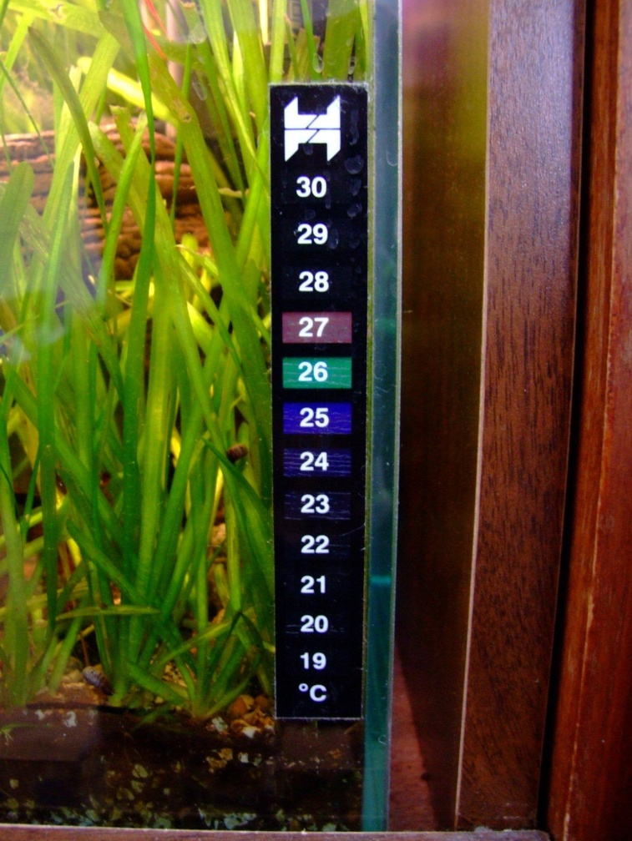
Temperature
preferred ranges variable
0 – 45 C (0-113 F)
temperature changes should be gradual
no more than 1 C/ 2 minutes in tank
no more than 2 -3 C between tanks

Slide 48
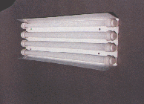
Light
light cycles
12/12
at least 8-10/24 hours of darkness
light source
fluorescent most common
no incandescent
no direct sunlight

Slide 49
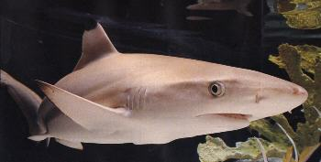
Chlorine/ Chloramines
toxic/ lethal to fish
removal
aeration and time
*sodium thiosulfate
carbon filter

Slide 50
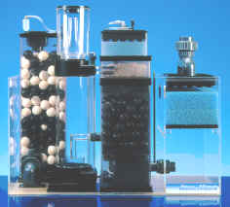
Filtration
mechanical filtration (sand, gravel, floss, plastic, diatomaceous earth)
chemical filtration (charcoal, protein skimmer, UV, ozone)
biological filtration (bacteria, gravel, live rock, decorations

Slide 51
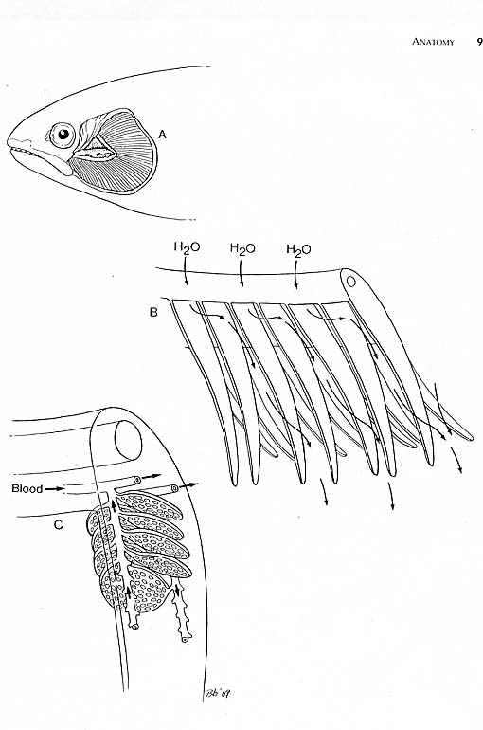
The Importance of Good Water Quality

Slide 52
Causes of Stress
water quality (O2, ammonia, nitrite, pH, other contaminants)
transportation
netting & handling
temperature
salinity
water hardness
poor nutrition
inappropriate housing conditions
noise
lighting
vibrations
stocking density

Slide 53
Common Pathogens and Parasites
Pathogens Aeromonas salmonicida · Columnaris· Enteric redmouth · Fin rot · Fish dropsy · Flavobacterium · Hematopoietic necrosis· Heterosigma akashiwo · Hole in the head · Hypodermal and hematopoietic necrosis · Infectious pancreatic necrosis· Koi herpes virus · Novirhabdovirus · Pfiesteria piscicida · Photobacterium damselae ssp piscicida · Salmon anemia · Streptococcus iniae · Taura syndrome · White spot · Yellowhead
Parasites Abergasilus · Amoebic gill disease · Carp lice · Ceratomyxa shasta · Dactylogyrus vastator · Diphyllobothrium · Flukes · Glugea · Gyrodactylus salaris · Henneguya zschokkei · Ich (freshwater) · Ich (marine) · Kudoa thyrsites · Myxobolus cerebralis · Nanophyetus salmincola · Salmon lice · Saprolegnia · Schistocephalus solidus · Sea louse · Sphaerothecum destruens · Swim bladder disease · Tetracapsuloides bryosalmonae

Slide 54
COMMON DISEASES OF AQUARIUM FISH
Most problems found in aquarium fish can be directly related to water quality issues.
Ammonia or nitrate poisoning are signs of a fish sickened by poor water quality include clamped fins, listlessness, or gasping at the surface
Hypoxia fish gasp at the surface of the water, or gather at water inlets where oxygen levels are highest.
Aspergillus, Fusarium, and Candida are all genuses of fungus that can systemically cause chronic health issues. An affected fish will present with cottony growths on the skin or gills.

Slide 55
Mycobacteriosis
Mycobacterium marinum can affect fish despite excellent husbandry. This acid-fast bacterial rod causes granulomas to form within the body of the fish, although sometimes fish can be affected externally as well.
Fish sickened by mycobacteriosis lose weight and become listless, and eventually succumb. This is a zoonotic disease, called “fish handler’s syndrome”.
Due to zoonotic potential and difficulty in treatment, affected fish are usually culled.

Slide 56
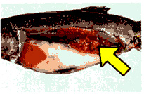
Mycobacteria

Slide 57
ZOONOSIS
Zoonosis = disease that can be transmitted from animals to humans (or other animals)
Anthroponosis = disease that can be transmitted from humans to animals
High Risk
immunosupressed (AIDs, other debilitating disease)
pregnant
age
Exposure (infected water, fish tissue, fish excrement)
dermal contact via skin abrasion, fissure
ingestion

Slide 58
Zoonotic Diseases
Potential for disease organisms to spread between species (fish ↔ human)
Bacteria - from handling (mycobacterium, streptococcus, erysipelothrix, vibrio, norcardia, aeromonas, edwardsiella)
from ingestion (staphylcoccus, clostridium, vibrio, aeromonas, elerichia, salmonella,
edwardsiella)
Parasites - primarily from ingestion (nematodes, cestodes, trematodes, protozoa).
Toxins - primarily from ingestion (ciguatera, scombroid, dinoflagellates toxins)

Slide 59
PREVENTION
Fish
Know health of your fish
Proper husbandry/aquaculture
Minimum - wear gloves when handling
All Wildlife
Know the hazards
Take all necessary “known”precautions
DO YOUR HOMEWORK!!!

Slide 60
Anesthesia
Consider for painful/stressful procedures and pre-euthanasia
Ice water (transport) - be careful
Chemical - MS-222, Benzocaine
Dose is species specific

Slide 61
MS-222
tricaine methanesulfate, ethyl-m-animobenzoate methansulfate, Finquel®
CNS depressant
water soluble but acidic (add buffer)
admin. via bath or recirculating system
for anesthesia 50-100 mg/L recommended (sedation vs surgical)
dose may be species specific - test before experiment

Slide 62
MS-222 con’t
induction w/in 3 minutes
recovery w/in 10-15 minutes after removal
is residual +/- could affect chemical analysis of tissue
no known hazards but wear gloves!

Slide 63
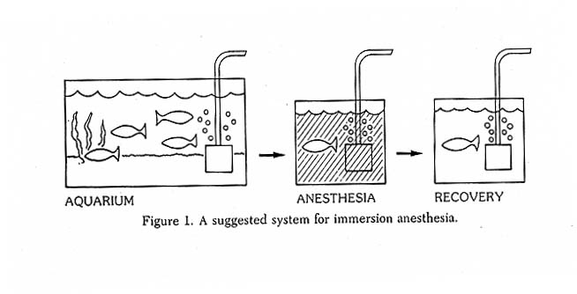
Immersion Anesthesia

Slide 64
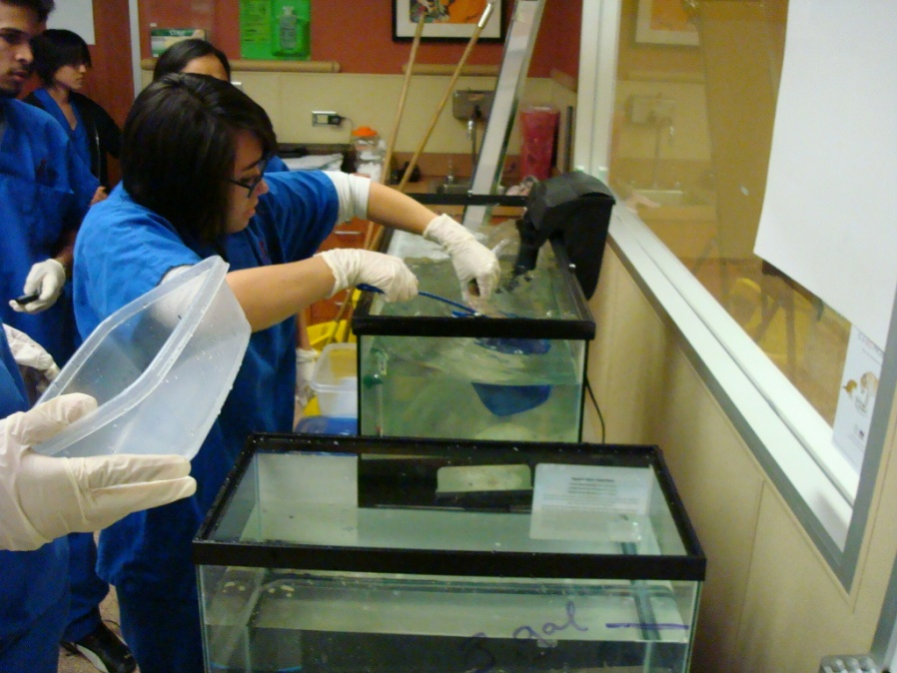
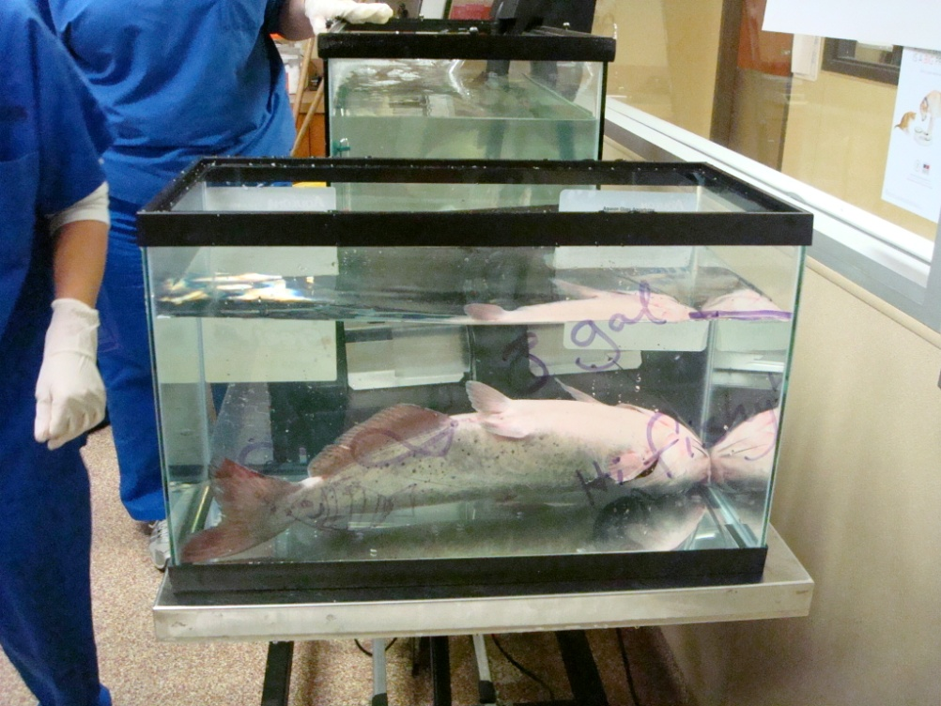

Slide 65
Levels of Anesthesia

Slide 66
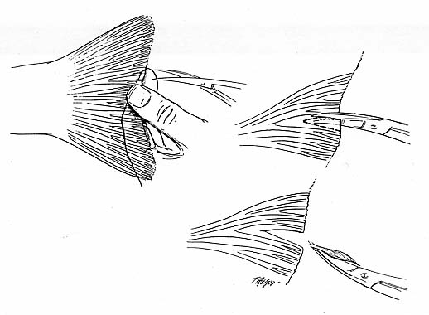
Simple Diagnostics
Skin scrape
Fin clip

Slide 67
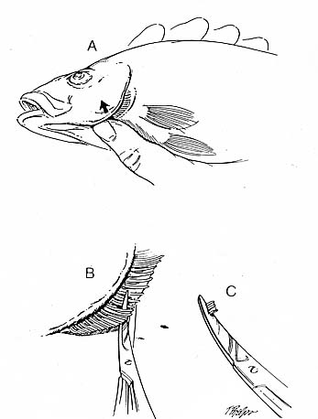
Simple Diagnostics
Gill clip

Slide 68
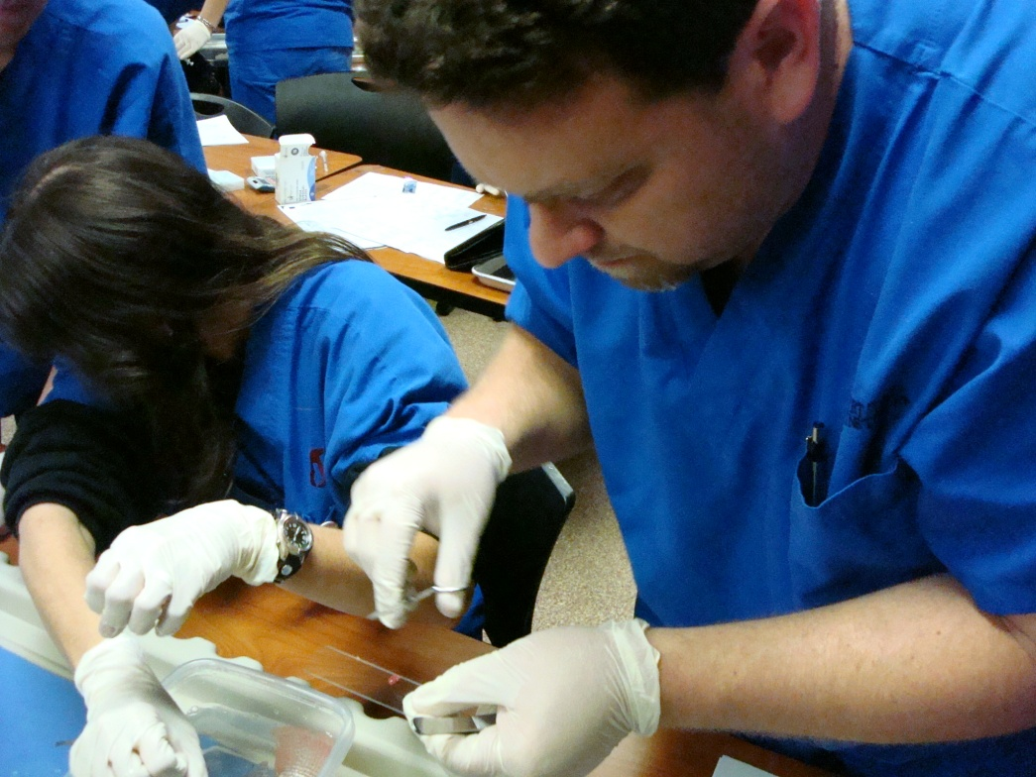
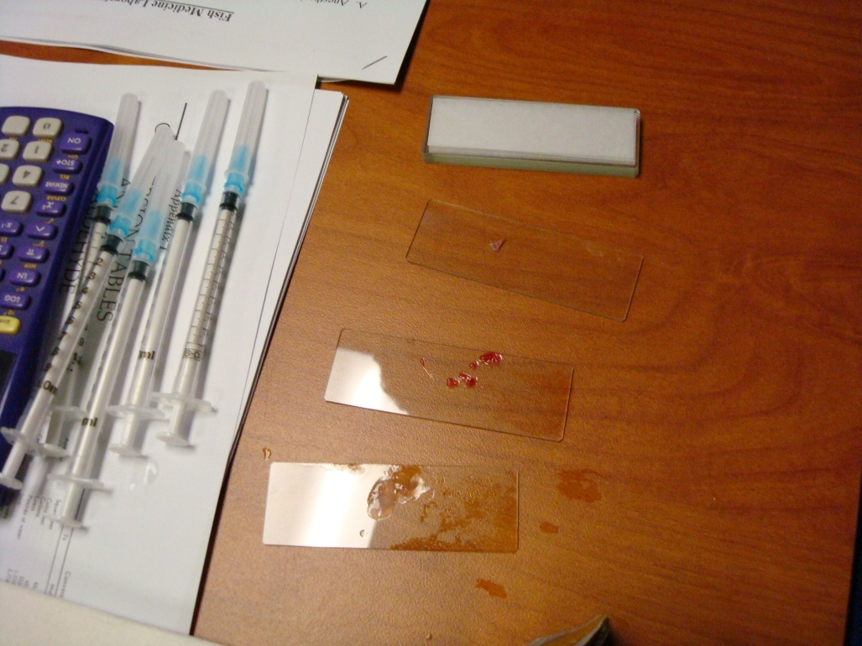
Gill sampling

Slide 69
Samples
Gill

Slide 70
samples
Scale
Fin

Slide 71
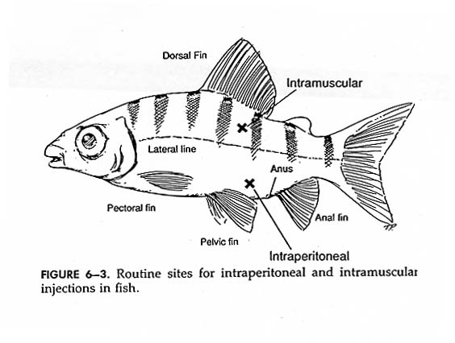
Venipuncture and Injection sites
Blood collection for analysis

Slide 72
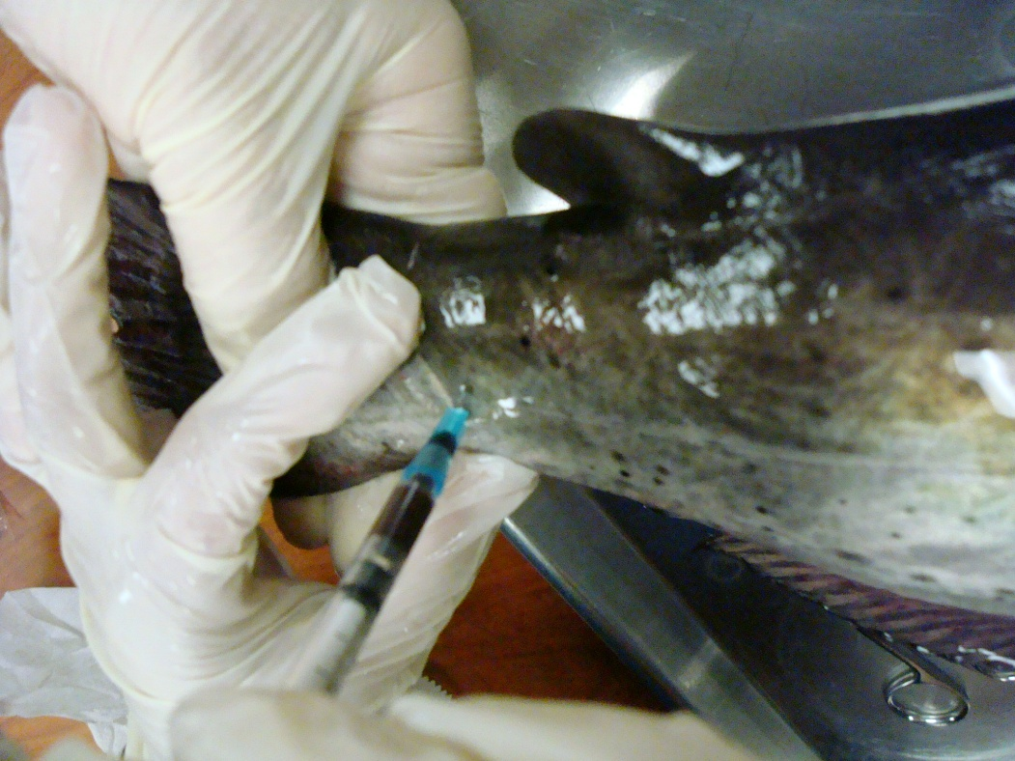
Venipuncture

Slide 73
Radiology

Slide 74
What do you see?

Slide 75
Fish Anatomy
Dorsal Fin
Brain
Caudal Fin
Air Bladder
Operculum
Anal Fin
Pectoral Fin
Pelvic Fin
http://northcentralanimalhospital.com/clients/15373/images/Fish_radiograph.jpg

Slide 76
Euthanasia
+/- pre-sedation with MS-222
decapitation
pithing
chemical (MS-222)
requires experience!!!
avoid direct insertion into fixative (alcohol or formalin)

Slide 77
Pithing

Slide 78
Fish Dissection

Slide 79
Preparation & Examination
Locate major external anatomical parts:
Dorsal Fin
Posterior Dorsal
Pectoral Fins
Pelvic Fins
Anal Fins
Caudal Fin
Gill Covers (operculum)
Lateral line - sensory organ of fish
Remove several scales
Prepare a dry-mount of a scale.
Observe it under a microscope
What function do you think scales serve?

Slide 80
Dissection
Remove operculum with scissors
Observe gill anatomy
Rakers - white, comb-like arches
Filaments - Red fingerlike projections
With a scalpel, remove a section of the lateral line
What function does this organ serve?
Do you notice a concentration of nerve endings?
Begin the main incision
Open the abdomen (below the gill) carefully with a scalpel
Cut with a scissors: remove a oval-shaped piece of skin (only skin) running from underneath the gills, to the anus, up to the lateral line, along the lateral line, to the gill, down to where you started the incision. Remove flap of skin (see diagram on next slide)

Slide 81
Main Incision
Cut along the blue line...
Only cut through scales, muscles, and skin
Take special care not to cut too deep!

Slide 82
Anterior View
1. Gills
2. Heart
3. Liver
4. Pyloric caeca
5. Small intestine
6. Stomach
7. Swim bladder

Slide 83
Disection

Slide 84
Posterior View
1. Swim bladder
2. Gonad
3. Large intestine
4. Urinary bladder
5. Anus

Slide 85
Close-up: Body Cavity
Ovary
Muscle
Swim Bladder
Eggs
Liver
Gastric Cecae
Small Intestine
Spleen
Stomach

Slide 86
Gravid female

Slide 87
Can you identify the parts?

Slide 88
I found him

Slide 89
References
Can Fish Suffer?: perspectives on sentience, pain, fear and stress; K.P. Chandroo et al./Applied Animal Behaviour Science 86 (2004) 225-250
Fish Cognition and Behavior; Culum Brown et al.; Blackwell Publishing (2006) ISBN: 9781405134293
Fish Medicine; Michael Stoskopf, W.B. Saunders Company; 1st edition (January 15, 1993) ISBN: 0721626297

