Slide 1

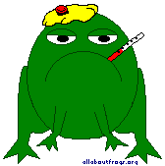

Amphibian Diseases

Slide 2
Red leg
In amphibians bacterial infections are commonly caused by gram-negative bacteria, such as Aeromonas, Pseudomonas, Proteus, and E. coli.
Poor husbandry, (e.g., overcrowding, poor water quality, inappropriate cage design or setup, spoiled food, exposure to toxins such as pesticides) may allow one of these bacteria to overwhelm amphibian's immunologic defenses

Slide 3
REDLEG
Aeromonas is the most common cause of clinical bacterial diseases in amphibians and has been associated with the syndrome known as redleg disease
The first thing to do, however, is to isolate the affected animal.
Check temps, water quality, humidity and lighting.

Slide 4
Gross Signs:
– Erythema (reddening) of the skin
– Cloudy eyes or bleeding in eye
– Fibrinous coelitis
– Fibrinous or cloudy lymph sacs
– Splenomegally
– Hepatomegally
Blood hemorrhages beneath the skin may be present up to several hours a before death or may appear immediately prior to or during the agonizing convulsions.

Slide 5
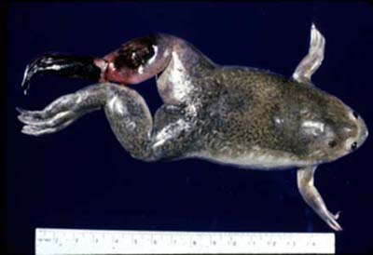
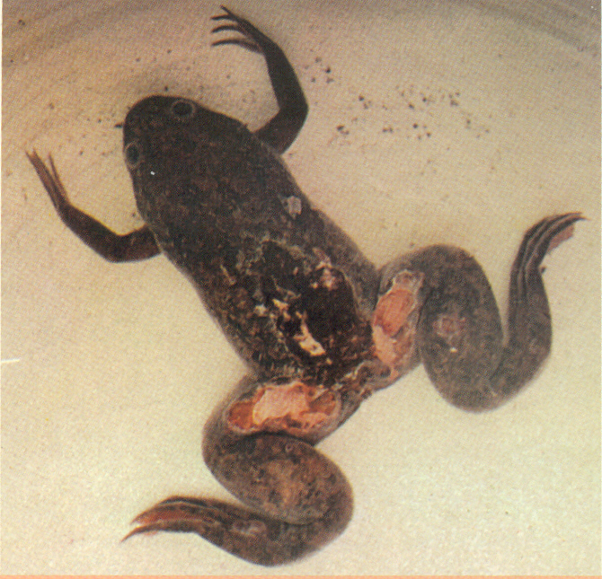
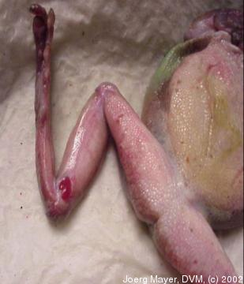
Red leg

Slide 6
Rx
An antibiotic ointment such as Tritop or Neosporin may be used to promote healing of skin tissues and prevent secondary infections.
If skin ulcers are observed, once a day topical 1% silver sulfadiazine
A tetracycline bath is helpful in some cases, but not many
Enrofloxacine (Baytril) 5-10 mg/kg PO or TO every 24 hours for 7 days

Slide 7

Disappearing Amphibians
In the early 1990’s it became apparent that amphibian populations worldwide were in rapid decline.
Subsequent review suggested that at least 9 and perhaps as many as 122 species had become extinct since 1980 and that population declines were ongoing.

Slide 8
Disappearing Amphibians
Localized causes of declines that have been identified include:
  microclimate changes due to logging, which results in less forest humid environments that suit amphibians.
  mining which often employs toxic chemicals that amphibians are especially sensitive to.
  Habitat destruction by cattle around breeding ponds: young anurans e.g. become trapped in hoofprints

Slide 9
Disappearing Amphibians
On a global level however there are a number of factors that appear to be associated with amphibian declines. These include
  Global warming
  Acid rain
  UV radiation
  Disease

Slide 10
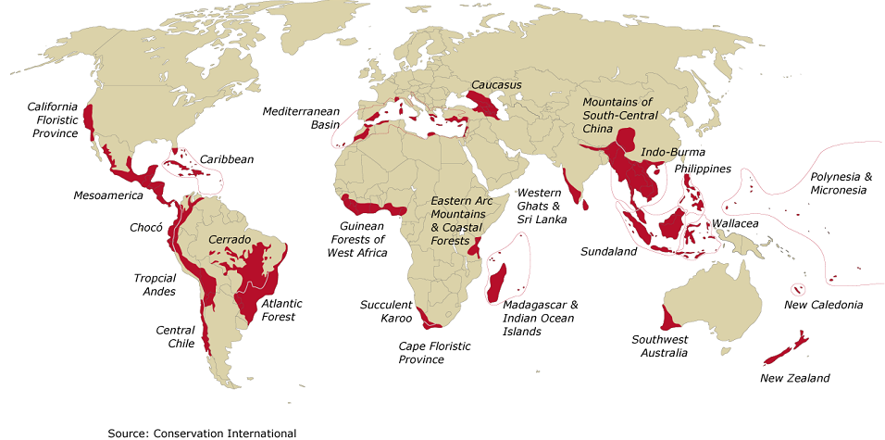
Distribution of Global Amphibian Declines
1
3
11
2
23
10
10
2
2
3
13
3
4
17
7
9
53
1
6
18
6
2
11
6
11
18
23
3
5
1
Extinct, Missing or Critically Endangered
Additional Threatened (Endangered or Vulnerable)
Source: IUCN 2000, AmphibiaWeb, Hero J.-M. & L.Shoo, 2003. Chapter 7 in Amphibian Conservation, Smithsonian Press.
Background biodiversity hotspots map from Myers et. al., 2000. Nature 403:853-858 c/o Conservation International.
Notes:
10

Slide 11
Disease
Most recently there has been increased focus on the role of disease in amphibian declines.
In particular, attention has focused on Chytrid fungi.
Batrachochytrium dendrobatidis
Waves of chytridiomycosis infection have spread along mountain chains in Central America, South America and Australia and the effects on local populations are often devastating.

Slide 12
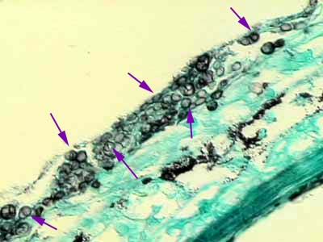
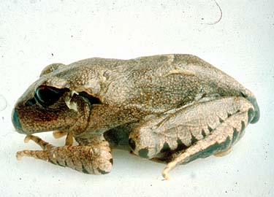
Chytrid fungi
The fungus in the form of motile zoospores in water penetrates the skin and causes a disease called chytridiomycosis.
The fungus forms a reproductive body called a zoosporangium and this interferes with respiration and control of water flow and kills adult frogs.

Slide 13
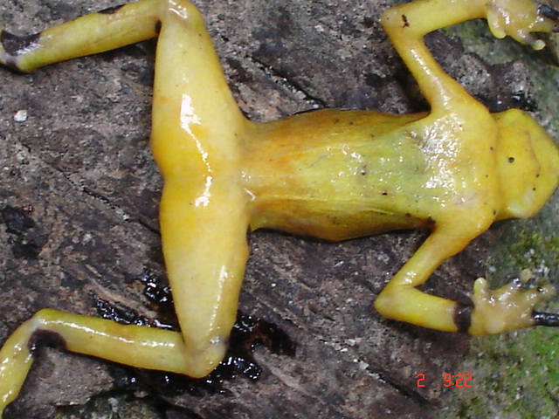
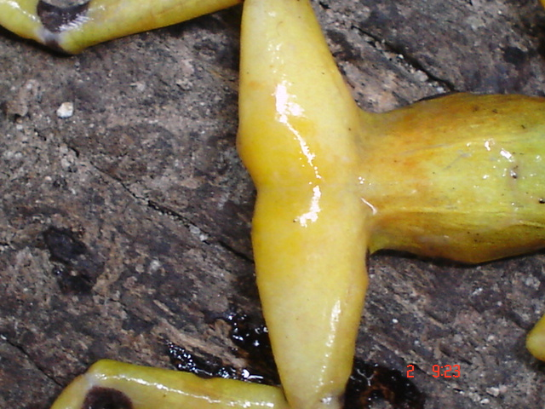
Panamanian Golden frog

Slide 14
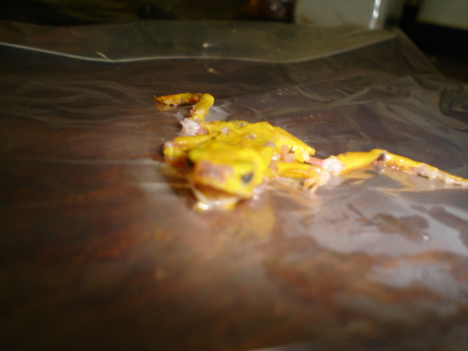

Slide 15
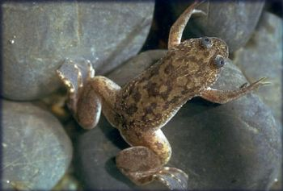
Disease
Infected tadpoles appear to survive, but grow slower than uninfected individuals.
The fungus appears to have originated in African Clawed frogs, which are resistant to it.
African clawed frogs have been used extensively worldwide in lab work and many escaped or were released into the wild bringing the fungus with them.

Slide 16
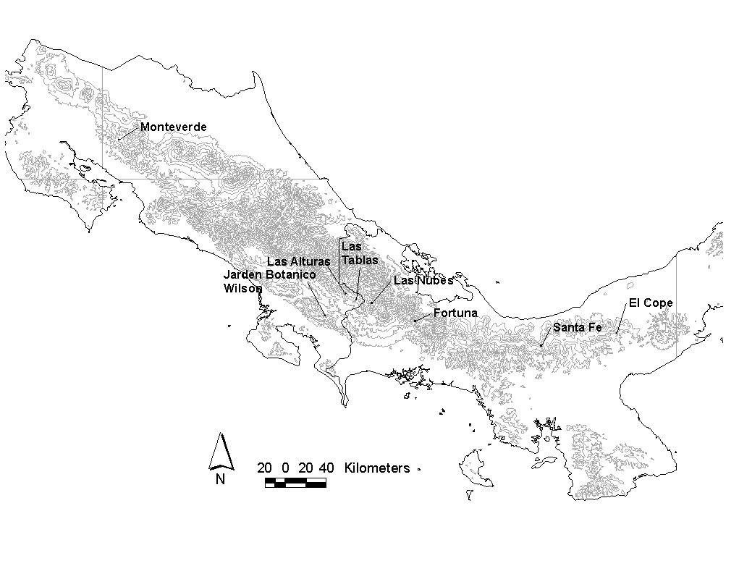
From Costa Rica to Panama
~28 km/yr

Slide 17
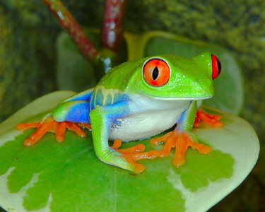

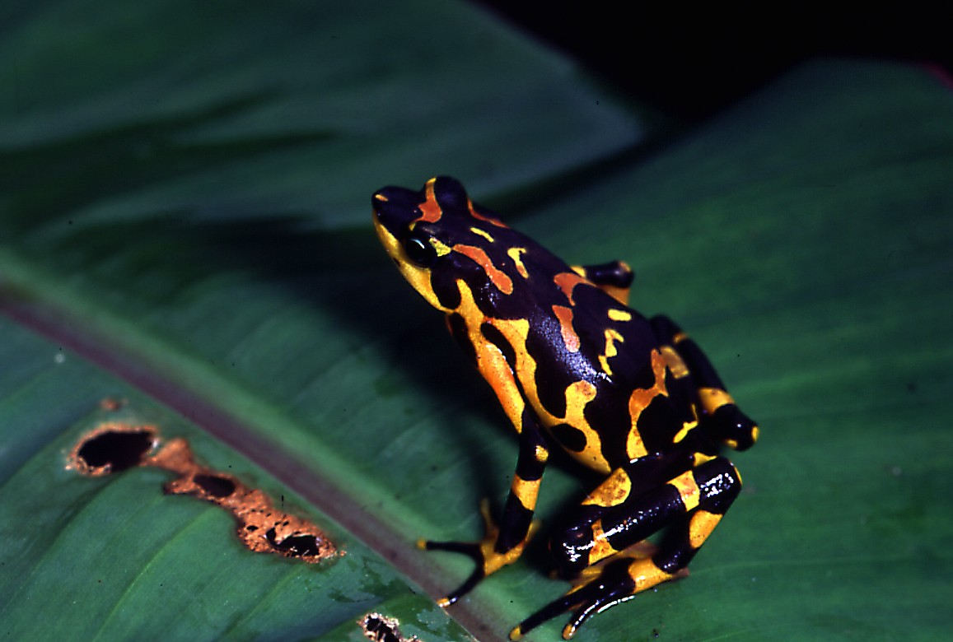
El Efecto del Hongo en Panamá
Un campo sin ranas y sapos……..

Slide 18
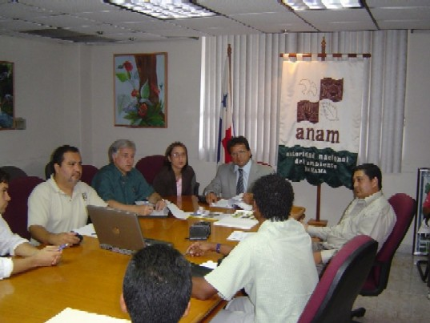

Meeting with the Panamanian government

Slide 19
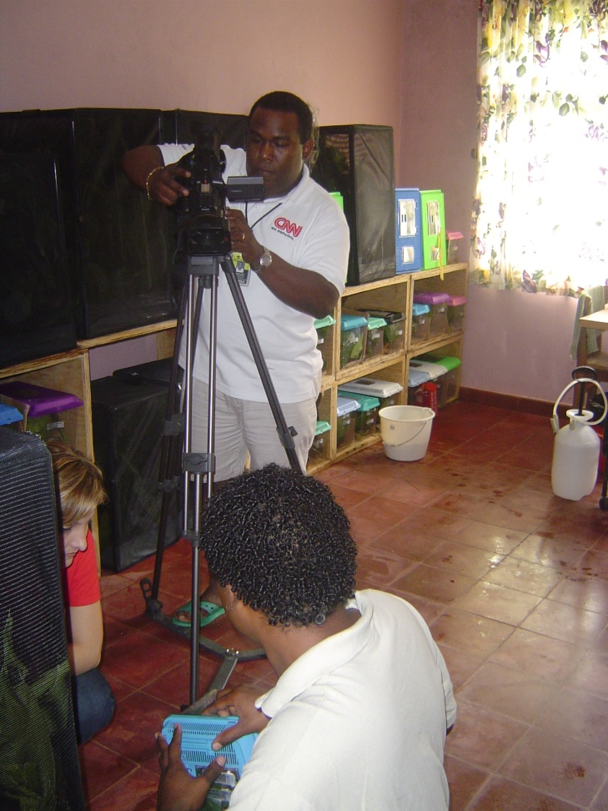
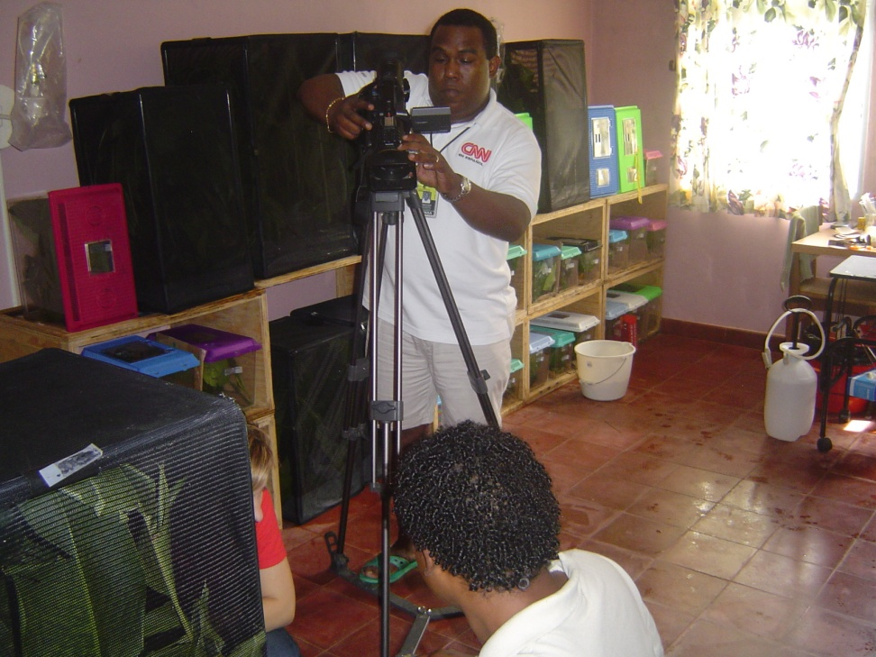
Media

Slide 20
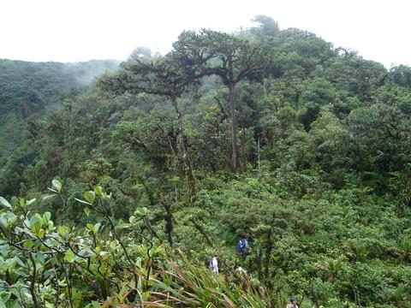
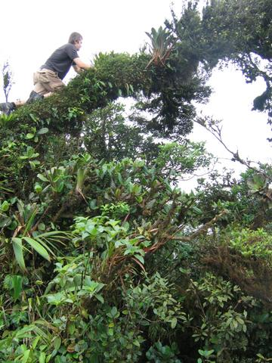
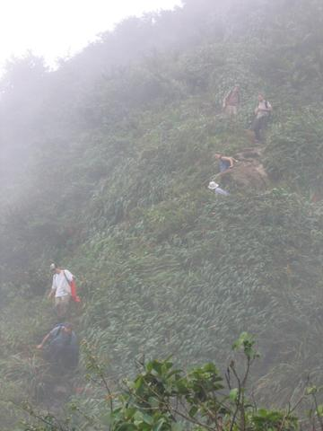
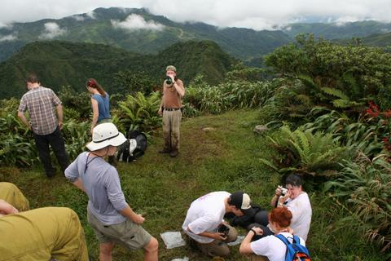
Rescue Volunteers

Slide 21
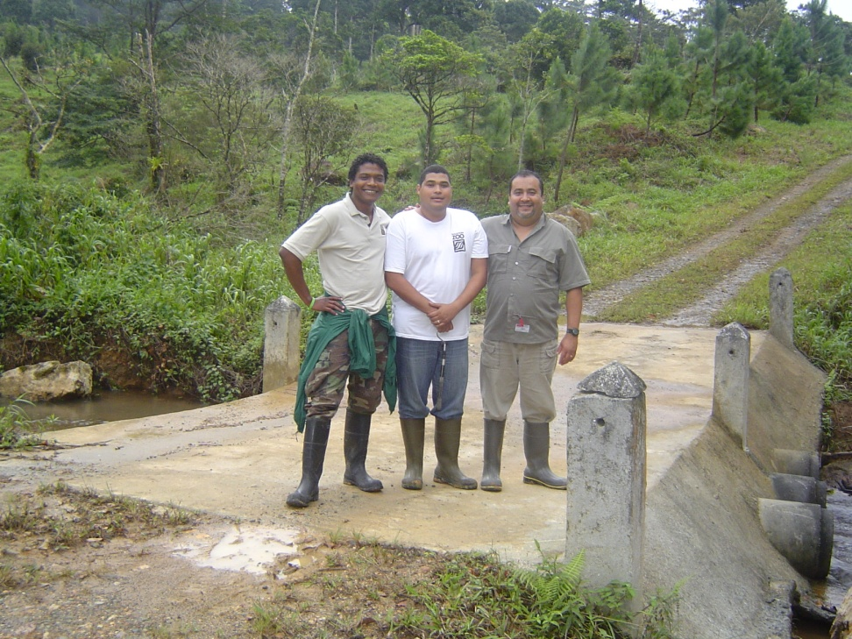
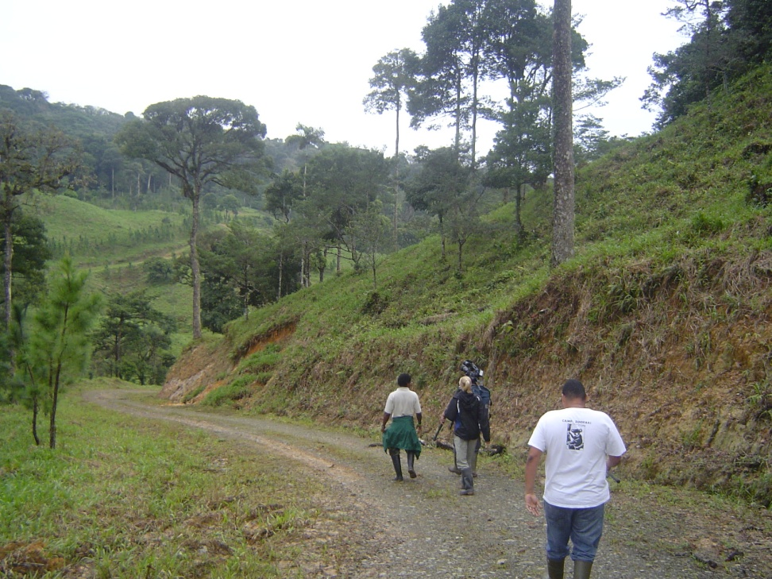

Slide 22


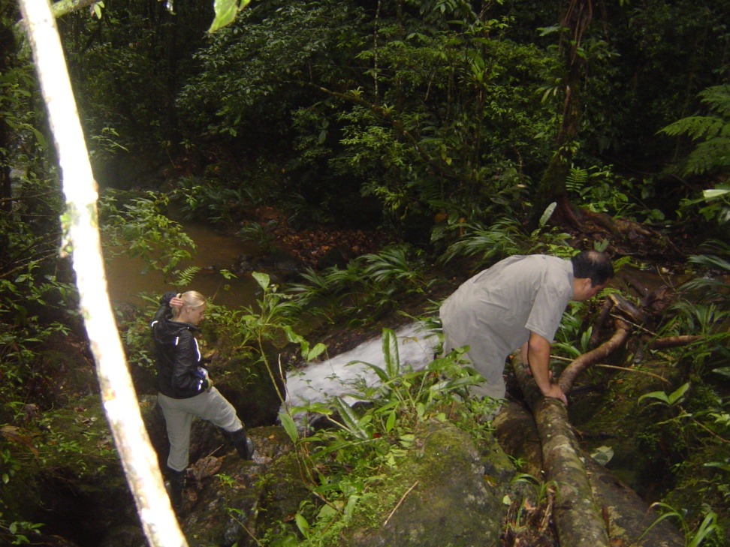

Slide 23
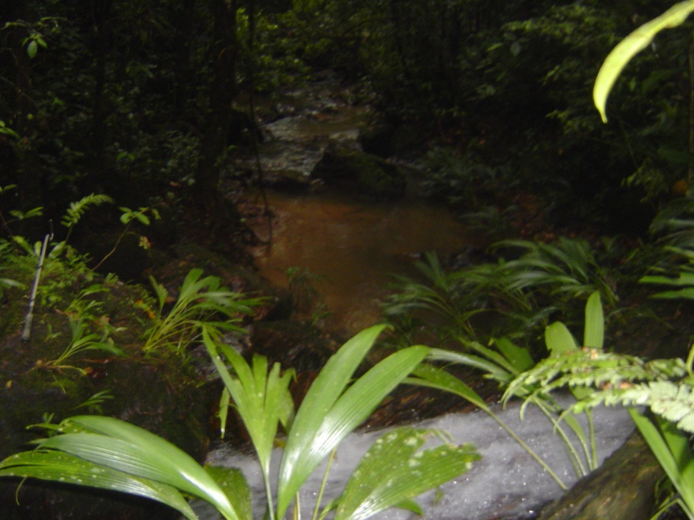
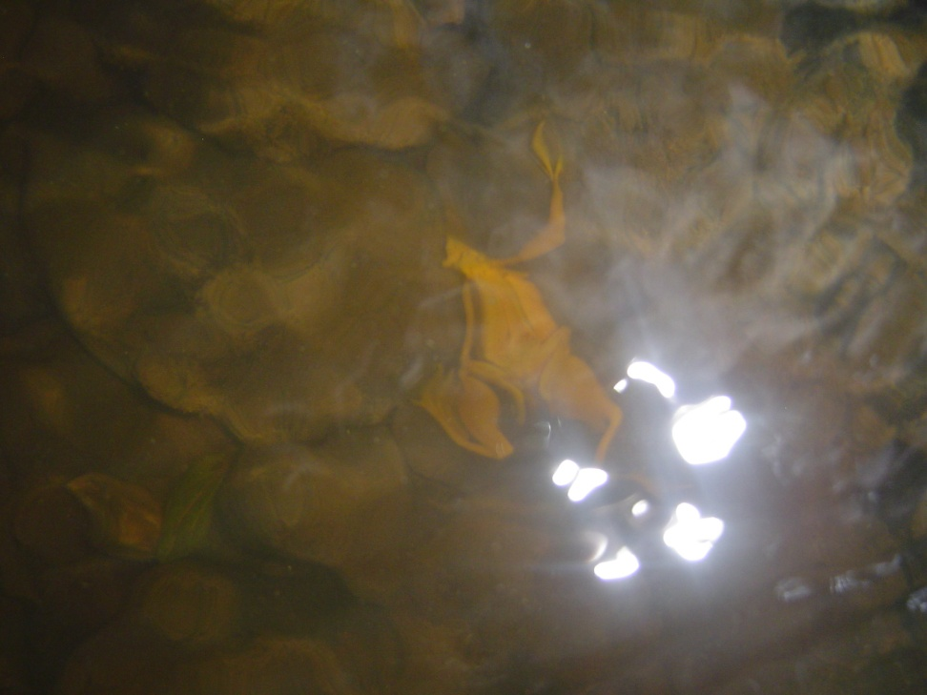
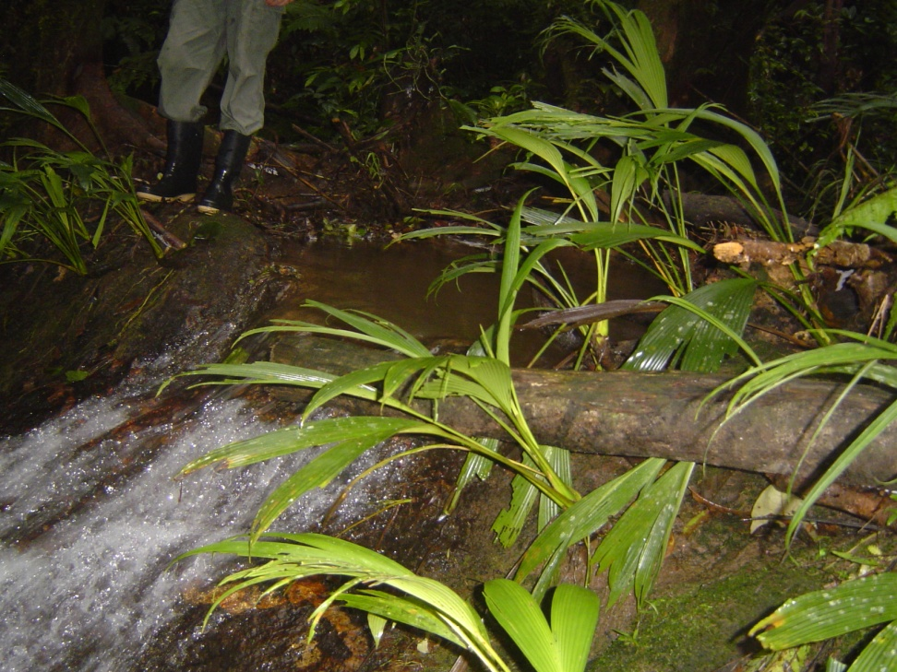

Slide 24
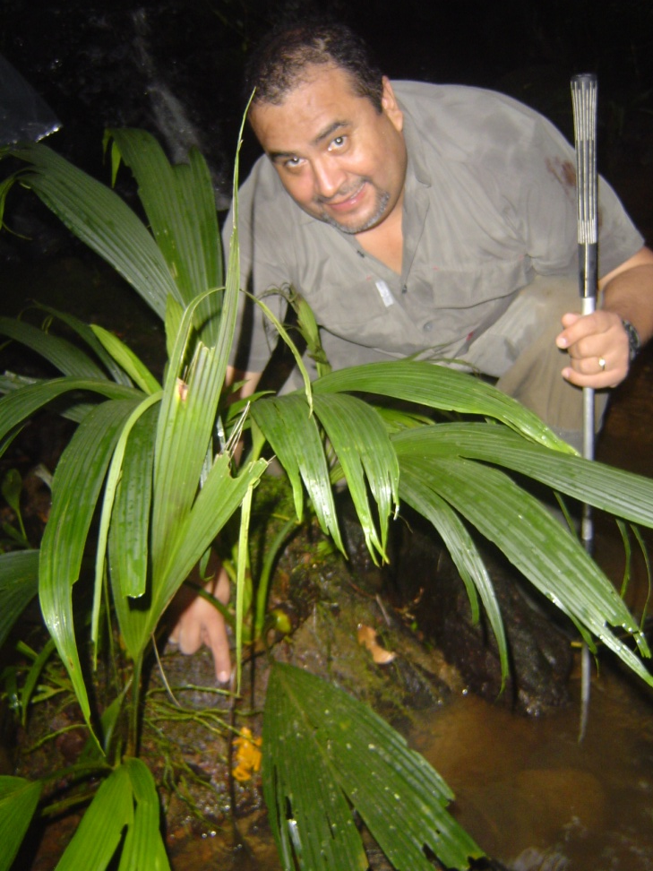
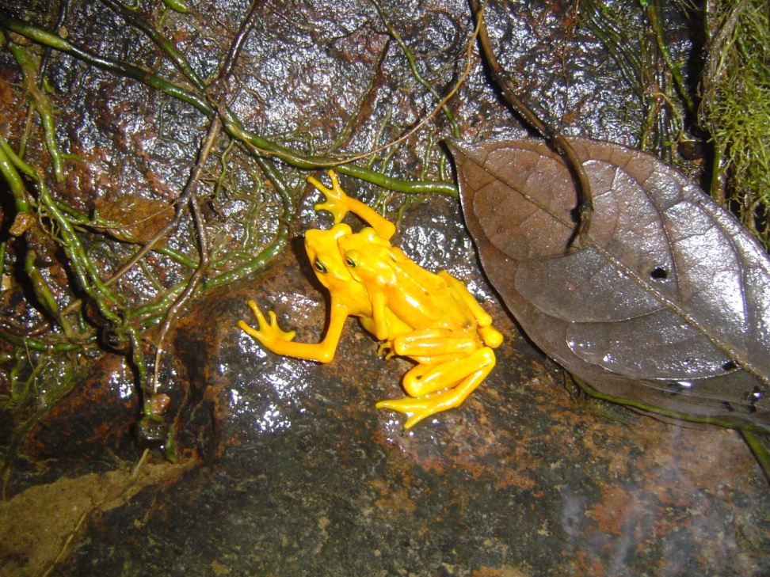

Slide 25
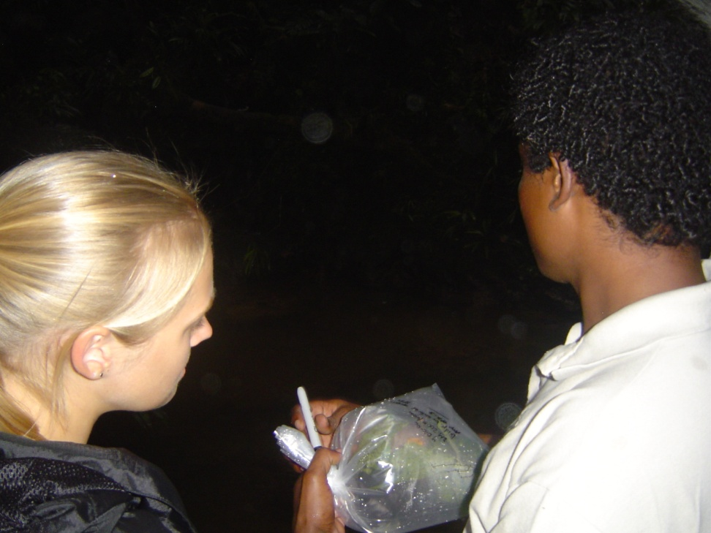
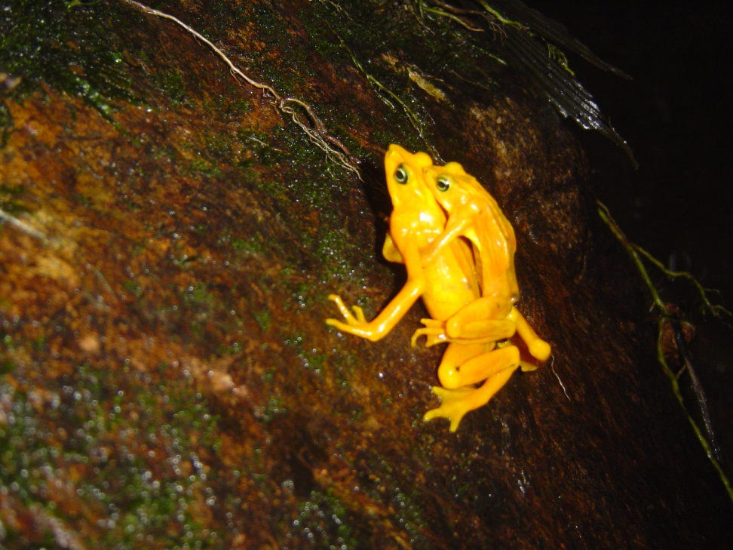
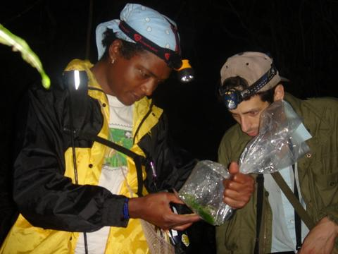

Slide 26

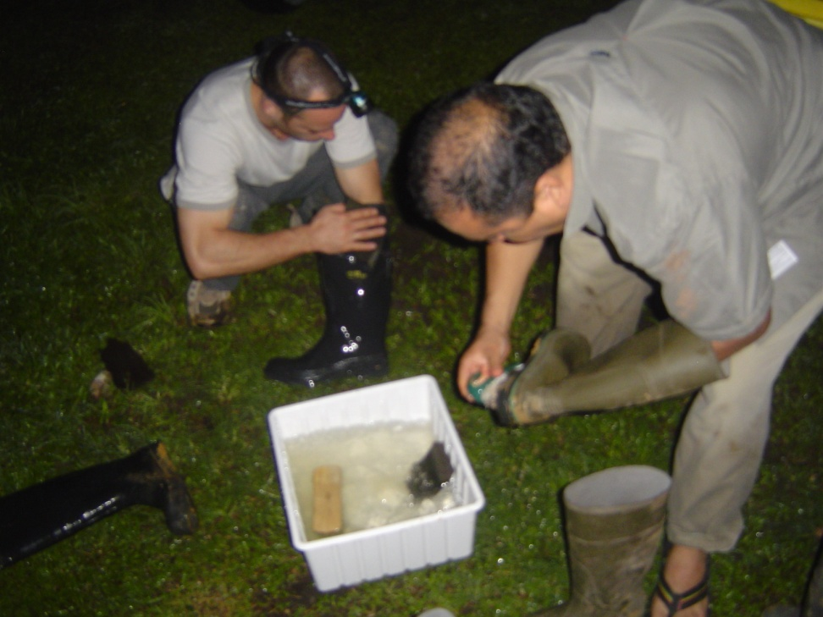

Slide 27

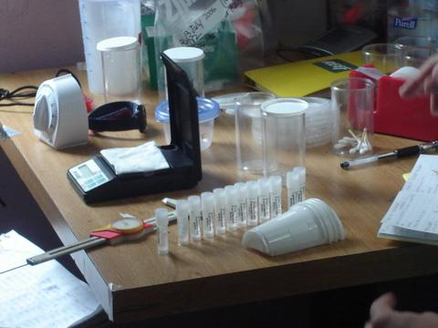
Set up

Slide 28
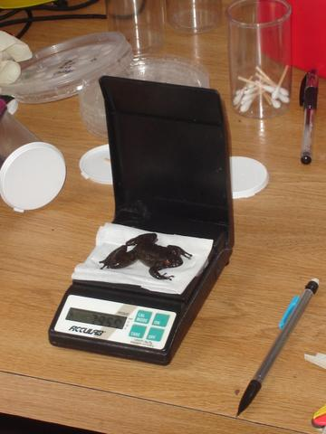
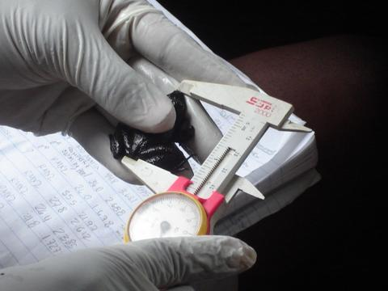

Slide 29

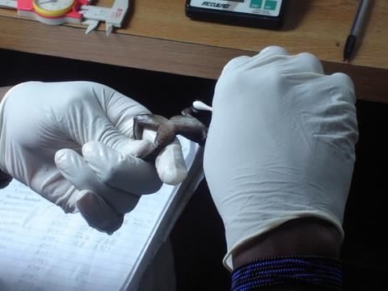
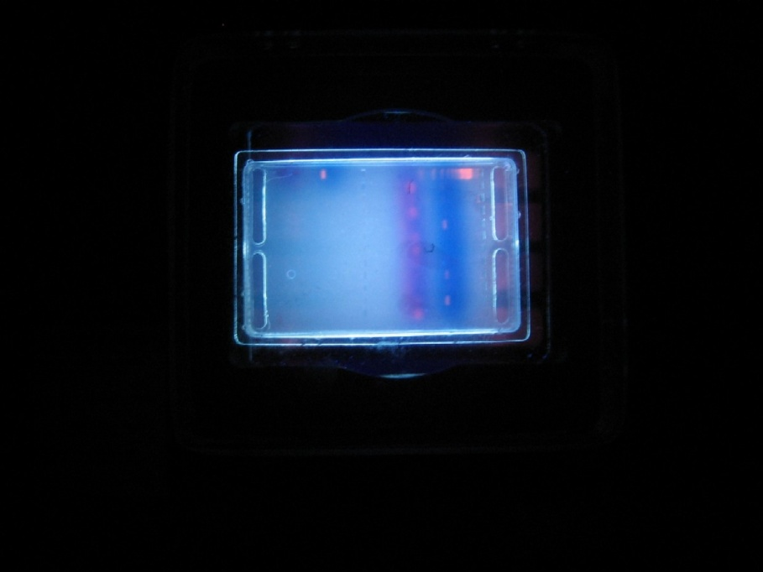
PCR Test

Slide 30
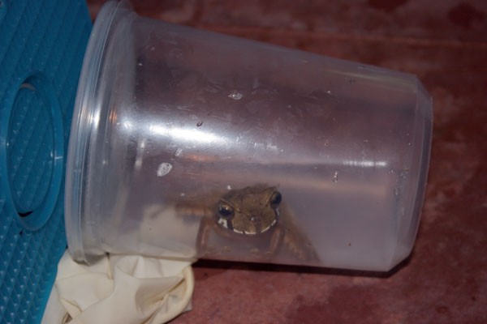
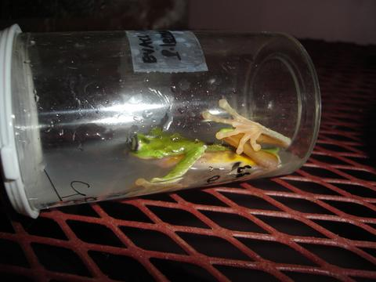
Rx.- 1% Itraconazole stock solution in methylcellulose is diluted to
0.01% in 0.6% NaCl.
Treatment consists of 5 minutes bath once daily for 10 days

Slide 31
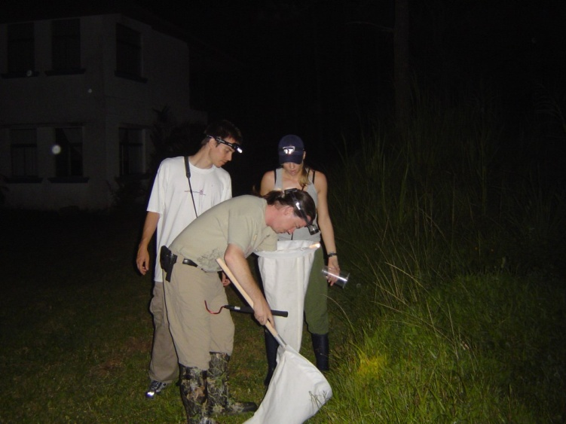
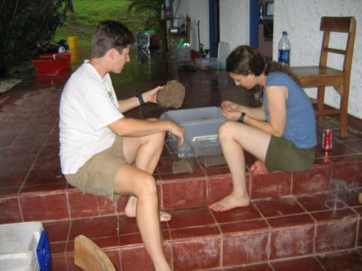
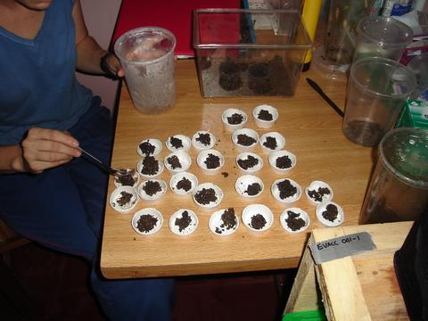

Slide 32
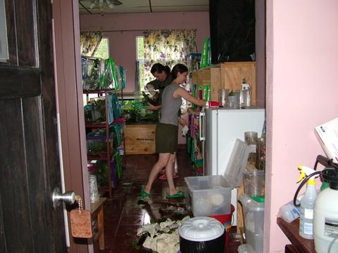
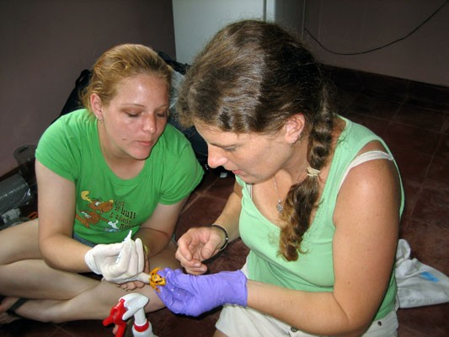
husbandry

Slide 33


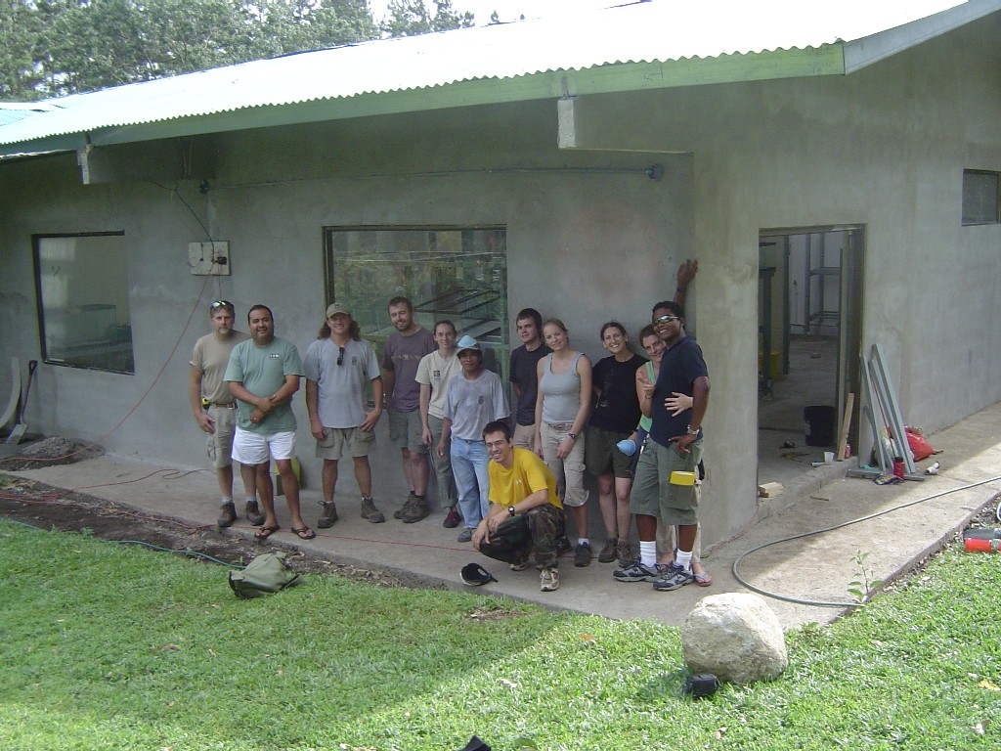

Slide 34
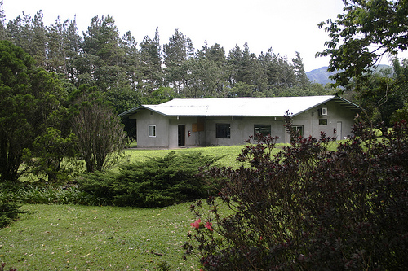
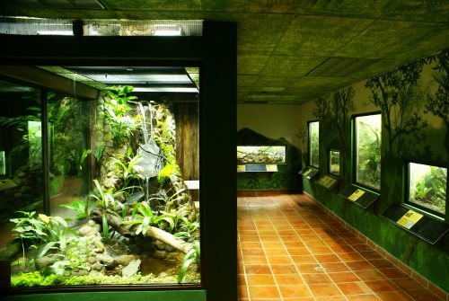
EVACC

Slide 35
