Slide 1
Wound Management and
Equine Surgical Procedures
Chapter 8 LACP
Page #270

Slide 2
Objectives
Understand the basic differences between standing surgical procedures and general anesthesia procedures.
Prepare a patient for surgery.
Assist with or perform induction and maintenance of anesthesia.
Provide anesthetic monitoring.
Manage the patient during recovery and immediate postoperative periods.
Understand the basic risks and possible complications associated with anesthesia and surgery, and implement preventative measures when indicated.

Slide 3
Equine Surgery
Availability of surgical procedures
Availability of surgical facilities
Expertise of available surgeons
Patient health status
Ability to provide aftercare and follow-up
Prognosis
Economic constraints

Slide 4
Equine Surgery (cont’d)
Standing surgery procedures
Most common
In the patient’s best interest if possible
General anesthesia (recumbent) procedures

Slide 5
Wound Types
Abrasions- partial thickness wounds (road rash, scraped knees). They can be large and become quite contaminated, but they do not fully penetrated all the layers of the skin
Puncture wounds- result from penetration with foreign objects- commonly nails, tree branches, or pieces of wire. They are narrow in diameter relative to their depth
Lacerations- full thickness wounds that transect the skin completely and often extend into underlying tissues.

Slide 6
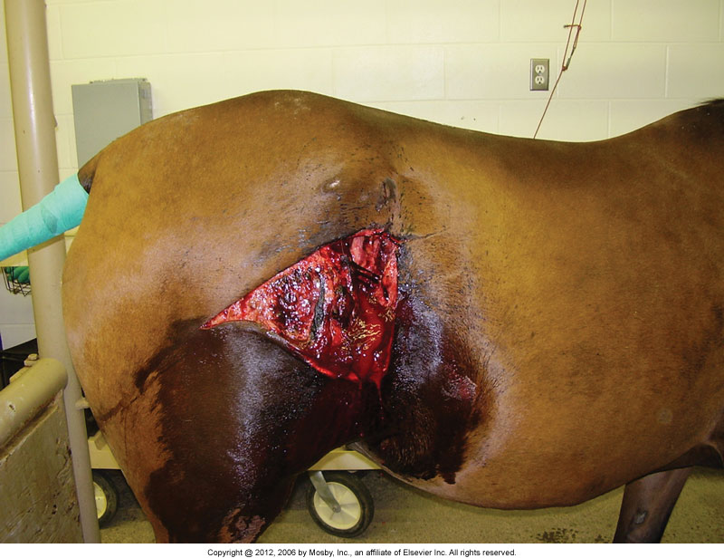
Equine Surgery (cont’d)

Slide 7
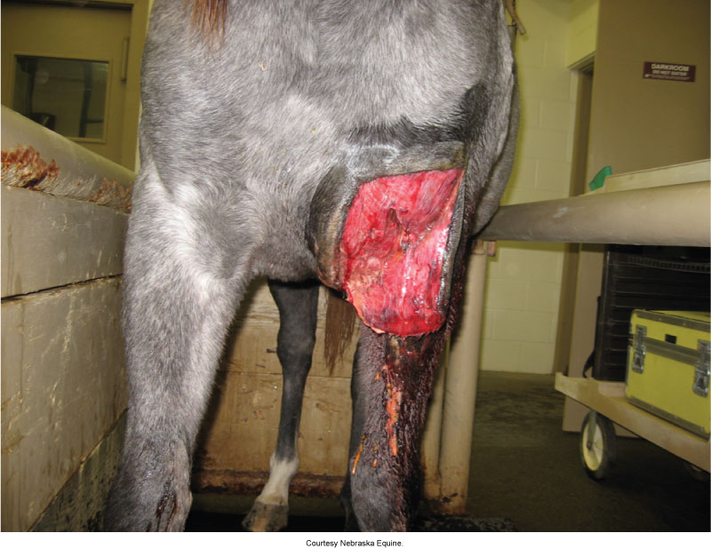
Equine Surgery (cont’d)

Slide 10
Standing Surgery
Must be safe
Beneficial for sick, debilitated, or elderly patients
None of the risks of recumbent anesthesia
History of problems under general anesthesia
Less expensive

Slide 11
Standing Surgery (cont’d)
Drawbacks
Surgeon comfort
Surgeon’s visualization of the surgical field
Difficult to maintain sterile field
The patient can move

Slide 12
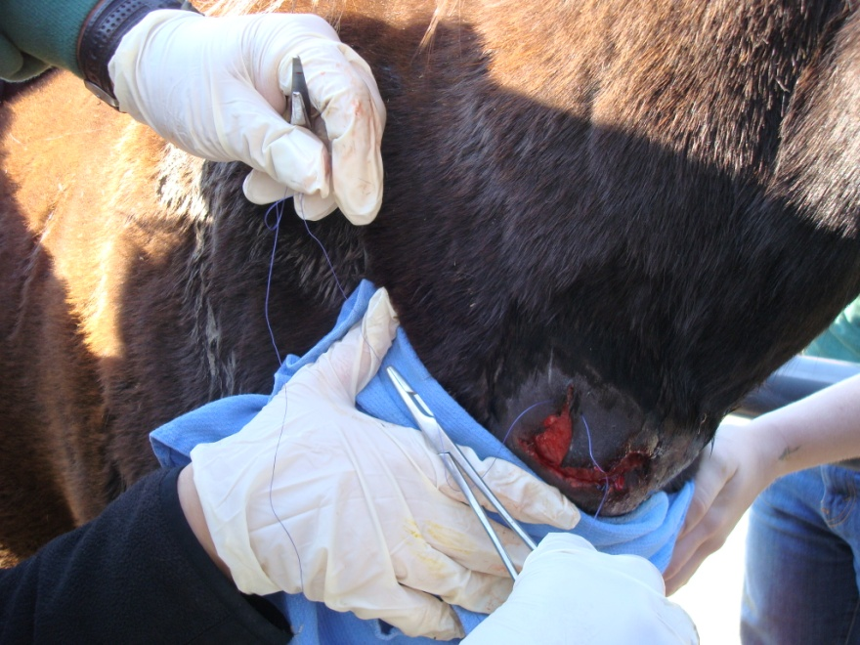
Standing Surgery (cont’d)
Show pictures N Royals

Slide 13
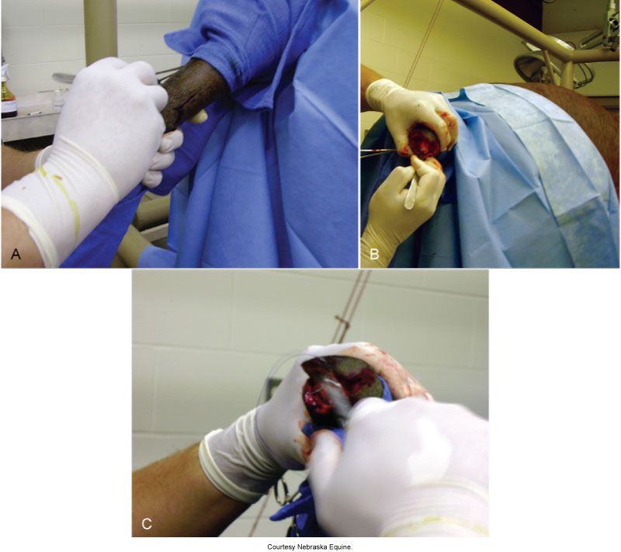

Slide 14
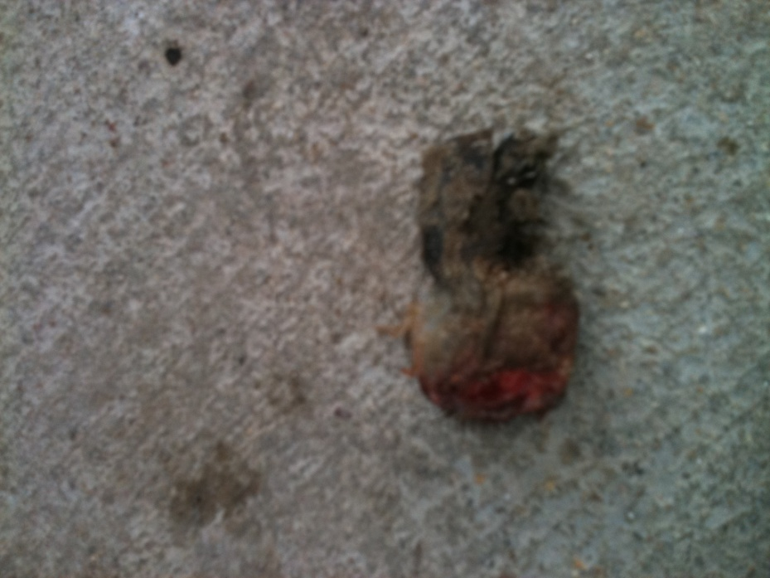

Slide 15
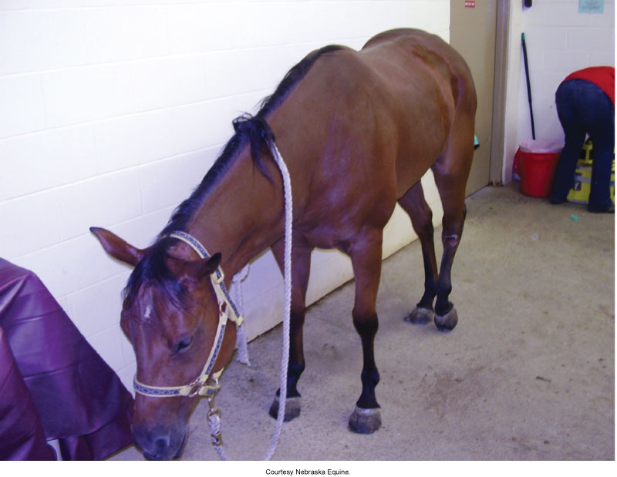
Standing Surgery (cont’d)
Patient preparation
Withhold grain 12 hours
Withhold hay for 2 to 6 hours
Water is not withheld

Slide 18
Why Castration?
Removal of the testicles reduces or prevents sexual behavior and aggressive behavior and prevents reproduction by individuals judged to have inferior or undesirable genetic traits.
Treats certain malignancies, testicular trauma, or inguinal or scrotal hernias.
Most commonly done between 1 and 2 yrs

Slide 19
Prerequisite for Castration
You need two fully descended testicles; equines have a high incidence of retained testicles=cryptorchid. Sometimes they are located in the abdomen or the inguinal area. Retained testicles do not produce sperm as the temperature in the body is too high.
Retained testicles do produce testosterone and these horses will exhibit stallion like behavior.
Retained abdominal testicles can become tumorous.

Slide 20
Castration (cont’d)
Age
12 to 24 months of age
Can be done later to see how it develops
Anesthesia
Standing castration
Tranquilizers
Local anesthetics, directly into the testicles and the spermatic cord using a long 18- to 20-gauge needle.
Recumbent animals
Triple drip combination of guaifenesin-ketamine-xylazine (GKX)
Ketamine
Thiopental

Slide 21
Castration (cont’d)
Prepping
The recumbent animal will have its legs tied or held out of the way.
Hold the head down on the recumbent animal; may want to put towel over the animal’s eye.
No clipping or shaving is necessary.
Scrub the surgical area.

Slide 22
Castration (cont’d)
Procedure
Closed castration
Spermatic cord and vaginal tunic are emasculated.
Greater chance that a vessel will emasculate improperly for this procedure; more bleeding.
Open castration
Incision is made over each testicle.
Dissecting out the testis and the spermatic cord separating them from the common vaginal tunic.
The spermatic cord is then crushed with the emasculators, and the testicles are torn away.

Slide 23
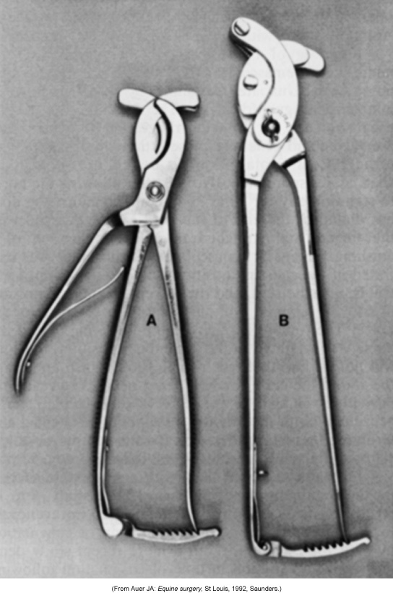
Emasculators
Reimer (A) and Serra (B) emasculators. (From Auer JA: Equine surgery, St Louis, 1992, Saunders.)

Slide 24
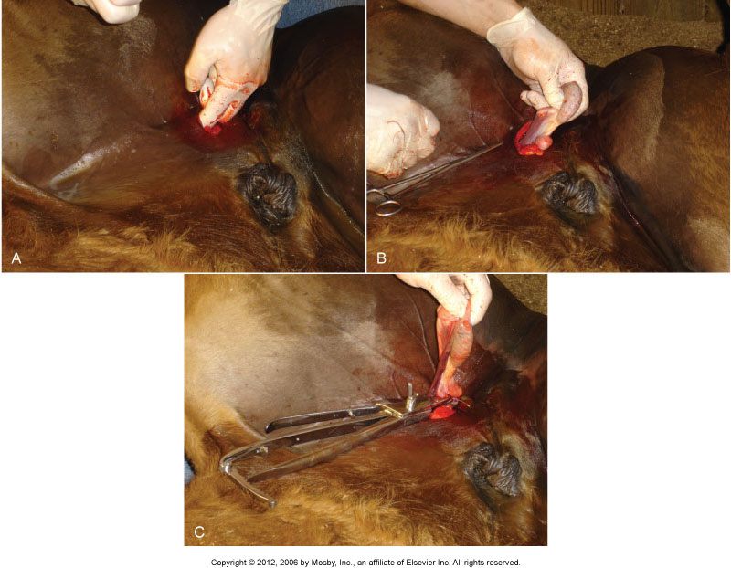

Slide 25
Castration Henderson tool

Slide 26
Castration video..

Slide 27
Castration (cont’d)
Postoperative care
Check for hemorrhaging for several hours after.
Recheck site periodically for one week for bleeding or swelling.
Exercise two times a day until healed, as this will promote drainage and healing.
If needed, rinse with hose to open and promote drainage.
Separate from other horses until healed.
Fly control is very important (spring or fall).
No medications should be needed.

Slide 28
Castration (cont’d)
Complications from castrations
Severe hemorrhaging
Excessive swelling from inadequate drainage
Acute wound infection and septicemia
Protrusion of abdominal viscera
Persistent masculine behavior

Slide 29
Standing Surgery (cont’d)
Clean quiet place
Surgical instruments within reach but away from the horse
Restraint: Halter and lead

Slide 30
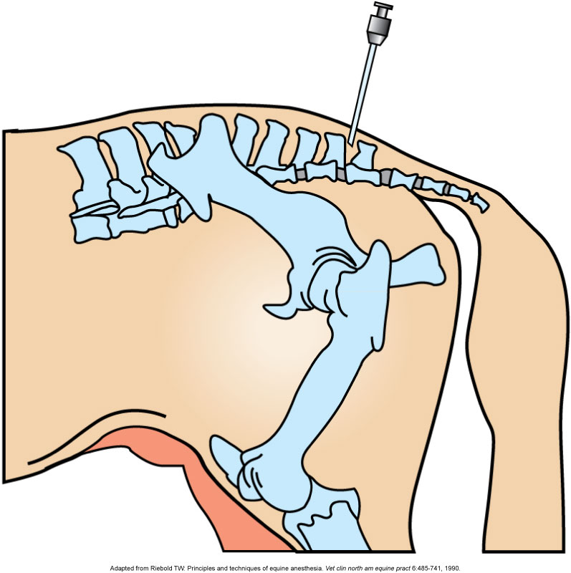
Standing Surgery (cont’d)
Intercoccygeal
Space
Nerve blocks
Field blocks
Epidural anesthesia

Slide 31
Caslick (Pneumovagina Repair)
Reasons
Prevents involuntary aspiration of air into the vagina.
Causes
Poor conformation
Injury, breeding, foaling

Slide 32
Caslick (Pneumovagina Repair) (cont’d)
Horses that need Caslick
Old thin mares with sunken anuses
Racing mares that aspirate air
Breeding mares
Mares foaling
AX
Tranquilize
Local ax: Vulva region

Slide 33
Caslick (Pneumovagina Repair) (cont’d)
Preparation
Remove feces from rectum
Tail bandage (keep out of the way)
Scrub region and rinse thoroughly
Use nonirritating scrub and 4 × 4 gauze

Slide 34
Caslick (Pneumovagina Repair) (cont’d)
Procedure
Remove a ribbon of mucosa tissue about 3 mm wide from each edge of the vulva labium (lips of vulva); done with tissue scissors.
Cut halfway down or as much as two thirds the length of the vulva.
Close raw edges together using a simple interrupted pattern.
Use nonabsorbable or absorbable sutures.

Slide 35
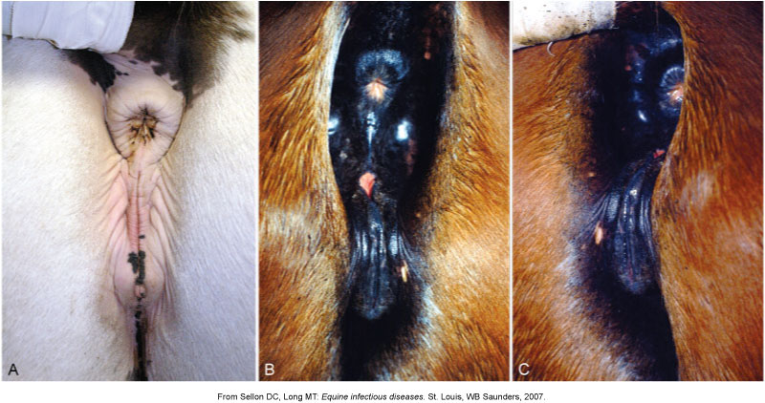

Slide 36
Caslick (Pneumovagina Repair) (cont’d)
Postoperative care
Remove sutures in 7 to 10 days.
Leave area alone until healed.
Check periodically to make sure sutures or skin is intact.
Complications
Sutures may tear out.
Too much tissue can be removed (hard to close); must be opened before parturition or breeding.

Slide 37
General Anesthesia
Risks
Prone to ventilation problems
Compartment syndrome. Page 276

Slide 38
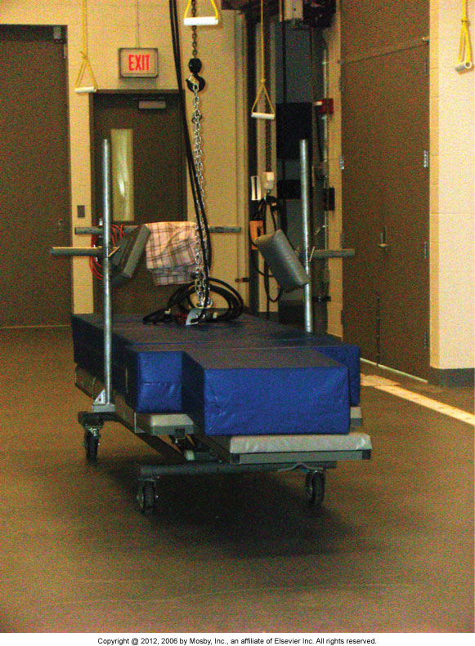

Slide 39
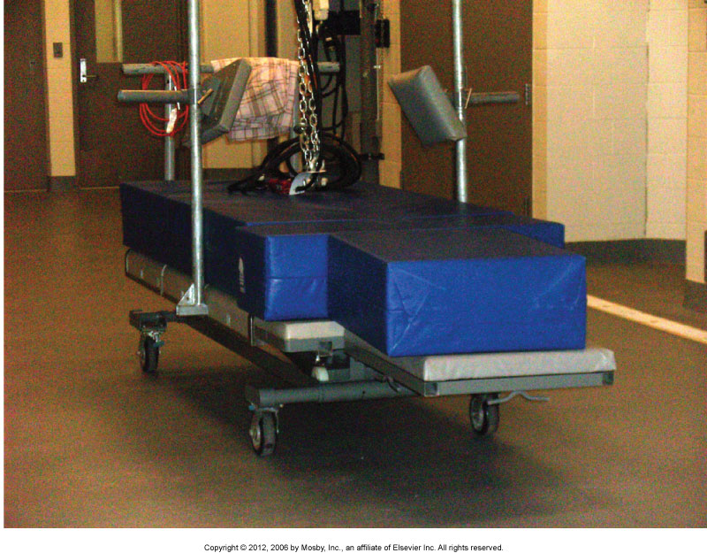

Slide 40
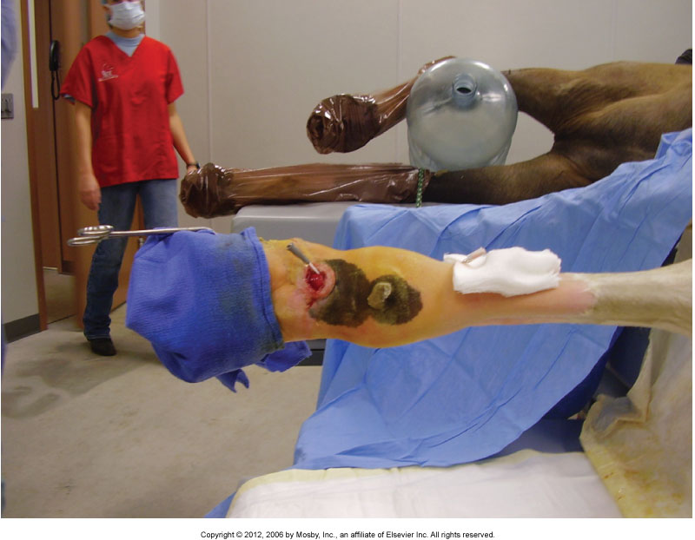

Slide 41
General Anesthesia
Induction
Commonly use injectable drugs, as well as for maintenance
Injectable drugs and maintenance with gas anesthesia
Induction with gas anesthesia and maintenance with gas anesthesia (Isoflurane) foals

Slide 42
General Anesthesia (cont’d)
Intubation
Orotracheal
Nasotracheal
Direct tracheal intubation
Tracheotomy

Slide 43
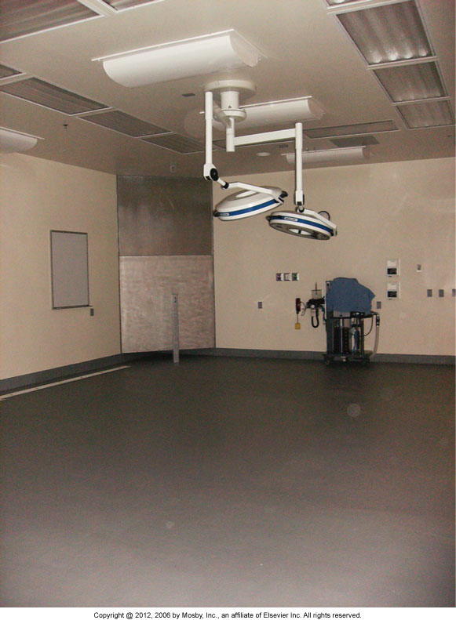
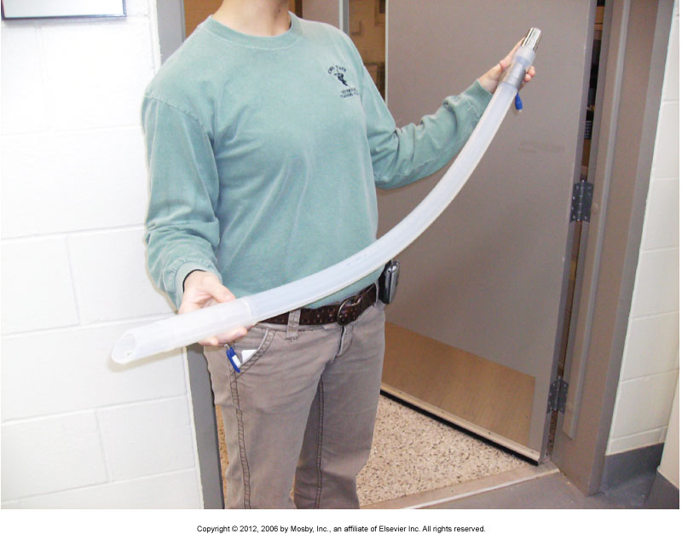
General Anesthesia (cont’d)

Slide 44
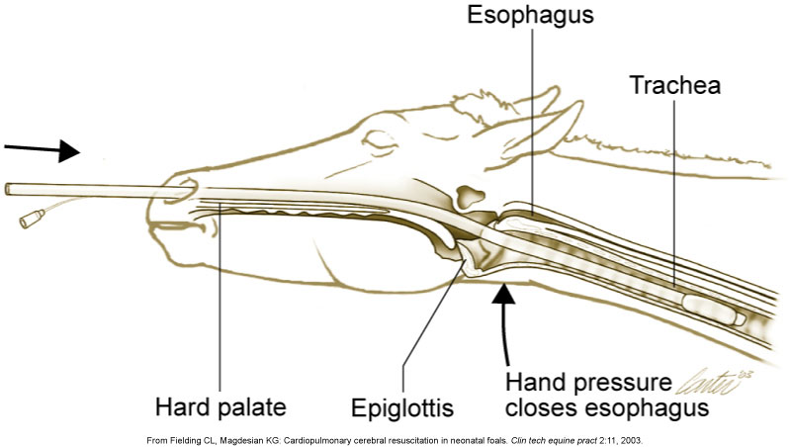

Slide 45
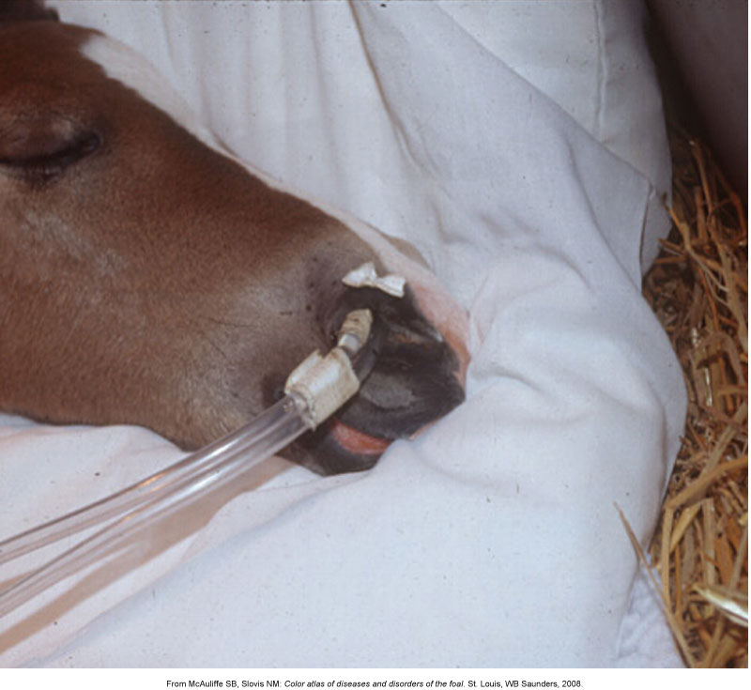

Slide 46
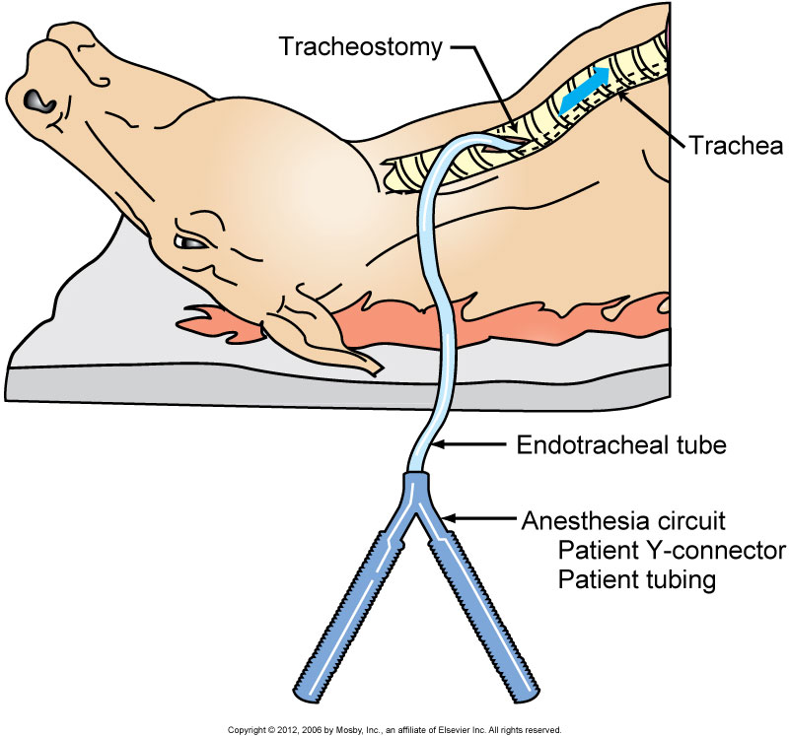

Slide 47
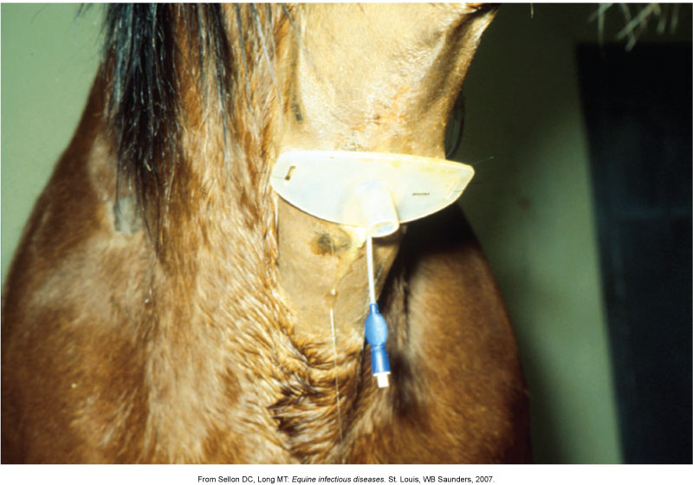

Slide 48
General Anesthesia (cont’d)
What to monitor
Temperature
Pulse rate and rhythm
Respiratory rate and depth
Capillary refill time
Mucous membrane color
ECG
Blood pressure
Oxygenation/ventilation
Depth of anesthesia

Slide 49
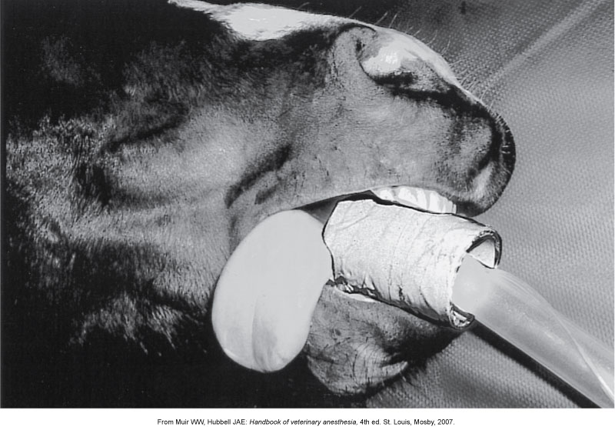
General Anesthesia (speculum)

Slide 50
General Anesthesia (size of tube p#281)

Slide 51
General Anesthesia (cont’d)

Slide 52
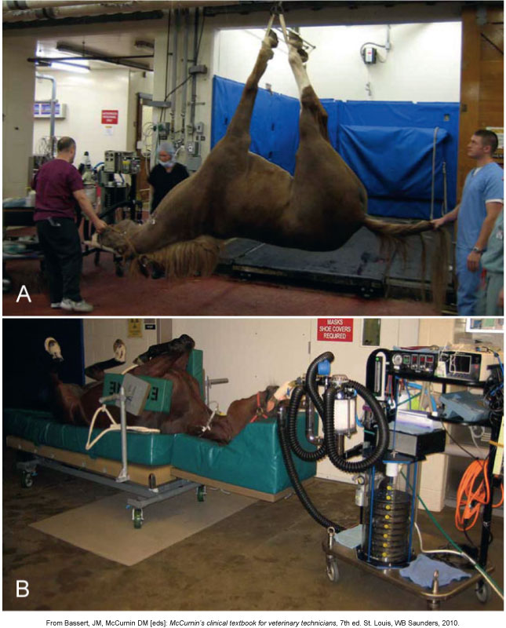

Slide 53
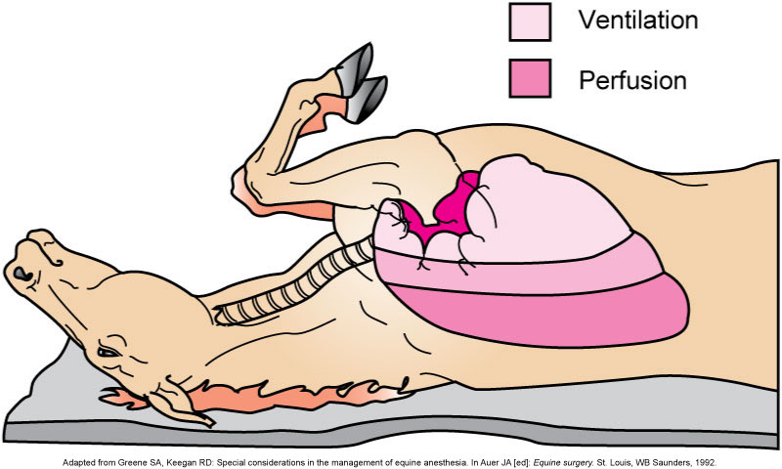
General Anesthesia (cont’d)

Slide 54
General Anesthesia (cont’d)
Rolling the patient
The down lung often partially collapses
Roll slowly
Control of bleeding
Tourniquet
Esmarch bandage

Slide 55
General Anesthesia (cont’d)
Recovery
Lateral recumbency
Do not encourage the patient to try to stand before the drugs have had sufficient time to wear off
Avoid external stimuli
Do not allow to eat or drink immediately
Provide water first
Supplemental oxygen
Extubate horse until attempts to swallow are made
Assistance to stand may be necessary
Two people typically stay with foals

Slide 56
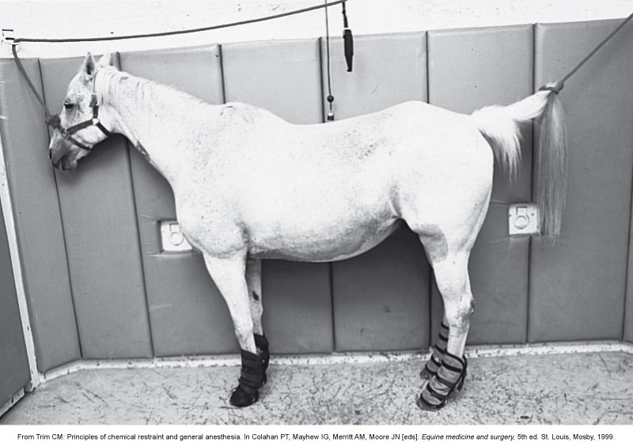
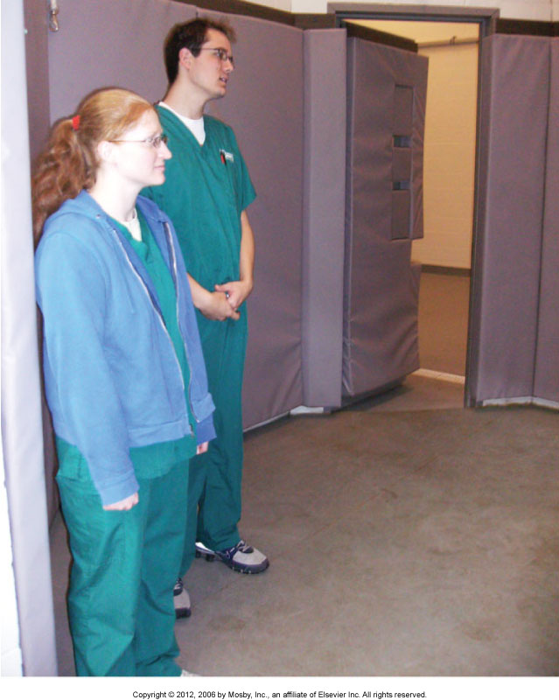

Slide 57
Abdominal Surgery
Ventral midline incision
Clip
Xiphoid to the udder/prepuce and laterally to each flank fold
Purse-string suture or place several towel clamps to close the prepuce
Pack with 4 × 4 gauze

Slide 58
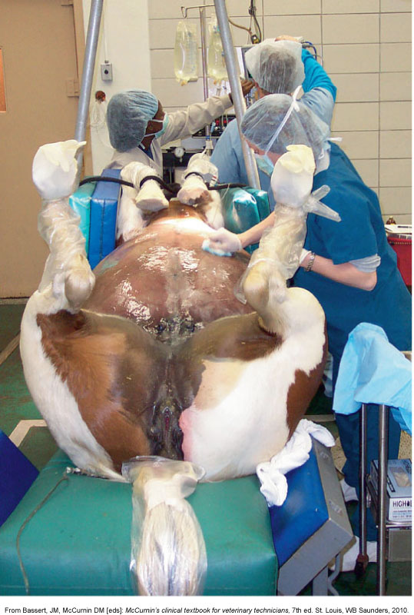

Slide 59
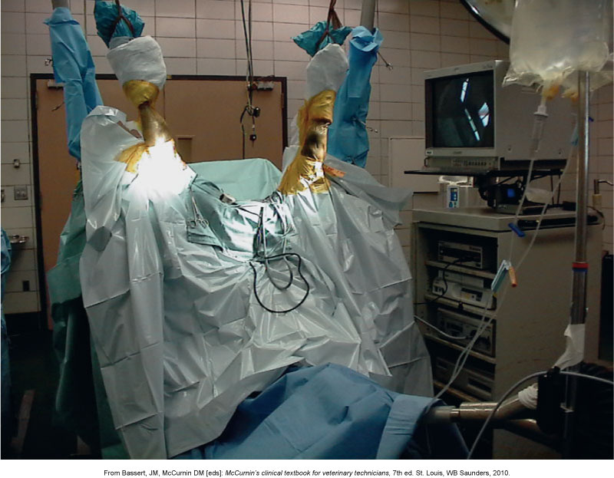

Slide 60
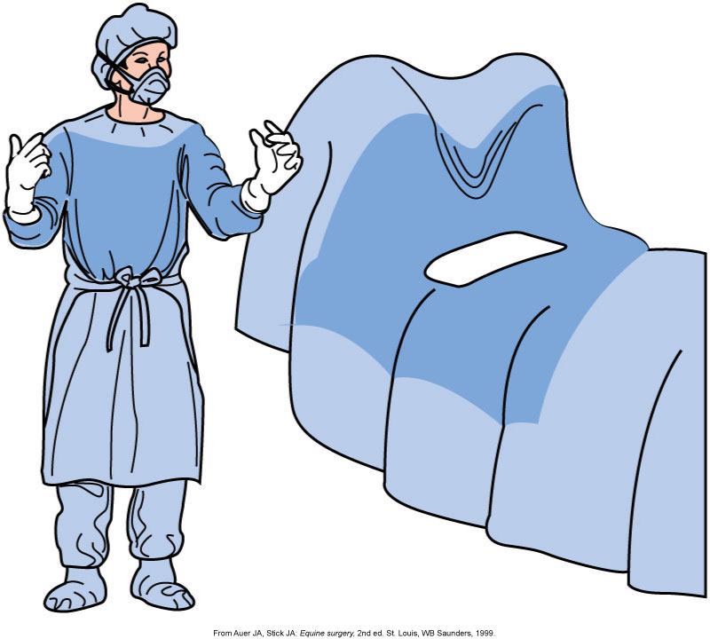

Slide 61
