Slide 1
Colic
Notes:
1

Slide 2

What is Colic?
Acute abdominal pain
“Colic is a Symptom, not a Diagnosis”
When we say a horse has colic or is 'colicking', we mean that the horse is experiencing significant abdominal pain ranging from the mild to the life-threatening or even fatal
Notes:
2
Colic is defined as acute abdominal pain in the horse.

Slide 3
FACT:
Colic is the most frequent emergency encountered in equine practice.
Notes:
3
and is THE most frequent emergency encounterd in equine practice.

Slide 4
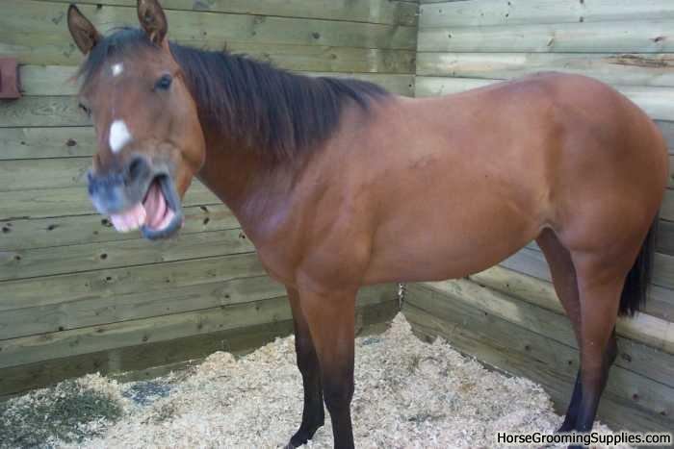
Why?
What caused my horse to colic?
Notes:
4
The most frequent QUESTION encountered in equine practice is WHY? What caused my horse to colic?

Slide 5
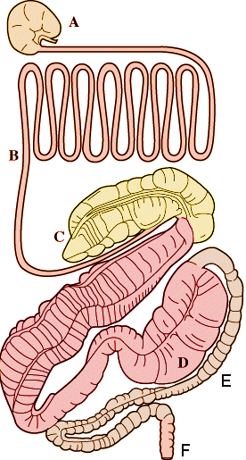
The complex and very large equine digestive tract
Notes:
5

Slide 6
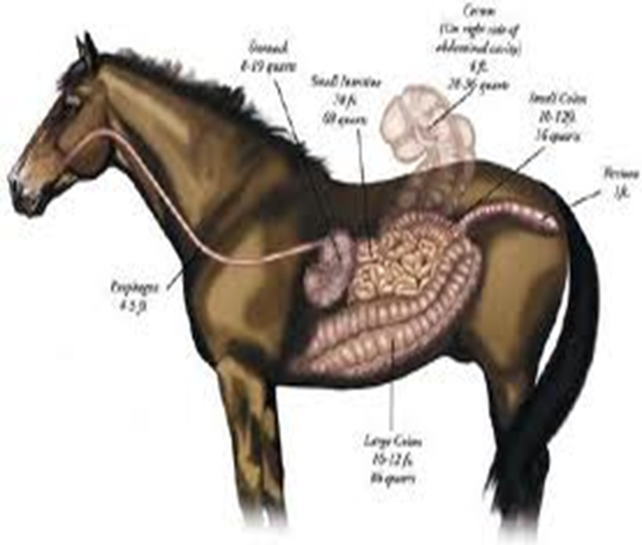
IntestinalAnatomy
The equine digestive tract is a complex
and fragile system that is easily
disrupted. With an average adult horse
having almost 100ft of intestines, it’s
no wonder why colic is the leading
cause of death in horses. Being hind gut fermenters, the capacity of the stomach of the horse is only about two gallons and the emptying time of the stomach after filling can be as quick as 12 minutes The small volume of the stomach and rapid passage of food from the stomach to the intestines is the reason horses eat almost continuously, thus the name "hay burners.“ It takes on average 48-72 hours for a meal to go from ingestion to being passed as manure.

Slide 7
Common causes of Colic
Changes in feed
Changes in weather
Poor quality feed or hay
Lack of water
Inadequate fiber intake
Parasites
Notes:
7
These are just a few of the potential situations that can lead to colic.
Switching from one type of grain to another; sudden changes in the environmental temperature that results in a drop in barometric pressure; moldy feed or hay; broken automatic waterers; or a horse with not enough access to grass or hay.

Slide 8














and the list goes on and on . . .
Notes:
8

Slide 9
Major types of Colic
Impaction
Gas colic
Parasites
Displacement
Torsion
Enteritis/colitis
Intussception
Obstruction
Notes:
9
These are the major types of colic types of colic that we will discuss: impaction, gas colic, colic caused by parasites, displacement, torsion, enteritis/colitis, intussception, and obstruction.

Slide 10
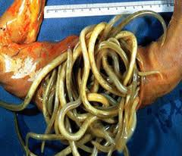
Impaction:
This is the term used when the intestine becomes blocked by a firm mass of food or other material. Impaction may be just the first obvious sign in a more complicated case.
Notes:
10
Impactions occur when there is a slow or stop in the progression of intestinal contents which over time causes a blockage. This may be promoted by reduced water intake, coarse roughage, poor dentition, or alterations in colonic motility.

Slide 11
Colic caused by parasites: very heavy infestation can subsequently cause a blockage, intestinal motility disturbances, arteritis, thromboembolism, and peritonitis
Notes:
11
This is most commonly seen in young horses as a result of a very high parasite burden. Colic caused by parasitism was once a significant problem, but with efficacy of today’s dewormers this is not nearly as big of a problem.

Slide 12
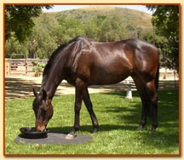
Sand Colic
Feeding horses on the ground
Sand colic is the result of the building up of sand in the intestinal tract of the horse. There can be as much as 150 pounds of sand lying in the bottom of the horse's belly

Slide 13
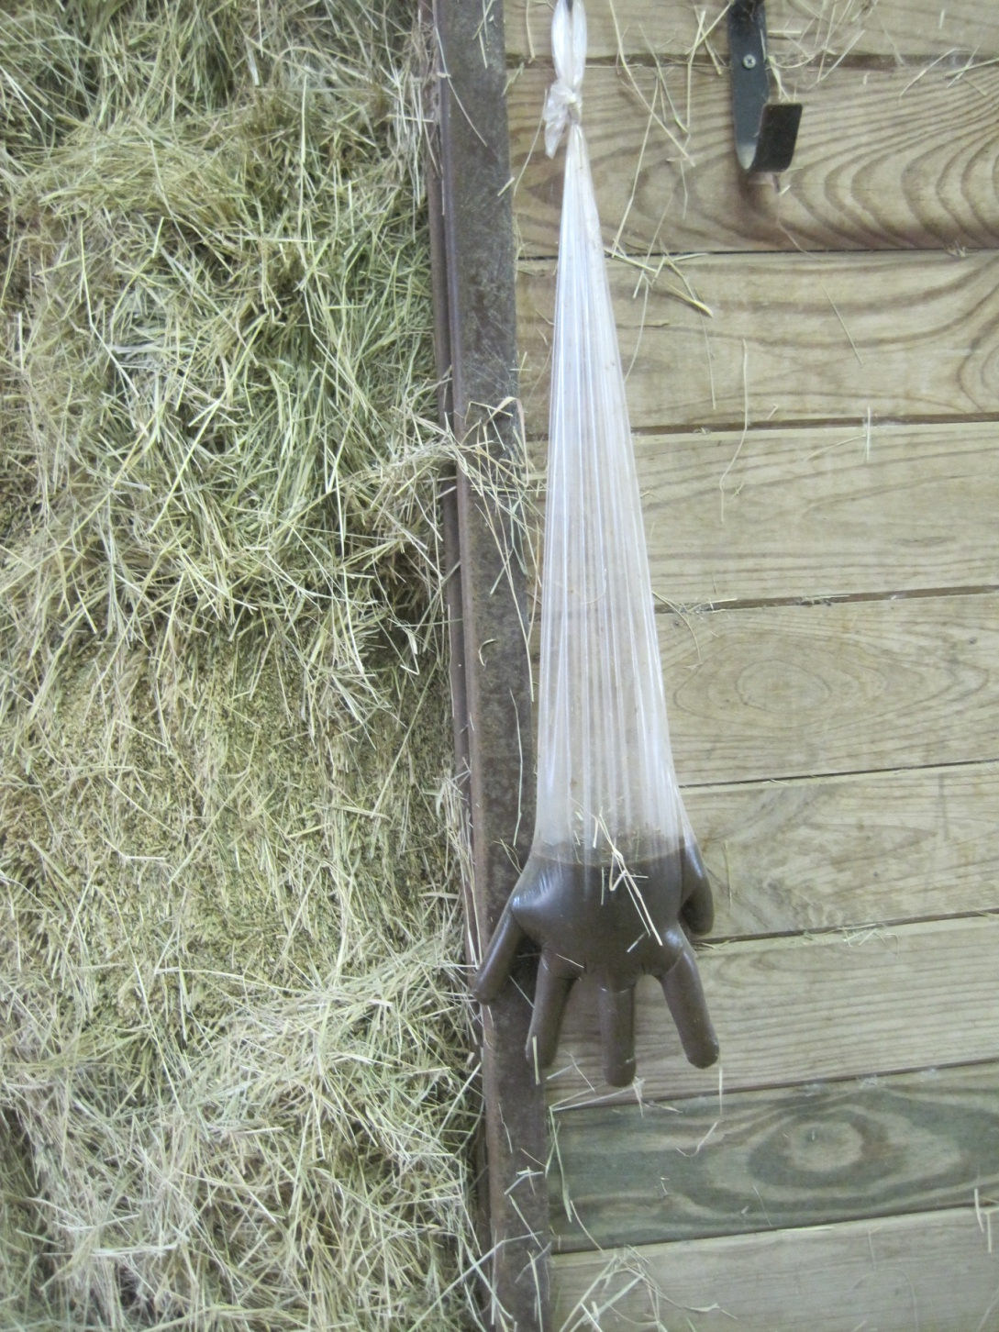
How do you know if your horse is ingesting sand?

Slide 14
  Obstruction: enterolith, fecalith, or foreign body.
Notes:
14
Obstruction of the intestines can be caused by enteroliths, fecaliths, or foreign bodies. Enteroliths are mineral concretions composed primarily of magnesium ammonium phosphates that are deposited around a nidus such as hair, metal, or other foreign objects.

Slide 15
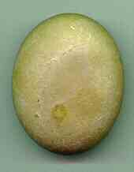
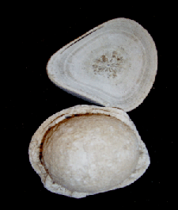
Enteroliths
Enteroliths are mineral concretions composed primarily of magnesium ammonium phosphates that are deposited around a nidus such as hair, metal, or other foreign objects.
Notes:
15
They develop like a pearl, around a grain of sand in an oyster. Many horses that develop enteroliths are fed a diet consisting mainly of alfalfa hay and the highest prevalence appears to be on the west coast.

Slide 16
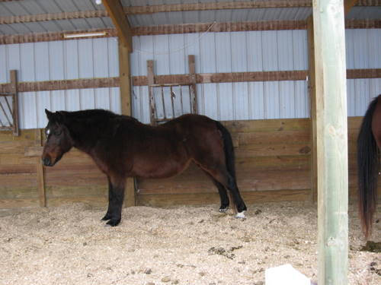
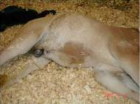
Gas colic:
Gas build up in the intestine, most commonly
in the large intestine and/or cecum.
Grazing in lush pastures, highly fermentable grains or pelleted feeds have been associated with gas colic. Horses experiencing this condition can often take on a bloated appearance or be “blown-up like a tick”.
Notes:
16
Gas colic can be caused by microbial digestion of highly fermentable feedstuffs that results in increased gas production. Grazing in lush pastures, highly fermentable grains or pelleted feeds have been associated with gas colic. Horses experiencing this condition can often take on a bloated appearance or be “blown-up like a tick”.

Slide 17
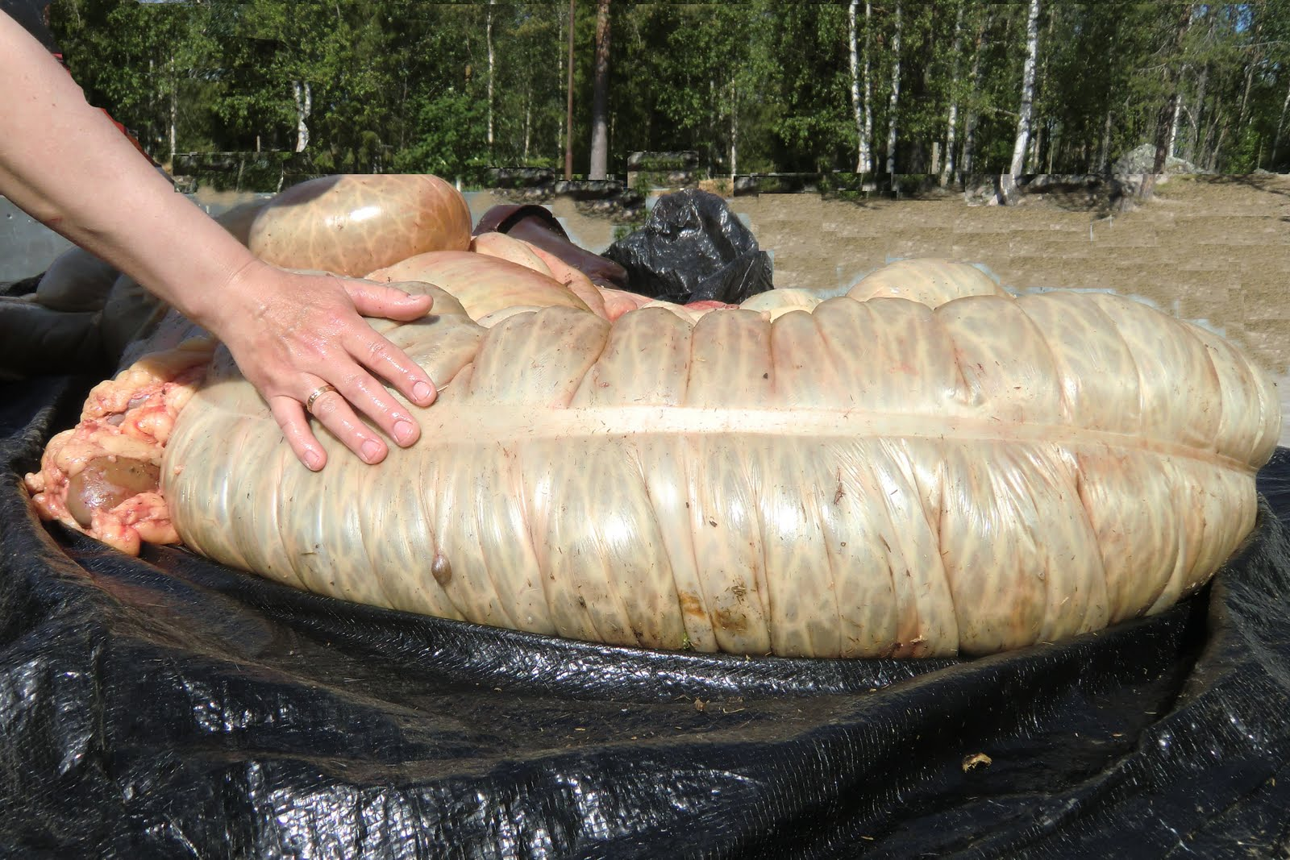
To much starch can lead to a growth of the gas-forming bacteria and to little roughage lessens the bowel movements

Slide 18
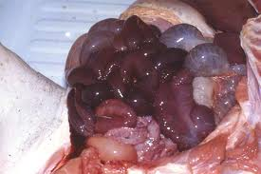
Displacement/volvulus/torsion ('twisted gut")
In a "displacement", a portion of the intestine has moved to an abnormal position in the abdomen. This occurs when a piece of the intestine twists. These types of colic cause a total blockage of the intestine and require immediate surgery if the horse is to survive.
Notes:
18
The ascending colon is freely movable except for the right dorsal and ventral colons. Rapid changes in gas and fluid volume may play a part in the migration during a displacement although the exact cause is unknown.

Slide 19
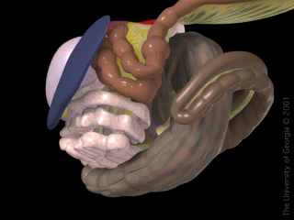
Displacement
Displacements of the ascending colon seem to be more prevalent in horses fed a high-concentrate, low roughage diet.
Notes:
19
Displacements of the ascending colon seem to be more prevalent in horses fed a high-concentrate, low roughage diet.

Slide 20
Torsion (“Twisted Gut"):
a piece of the intestine (large colon) twists.
One of the most common and most dangerous colic conditions.
Notes:
20
One of the most common and most dangerous colic conditions in the horse is torsion of the large colon. This displacement consists of rotations of the double loop of dorsal and ventral colons about their long axis.

Slide 21
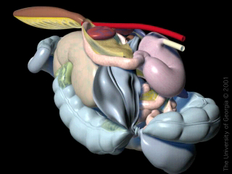
Torsion
The exact cause of colonic displacement is unknown, but may be attributed to rapid changes in gas and fluid volume or alterations in motility. The most commonly affected type of horse is the periparturient or post-foaling broodmare. This may be related to an increase in the volume of the abdomen during pregnancy.
Notes:
21
Like I mentioned earlier, the exact cause of colonic displacement is unknown, but may be attributed to rapid changes in gas and fluid volume or alterations in motility. The most commonly affected type of horse is the periparturient or post-foaling broodmare. This may be related to an increase in the volume of the abdomen during pregnancy.

Slide 22
Enteritis/Colitis:
inflammation of the small (enteritis) or large (colitis) intestines.
Notes:
22
Enteritis and colitis are characterized by severe inflammation of the lining of the small intestines and large intestines respectively.

Slide 23
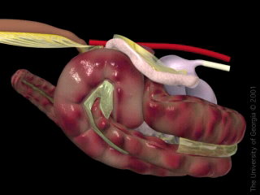
Enteritis/Colitis
Both conditions commonly present with an initial fever and an acute onset of colic, with enteritis resulting in large amounts of gastric reflux and colitis resulting in profuse diarrhea.
Notes:
23
Both conditions commonly present with an initial fever and an acute onset of colic, with enteritis resulting in large amounts of gastric reflux and colitis resulting in profuse diarrhea.

Slide 24
Intussusception: prolapse of one part of the intestine into the lumen of an adjacent part (telescoping)
Notes:
24
An intussusception occurs when a section of bowel telescopes inside the lumen of the adjacent distal segment of bowel.

Slide 25
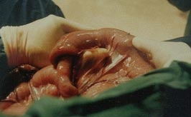
This condition is presumed to be a result of abnormal peristalsis and occurs most commonly in foals and horses less than 3 years of age.
Notes:
25
This condition is presumed to be a result of abnormal peristalsis and occurs most commonly in foals and horses less than 3 years of age.

Slide 26
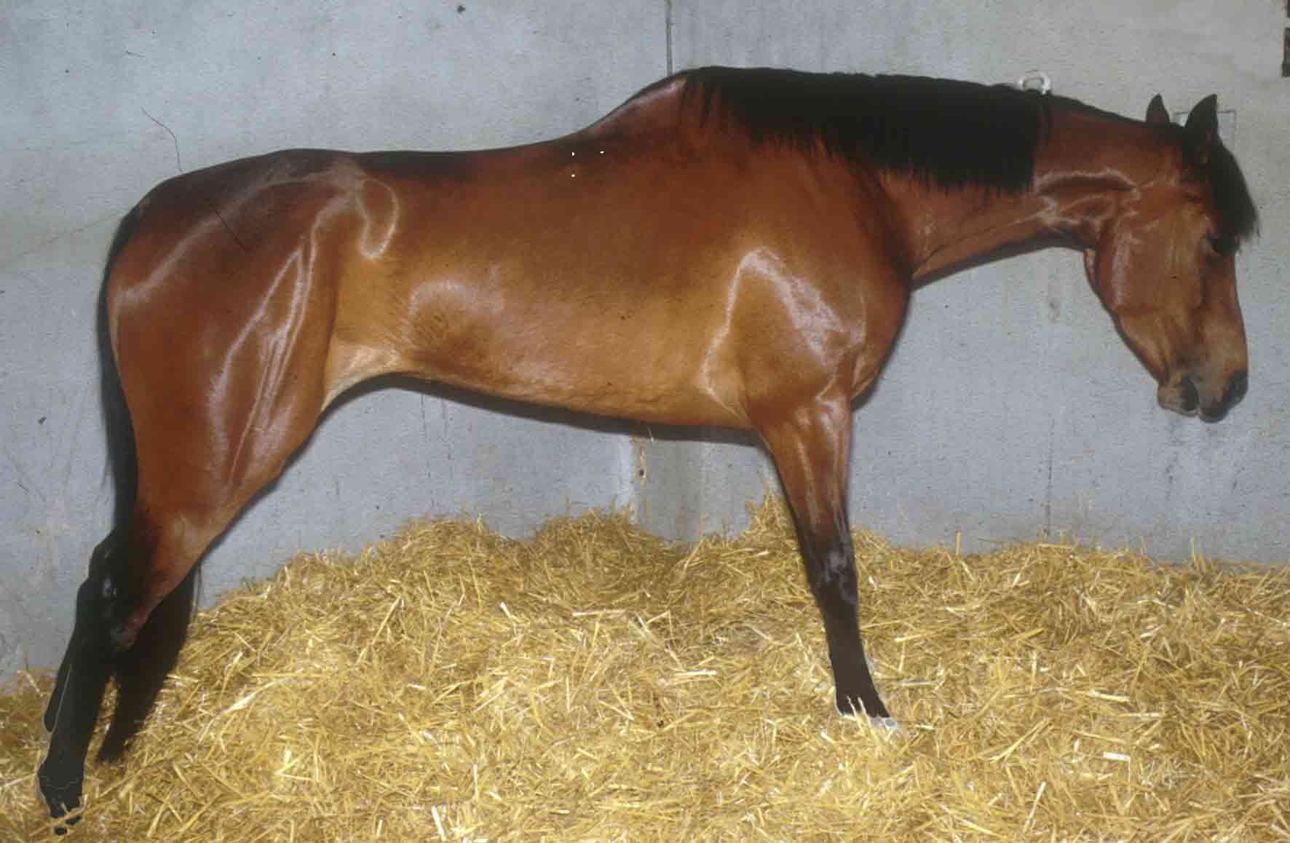
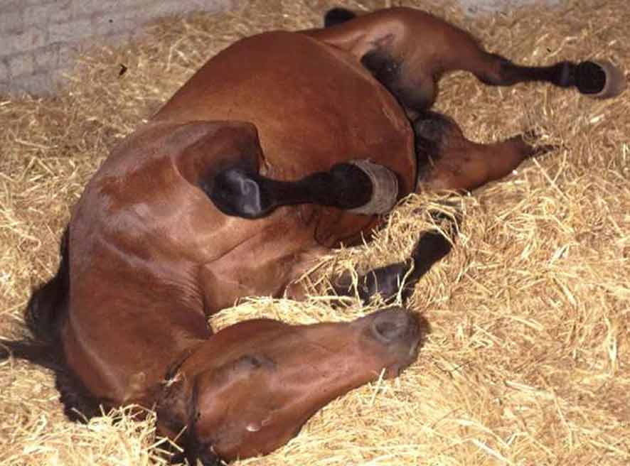
Signs of Colic
Off feed
Restlessness
Standing stretched out
Posturing to urinate
Looking at their belly
Lying down and getting up repeatedly
Notes:
26
Signs of colic may be presented in a multitude of ways and no two horses are like in their presentation. The pain threshold may vary from horse to horse and the severity of the clinical signs does not always correlate to the severity of the colic and vice versa.

Slide 27
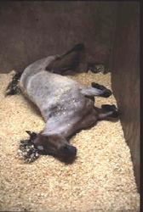
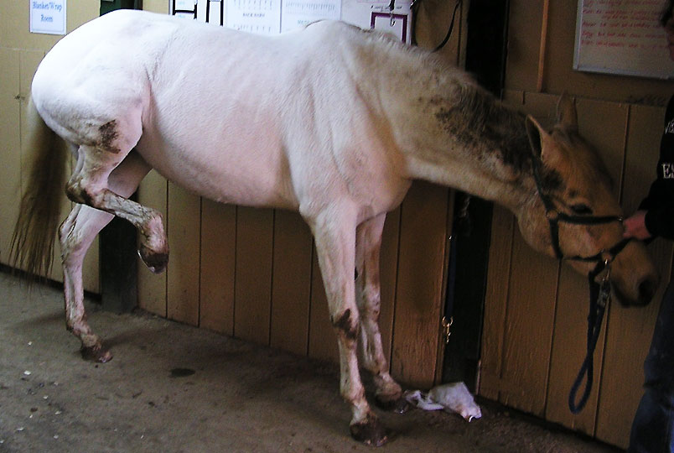
Signs of Colic
Curling the upper lip
Pawing
Sweating
Kicking at the abdomen
Rolling

Slide 28
If you suspect colic…
Remove all grain and hay.
Offer plenty of clean, cool water.
Note frequency and consistency of any feces passed.
Hand-walk
Do not administer any medications
Wait for further instructions from your veterinarian.
Notes:
28
If your horse begins to show signs of colic you should first call your veterinarian. Next you should remove all hay and grain, offer your horse plenty of clean, cool water and make note of frequency and consistency of any feces passed. You may handwalk your horse while waiting further instructions from your veterinarian.
We do not recommend administering any medications without consulting your veterinarian first as this may alter the presentation of the colic and make the diagnosis and therefore treatment more difficult.
Remember: Not all horses show the same severity of signs with the same type of colic

Slide 29
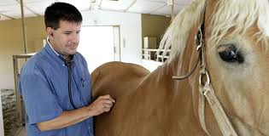
Diagnosis
The list of possible conditions that cause
colic is long, and it cannot always be
determined, but a diagnosis and
appropriate treatment can begin only
after thoroughly examining the horse,
The physical examination
should include assessment of the cardiac,
GI systems., MM color, moistness, and CRT.
*The abdomen should be auscultated over several areas Checking for gut motility sounds.
*An important aspect of the physical examination is passing a nasogastric tube To relieve gas or fluid buildup and to administer mineral oil if needed for possible impactions.
*The most definitive part of the examination is the rectal examination. To determine size, consistency of contents (gas, fluid, or impacted ingesta), distention, thickness of intestinal walls, blockage and pain on palpation.

Slide 30

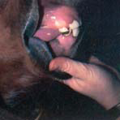
Assessing severity of colic:
1. Mucous membrane color and capillary refill time
COLOR
• Pink = good perfusion
• Blue = poor perfusion due to shock
CAPILLARY PERFUSION
• <1.5 seconds = good
• >2 seconds = less good

Slide 31
Assessing severity of colic:
2. Palpation for displacement

Slide 32
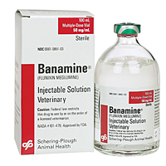

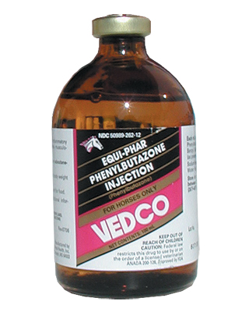
Treatment
Depends on SEVERITY, CAUSE and
whether or not SURGERY is needed
• NON-SURGICAL:
– Pain relief (e.g., Banamine)
– Sedatives (e.g., Xylazine)
– Lubricants and laxatives
– I/V fluids
– ?Antibodies to endotoxin
Failure of analgesics to confer relief is an
indication that surgery may be required
Notes:
32
Once the veterinarian arrives a history is obtained and a physical exam is performed. The information gathered at the time of the exam usually includes: temperature, heart rate, respiratory rate, gut sounds, capillary refill time and physical appearance the mucus membranes. Based on the findings of the initial physical exam analgesics may need to administered to help relieve the pain associated with colic.

Slide 33
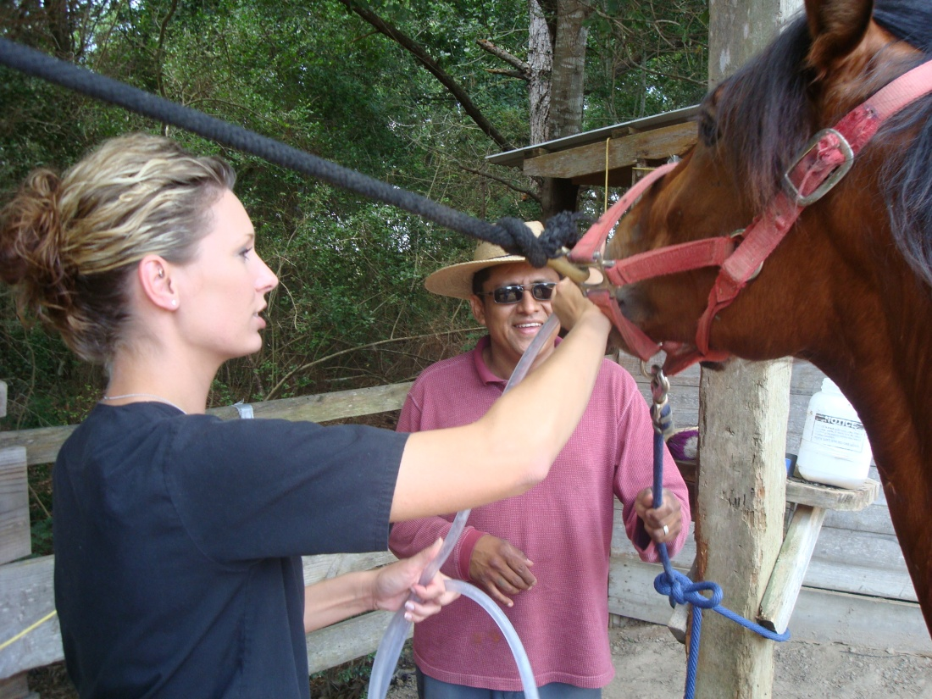
Passage of nasogastric tube into the stomach
Administration of mineral oil.
Rectal exam
Other procedures
and/or diagnostics
may be needed
Notes:
33
The use of nasogastric tube is dependent on the type and severity of the colic. The tube is passed up the nostril, down the esophagus and into the stomach. The stomach is then checked for fluid by means of siphoning and mineral oil or other medications may be administered if needed. In some colic situations a rectal exam may need to be performed to provide the veterinarian with additional information to help treat the colic.

Slide 34
Colic surgery
Most deaths <10 days post-surgery
• About 70% deaths within 100 days
Colic and surgery

Slide 35
Prevention
It is not possible to prevent all colics but the incidence can be reduced through proper management, including:
  Good parasite control (deworming) program
  Providing a horse with plenty of fiber
  Increasing feeding frequency
  Constant access to fresh water
Notes:
35

Slide 36
References
http://www.merckvetmanual.com
www.uky.edu/Ag/AnimalSciences
http://www.liv.ac.uk/equinecolic

